Slide 1
Software Architecture
2023

Slide 2
Assessments I
Attendance, studying recording of classes and class tests.

Slide 3
Assessments II
Coursework – designing and developing an architecture for a specific software system.

Slide 4
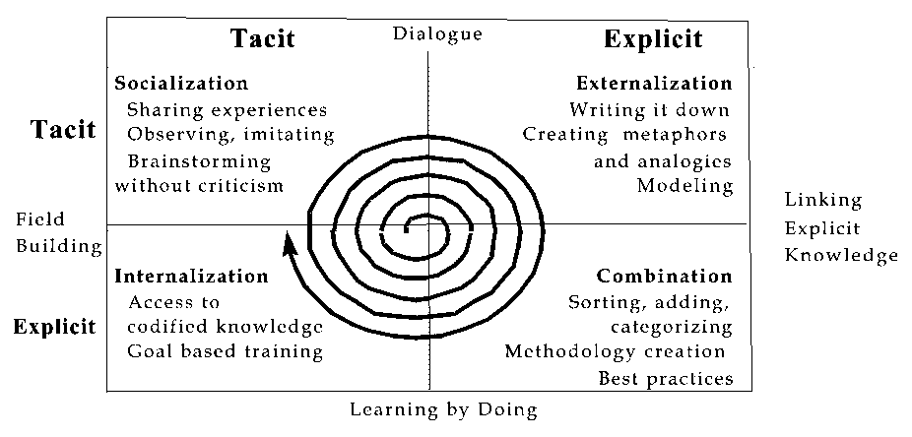
Nonaka’s ‘Spiral of Knowledge’
Nonaka and Takeucki (1995)
of 20
Notes:
Computing cuts across all research disciplines. Creative Computing is knowledge combination, something that is required in the world today. We combine explicit and tacit knowledge of propositions and processes to build the field, somewhat in the manner of Nonaka’s ‘Spiral of Knowledge’.

Slide 5
Contents
Topic 00 Overoverrview
Topic 0 - Overview
Topic 1 - History and Definition of Software Architecture
Topic 2 - Modern Software Architecture
Topic 3 - Software Architecture and the Built Environment
Topic 4 - Masterplans and Piecemeal Growth
Topic 5 - Architecture Description Languages
Topic 6 - Architectural Styles
Topic 7 - Architecture Patterns
Topic 8 - Domain Specific Software Architecture
Topic 9 - Discipline of Software Architecture
Topic 10 - Software Architecture and the UML
Topic 11 - Architecture and Component Based Development
Topic 12 - Software Architecture Evaluation
Topic 13 - Software Architecture and OO Development
Topic 14 - Software Architecture and CORBA Middleware
Topic 15 - The OMG’s Domain Driven Architecture
Topic 16 - Software Architecture and Process
Topic 17 - Software Architecture Reengineering
Topic 18 – Service Oriented Architecture (SOA)
Topic 19 - Security and Trust of Software Architecture
Topic 20 - Web2.0 and Software Architecture
Topic 21 - Cloud Computing and Software Architecture
Topic 22 - Software Architecture and Concurrency
Topic 23 - Visualising Software Architecture
Topic 24 - Implementing Software Architecture
Topic 25 - Implementing Software Architecture (II)
Topic 26 - Software Architecture: Being Creative

Slide 6
Topic 000: Overoveroverview

Slide 7
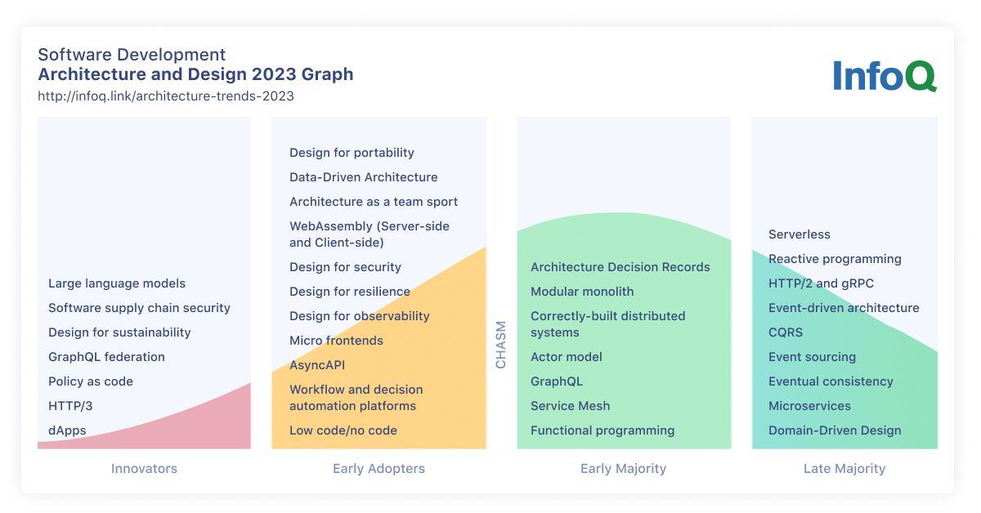

Slide 8
Topic 00: Overoverview

Slide 9
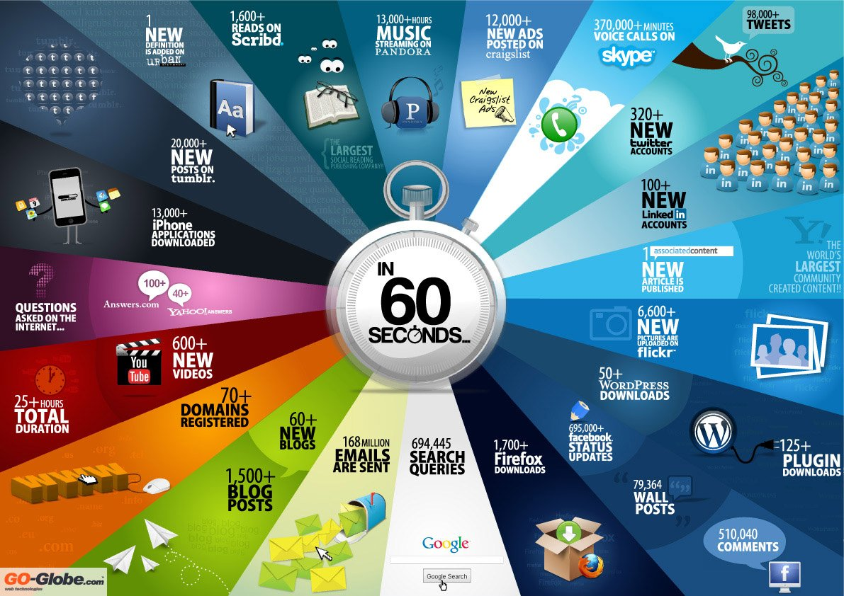

Slide 10

Software Architecture
§▪ The quality and longevity of a software- reliant system is largely determined by its architecture.
§▪ US studies identify architectural issues as a systemic cause of software problems in government systems (OSD, NASA, NDIA, National Research Council).
Architecture is of enduring importance because it is the right abstraction for performing ongoing analyses throughout a system’s lifetime.

Slide 11
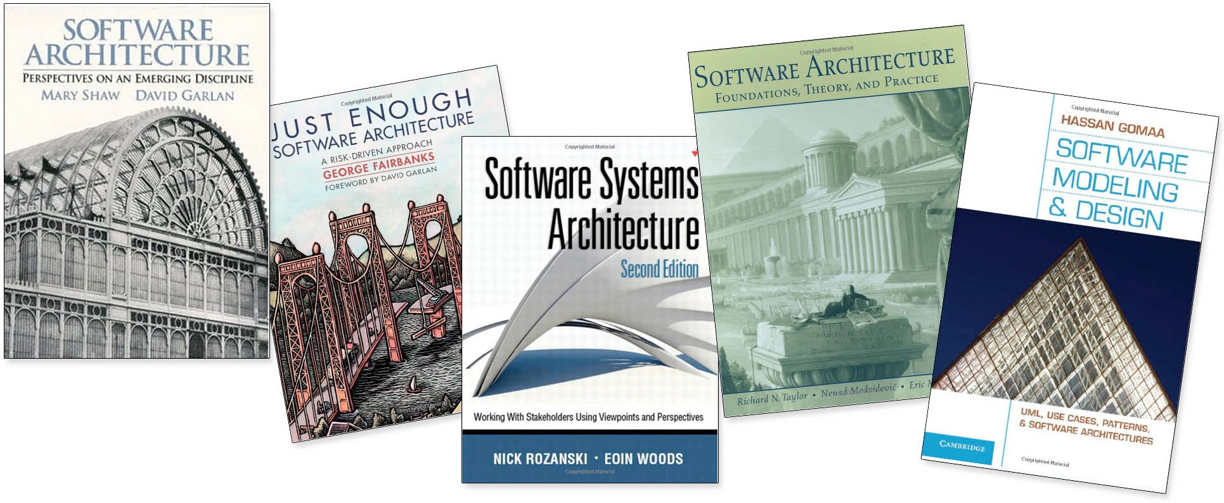
Software Architecture Thinking
§▪ High-level system design providing system-level structural abstractions and quality attributes, which help in managing complexity
§▪ Makes engineering tradeoffs explicit

Slide 12



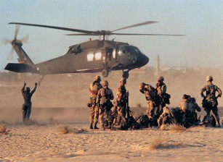

Quality Attributes
Quality attributes
§▪ properties of work products or goods by which stakeholders judge their quality
§▪ stem from business and mission goals.
§▪ need to be characterized in a system-specific way
Quality attributes include
§▪ Performance
§▪ Availability
§▪ Interoperability
§▪ Modifiability
§▪ Usability
§▪ Security
§▪ Etc.

Slide 13
Central Role of Architecture
IMPLEMENT AND EVOLVE
DESIGN
IMPLEMENT
BUSINESS AND MISSION GOALS
ARCHITECTURE
SYSTEM
SATISFY
CONFORM
SATISFY

Slide 14

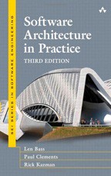


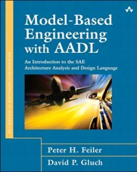





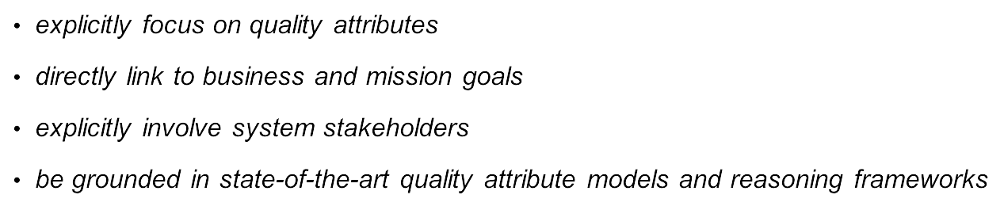
One View: Architecture-Centric Engineering

Slide 15
Advancements Over the Years
§▪ Architectural patterns
§▪ Component-based approaches
§▪ Company specific product lines
§▪ Model-based approaches
§▪ Frameworks and platforms
§▪ Standard interfaces

Slide 16
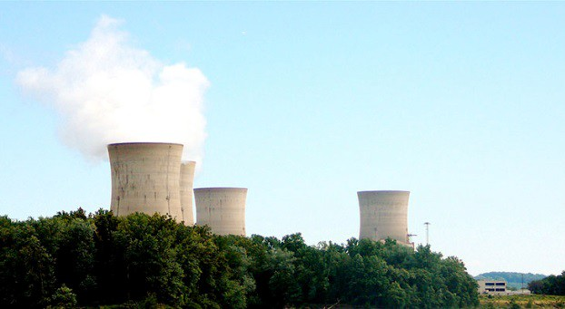
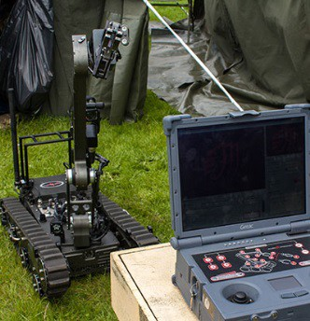

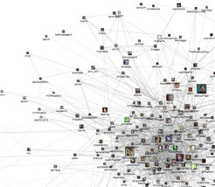
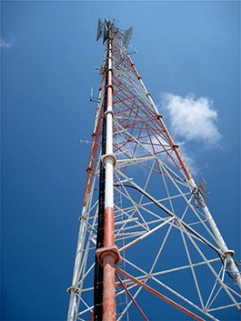


What HAS Changed?
§▪ Increased connectivity
§▪ Scale and complexity
− decentralization and distribution
− “big data”
− increased operational tempo
− inter-reliant ecosystems
− vulnerability
− collective action
§▪ Disruptive and emerging technologies
https://www.flickr.com/photos/simononly/
https://www.flickr.com/photos/c

Slide 17

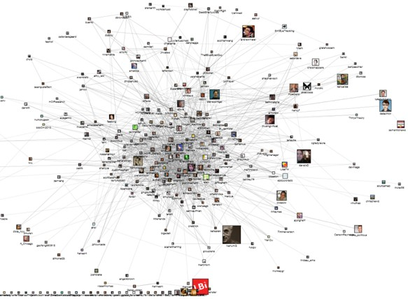

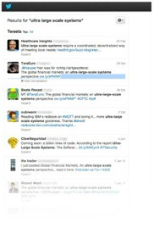








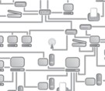
Technology Trends
10

Slide 18







Software Development Trends
§▪ Application frameworks
§▪ Open source
§▪ Cloud strategies
§▪ NoSQL
§▪ Machine Learning
§▪ MDD
§▪ Incremental approaches
§▪ Dashboards
§▪ Distributed development environments
§▪ DevOps

Slide 19
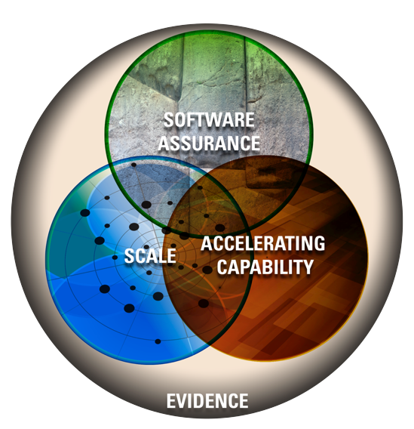
The Intersection and Architecture
At the intersections there are difficult tradeoffs to be made in structure, process, time, and cost.
Architecture is the enabler for tradeoff analyses.

Slide 20

State of the Practice
Focus is on
§▪ culture and teaming
§▪ process and practices
− value stream mapping
− continuous delivery practices
− Lean thinking
§▪ tooling, automation, and measurement
− tooling to automate repetitive tasks
− static analysis
− automation for monitoring architectural health
− performance dashboards

Slide 21
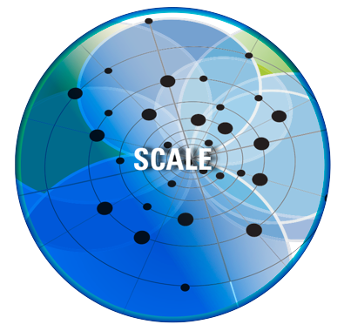

Architecture and Scale
§▪ Cloud strategies
§▪ Cloud strategies for mobility
§▪ Big data
“Scale Changes Everything”

Slide 22
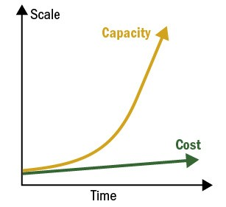
Architecture and Big Data
§▪ System costs must grow more slowly than system capacity.
§▪ Approaches
− scalable software architectures
− scalable software technologies
− scalable execution platforms
§▪ Scalability reduces as implementation complexity grows.
§▪ NoSQL models are not created equal.
§▪ You cannot manage what you do not monitor.

Slide 23
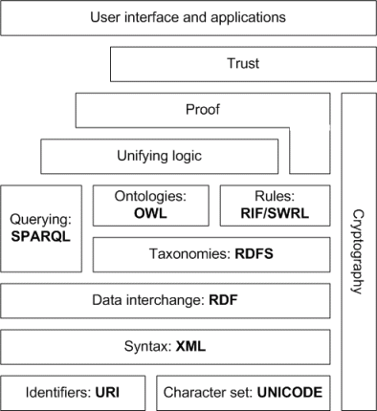
SW Stack: Architecture, Standards
Notes:
RDF: Resource Description Framework.
RDFS: RDF schema
Web Ontology Language (OWL).

Slide 24
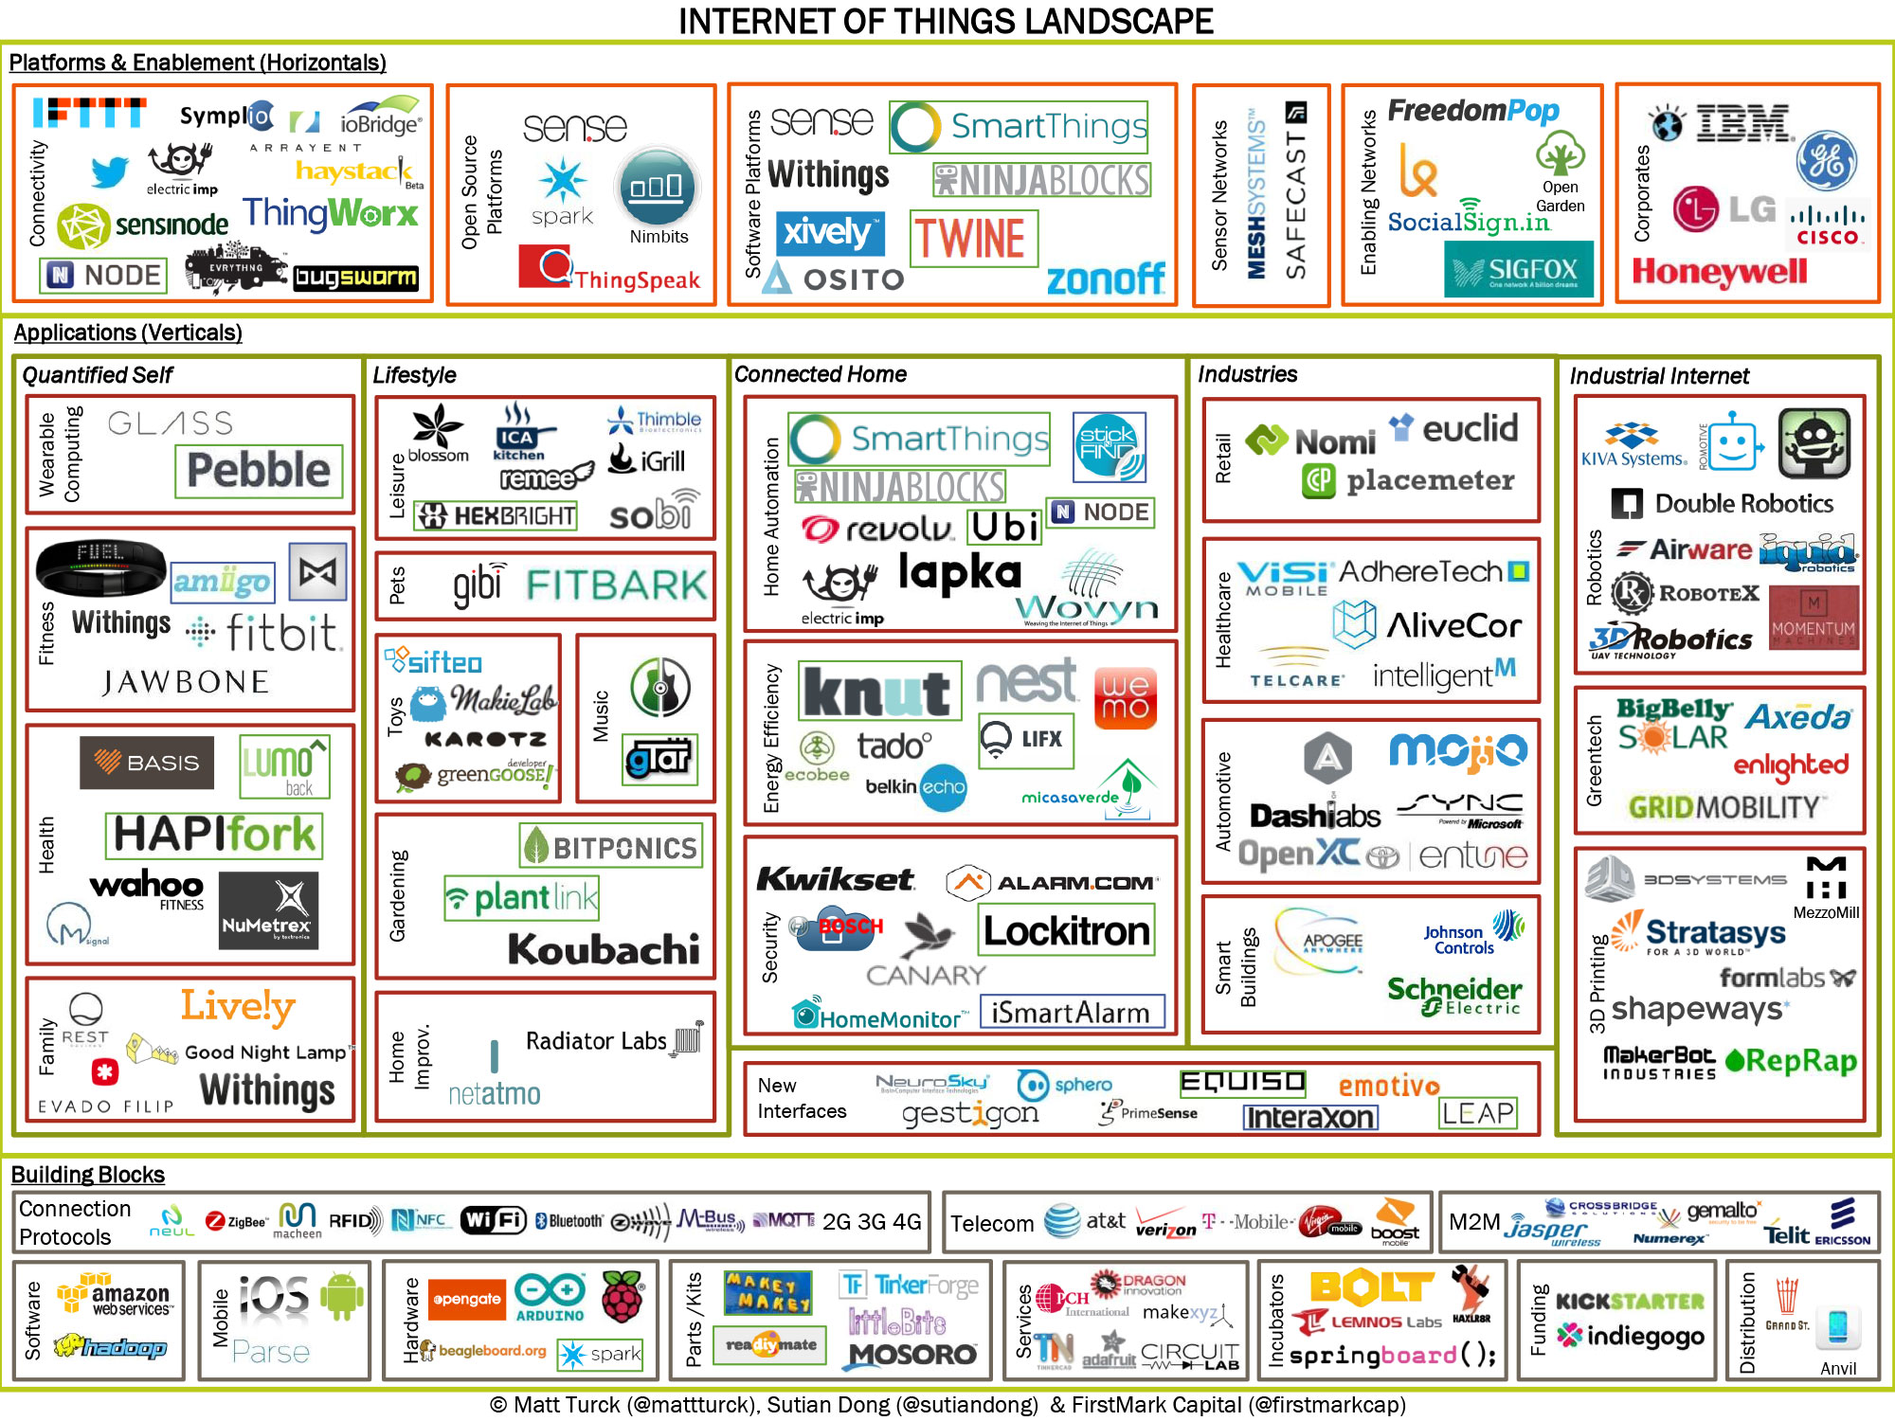
IoT Landscape

Slide 25
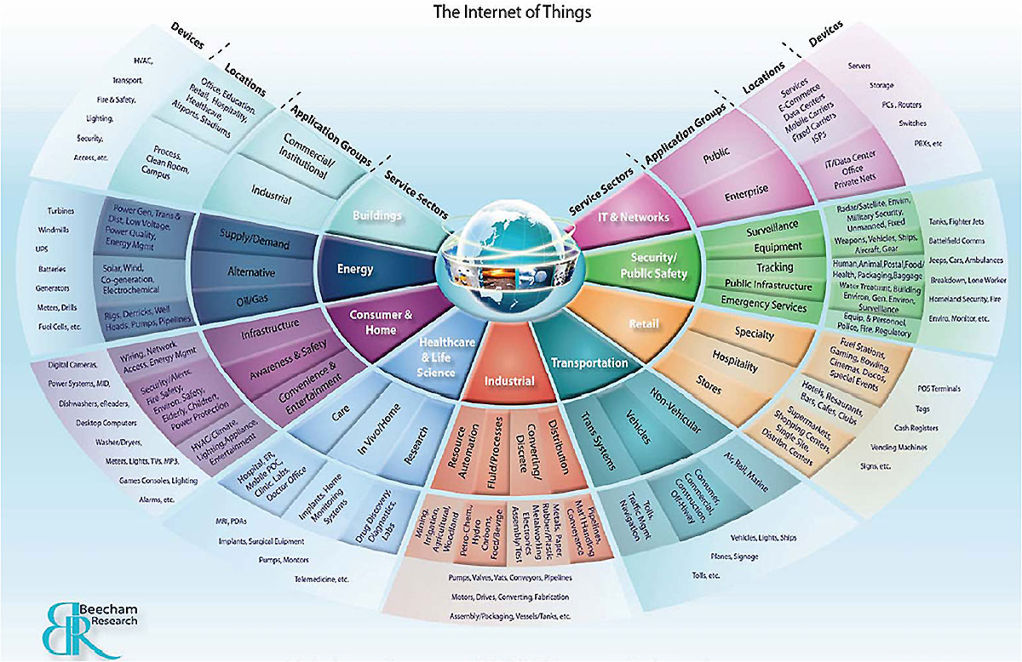
EVERY Where

Slide 26
Class Book & References
Classics:
Mary Shaw & David Garlan, Software Architecture: Perspectives on an Emerging Discipline;, Prentice Hall, 1996.
Many IEEE, ACM, ELSEVIER, and Open Source papers
Other references actively used:
Evaluating Software Architectures: Methods & Case Studies, Addison-Wesley, ISBN 020170482X.
Design & Use of Software Architectures: Adopting and Evolving a Product Line Approach: ISBN: 0201674947
SEI Selected Papers: http://www.sei.cmu.edu/architecture/
USC Selected Papers: http://sunset.usc.edu
UCI Selected Papers: http://www.ics.uci.edu
Other References & Standards discussed:
IEEE 1471, ISO RM-ODP
http://www.dstc.edu.au/Research/Projects/ODP/ref_model.html
IEEE 1220, EIA-632, EIA-731, DO-178B, J-STD-016-1995

Slide 27
Other Referenced Sites
Primary References:
http://portal.acm.org/dl.cfm?coll=portal&dl=ACM&CFID=3943453&CFTOKEN=26992569
(ACM Copyrighted Papers)
http://ieeexplore.ieee.org/Xplore/DynWel.jsp
(IEEE Copyrighted papers)
http://www.sciencedirect.com/
(Elsevier Copyrighted material)
http://citeseer.nj.nec.com/cs (Lots of open source materials)
http://www.sei.cmu.edu/str/ (Lots of open source materials)
http://www-2.cs.cmu.edu/~able/publications/ (Lots of open source materials)
http://www.sei.cmu.edu/staff/rkazman/SE-papers.html (Lots of open source materials)
http://www.cs.ukc.ac.uk/people/staff/cr3/bib/bookshelf/Modules.html
(A ton of open source materials)
http://www2.umassd.edu/SECenter/SAResources.html (Links to other sites)
http://www.cgl.uwaterloo.ca/~rnkazman/SA-sites.html (Links to other sites)
http://www-ksl-svc.stanford.edu:5915/ (Ontologies)
http://www.sei.cmu.edu/architecture/adl.html (Architecture Definition Languages)

Slide 28
Other Referenced Sites
Secondary References Used:
http://www-2.cs.cmu.edu/afs/cs/academic/class/17655-s02/www/ (Garlan’s Class on SA)
http://www.softwaresystems.org/architecture.html
http://www-old.ics.uci.edu/pub/arch/
http://cora.whizbang.com/
http://selab.korea.ac.kr/selab/resources/se/architecture.htm#Web
http://www.cebase.org/
http://www.afm.sbu.ac.uk/
http://www.wwisa.org
http://www.dacs.dtic.mil/databases/url/key.hts?keycode=71:2024&islowerlevel=1
http://www.cs.colorado.edu/serl/arch/Papers.html
http://www.cetus-links.org/

Slide 29
Other Referenced Sites
Tools:
http://www.isr.uci.edu/projects/xarchuci/ (xADL 2.0 )
http://www.isr.uci.edu/projects/xarchuci/tools-overview.html
http://www.isr.uci.edu/projects/archstudio/setup-rundevelop.html (xADL)
http://www.isr.uci.edu/projects/archstudio/
http://www.kc.com/products/iuml/lite.html (xUml)
http://www-2.cs.cmu.edu/~able/software.html (ACME SW)
http://www-2.cs.cmu.edu/~Compose/html/tools.html
http://pavg.stanford.edu/rapide/ (RAPIDE)
http://www.afm.sbu.ac.uk/z/ (Z)

Slide 30
Further Reading
Design and Use of Software Architectures : Adopting and Evolving a Product-Line Approach, Jan Bosch, 2000
Applied Software Architecture, Hofmeister Christine, 1999
The Art of Software Architecture: Design Methods and Techniques, S. T. Albin, 2003
Software Architecture in Practice, L. Bass, P. Clements and R. Kazman, 2003.

Slide 31
Further Reading
Evaluating Software Architectures: Methods and Case Studies, P. Clements, R. Kazman and M. Klein, 2001.
Documenting Software Architectures: Views and Beyond, Clements, Paul, Felix Bachmann, Len Bass, David Garlan, James Ivers, Reed Little, Robert Nord and Judith Stafford, 2002.
Software Architecture: Organizational Principles and Patterns, Dikel, David, D. Kane and J. Wilson, 2001.
Large-Scale Software Architecture : A Practical Guide using UML, Jeff Garland and Richard Anthony, 2002.
Designing Software Product Lines wtih UML: From Use Cases to Pattern Based Software Architectures, H, Gomma, 2005.
Essential Software Architecture, Ian Gorton, 2006.

Slide 32
Further Reading
Software Architecture: Foundations, Theory, and Practice, Richard N. Taylor, Nenad Medvidovic and Eric Dashofy
Essential Software Architecture, Ian Gorton, 2006.
97 Things Every Software Architect Should Know, Richard Monson-Haefel
Documenting Software Architectures: Views and Beyond, Paul Clements, Felix Bachmann, Len Bass and David Garlan, 2010.
The Process of Software Architecting, Peter Eeles and Peter Cripps, 2009.

Slide 33
Topic 0: Overview

Slide 34
Build Software or Build Airliners
True Feats of Engineering
The Boeing 747 (the biggest beast)
Software Systems
The Boeing 747
1970: 4.5 million parts, 3 million pins, rivets
2003: 6 million parts, 3 million pins, rivets
Windows TM Operating System
Windows XP: 40 Million Lines of Code
Windows 2000: 20 Million Lines of Code
Linux Operating System
Kernel ver. 2.6: 5.7 Million Lines of Code
There is no “Silver Bullet”
Notes:
One of the most popular and time-tested is the measure of Source Lines of Code (SLOC).
The installed Windows TM platform may stand at 41 million lines with the next announced version of Windows TM nearing the mark of 50 million total lines.
The Boeing 747 is assembled from greater than six million parts supplied by over 1000 vendors located all around the globe.
Boeing Corporation employed 157,000 people in 27 states and around the world (2003).
Microsoft Corporation employed 57,000 workers around the world in 2003.
Redhat: In 2002-2003, employee population and expenditures increased by almost 60 percent.

Slide 35
Engineering Common Ground
Reliability
Specification Owner
Frozen Requirements
Verification
Budgets
Schedule
Complexity
Innovation
Near-term Requirements
In-place Evolution
People
Management
Personalities
Notes:
The design processes accepted in each are characterised by recognisably similar phases. The core phases include: specification, requirement, design change, and verification.
Software can have programming errors. Software can be incorrectly specified. Software requirements can be incorrect. Software design changes can occur too often.
Stasis is not good for business. Stasis is not good for innovation.
Verification: During repair and maintenance cycles, each of these three million fasteners is inspected individually for wear and defect to ensure the safely of the millions of passengers that depend on its reliability for their transportation every year.
Additionally, these processes must incorporate ordinary people management and cost and complexity estimation.

Slide 36
No “Silver Bullet”
Innovation in aerospace, not the 747!
Complexity per Year: 1% vs. 20% in Software
Boeing 747 35yrs Reliable WW2 technology
Software 49yrs Constant Innovation
Reinventing Engineering
Reliability follows Innovation
Being First means Learning the Hard Way
Build Software, not Airliners
Notes:
To throw away all our effort to this point and accept a ready-made straightjacket would be like a child wanting to stay small… just to avoid growing pains.
Where software has routinely increased in complexity by up to 20 percent in one year, the Boeing 747 assembly complexity has only increased by 33 percent in 35 years. This is less than a one percent increase in complexity each year.
Where Microsoft Corporation is currently king, there is no “right” way, yet. The consumer will take all that they can get.
We begin to see that reliability and innovation are not exclusive goals. In fact, with recent studies on the Linux Kernel we see innovation leading reliability on the horison.
We face many new problems that make our decisions unique. We have to make good trade-offs. Sometimes we must learn the hardest way. When we do something first, there is no other way to learn.
Could we adopt aeronautical design practices? Definitely. Do we want to adopt them wholesale? Count me out.

Slide 37
The Core Triad for Success
People
Process
Technology
People + Process + Technology !!!
Notes:
It’s really all about people. If you staff a team with great people, the process and technology will take care of themselves. Don’t let people think that there isn’t any process. This is wrong. A great team will synthesise process; one will just spring forth and be used. This is, in fact, why they are great people…
We emphasise the foundations required for all great engineering feats:
People – good architects, designers, engineers, doers
Process – help provide guidance to the people to produce repeatable, quality, results
Tools – use tools to assist in automating tasks required to get the job done

Slide 38
Software Evolution
People
Position Descriptions of the 70s:
Programmers
80s
Programmer/analysts
90s
Developer
Architect
Business Analyst
00s ?
UI Designer
Bean Provider
Assembler
Deployer
+ Architect
+ Modeler
+ Implementer
+ Project Manager
+ System Analyst
+ Config. Mgr.
+ System Tester
+ Test Designer
Notes:
A whole host of position names

Slide 39
Software Evolution (cont’d)
Processes
Ad Hoc
Waterfall
Spiral
Incremental
Iterative
RAD/JAD
Unified Process
Extreme Programming (XP)
Feature-Driven Development
etc
Notes:
How many practice?
Ad hoc
Waterfall
RUP
XP

Slide 40
Software Evolution (cont’d)
Technology
Languages: Assembler , Procedural, Structured, Object-Oriented
3GL/4GL/CASE
Life Cycle Tools
Requirements, Architecting, Building, Testing
Configuration Management/Version Control
Round-trip Engineering (manual steps)
Simultaneous round-trip tools
Modeling:
Structured, DFD,
Coad, OMT, Booch,
UML
Notes:
How many people think OO is the best solution to most application development projects?
To me, OO is the only way to solve the problem – even if I am forced to use a non-OO language, I still attack the problem using the same techniques.
UML is the de facto standard diagramming style.

Slide 41
Some Fundamental Issues
Software is very complex today
Hard for one to understand it all
Difficult to express in terms all stakeholders understand
Business drivers add pressure
Shrinking business cycle
Competition increasing
Ever rising user expectations
“Soft” Requirements
A common threat to schedule, budget, success
Too much change can cause failure

Slide 42
Fundamental Issues (ii)
Flexibility and resilience to change is key
Ability to adapt to sudden market changes
Design is solid enough that change does not impact the core design in a destabilising way
Willingness to re-architect as required
Most projects are unpredictable
Lack of knowing where and what to measure
Lack of yardsticks to gauge progress
Requirements creep is common
Scrap and rework is common
Interminably 90% done
Notes:
The term “resilience” means that we want to build an architecture that allows gracefully accepting change (since change is an inescapable reality).

Slide 43
Fundamental Issues (iii)
Lack of quality people results in failure
…in spite of best processes and tools!
Managing people is difficult
Major change is organisationally difficult
Reusing software artifacts is rare
Architectures/Designs/Models
Estimating processes
Team processes
Planning & Tracking procedures and reports
Software construction & management
Reviews, testing
etc.
Notes:
Most organisations need to understand that new methodologies are needed. Organisational change is not always easy. The new paradigm needs to be understood and embraced at all levels and throughout the organisation.
Most organisations have little or no reuse. That means reuse of anything – not just code reuse.

Slide 44
The Pioneering Era (1955-1965)
New computers were coming out every year or two.
Programmers did not have computers on their desks and had to go to the "machine room".
Jobs were run by signing up for machine time. Punch cards were used.
Computer hardware was application-specific. Scientific and business tasks needed different machines.
High-level languages like FORTRAN, COBOL, and ALGOL were developed.
No software companies were selling packaged software.
Academia did not yet teach the principles of computer science.

Slide 45
The Stabilising Era (1965-1980)
Came the IBM 360.
This was the largest software project to date.
The 360 also combined scientific and business applications onto one machine.
Programmers had to use the job control language (JCL) to tell OS what to do.
PL/I, introduced by IBM to merge all programming languages into one, failed.
The notion of timesharing emerged.

Slide 46
The Stabilising Era (1965-1980)
Software became a corporate asset and its value became huge.
Academic computing started in the late 60's.
Software engineering discipline did not yet exist.
High-hype disciplines like Artificial Intelligence emerged.
Structured Programming burst on the scene.
Standards organisations became control battle grounds.
Programmers still had to go to the machine room.

Slide 47
The Micro Era (1980-Present)
The price and size of computers shrunk. Programmers could have a computers on their desks.
The JCL got replaced by GUI.
The most-used programming languages today are between 15 and 40 years old. The Fourth Generation Languages never achieved the dream of "programming without programmers".

Slide 48
Software Characteristics
software is engineered, not manufactured
no manufacturing phase which introduces quality problems
costs concentrated in engineering
software does not wear out
does deteriorate
no spare parts
most software is custom built rather than being assembled from components

Slide 49
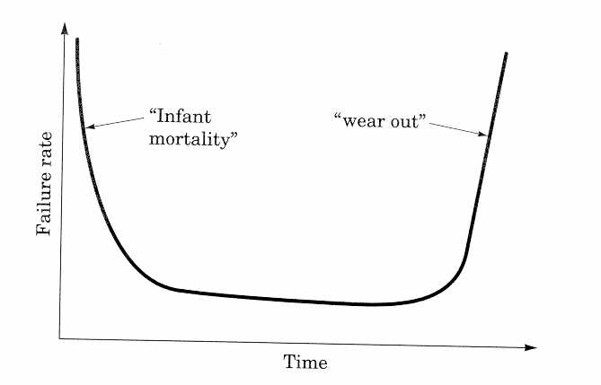
Hardware Characteristics

Slide 50
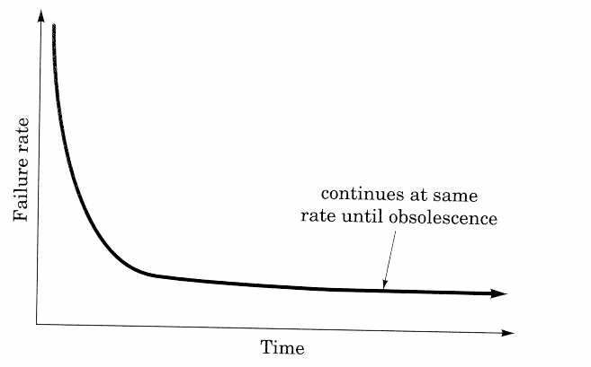
Software Characteristics

Slide 51
Software attributes - conflicting aims

Slide 52
Digital Economy
E-Commerce
– the online exchange of value (goods, services, and/or money) within firms, between firms, between firms and their customers, and between consumers.
Digital Economy
– An economy that is empowered by IT, Internet and digital technologies.
– Individuals and enterprises create wealth by applying knowledge, networked human intelligence, and effort to manufacturing, agriculture and services
Impact of the Digital Economy
– New Products
– New Business Opportunities
– New Business Relationship

Slide 53
BITS INSTEAD OF ATOMS
Digital Representation
The physical world (atoms) is modeled with 1’s and 0’s (bits)
Enabling Technology
Allows high capacity data storage (bit memory)
Allows large system integration (bit regeneration)
Allows large distance communications (noise immunity)
Allows inexpensive, low power hardware (CMOS)
Allows data compression (Internet images & video)
Allows data encryption (e-commerce)

Slide 54
Summary
Changing Society & Changing Software
A Day in the Life of the Digital Consumer in the Future
People move freely from one environment to another
They use whatever devices are most convenient at the time
They automatically connect using the best network available at the time based on their personal profile
They have access to the same personalised services automatically scaled to the device and connection they are using
They have one service provider that manages and optimises their service and account based on their unique needs and resources.

Slide 55
Topic 1: History and Definition of Software Architecture

Slide 56
Software Life Cycle Revisited
software development projects are large and complex
a phased approach to control it is necessary

Slide 57
Waterfall Model
Reqs. Analysis
V & V
Design
V & V
Implementation
V & V
Testing
V & V
Maintenance
V & V

Slide 58
Waterfall Model (cntd)
includes iteration and feedback
validation (are we building the right system?) and verification (are we building the system right?) after each step
user requirements are fixed as early as possible
problems
too rigid
developers cannot move between various abstraction levels

Slide 59
Spiral Model
all development models have something in common: reducing the risks

Slide 60
Spiral Model (cntd)
Determine
objectives,
alternatives,
constrains
Evaluate alternatives,
Identify and resolve risks
Develop, verify
next-level product
Plan next phase

Slide 61
Towards a Software Factory
developers are not inclined to make a maintainable and reusable product, it has additional costs
this viewpoint is changed somewhat if the product or product family is the focus of attention rather than producing the initial version of the product

Slide 62
Towards a Software Factory (cntd)
reuse becomes important
progress has been made in the areas of: reusable design (e.g., software architecture and design patterns) and software components
the idea of a software factory
share people’s knowledge
share reusable products/components

Slide 63
Software Architecture
High-level abstraction of system - Programming in the large

Slide 64
Benefits of Studying Software Architecture
Greater understanding
Reuse
Evolution
Analysis
Management

Slide 65
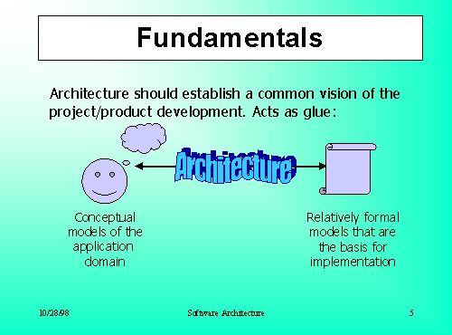

Slide 66
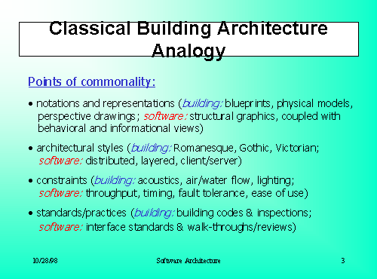

Slide 67
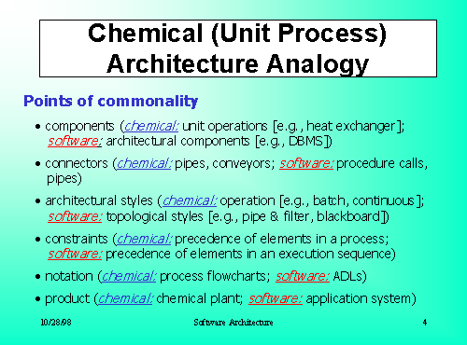

Slide 68
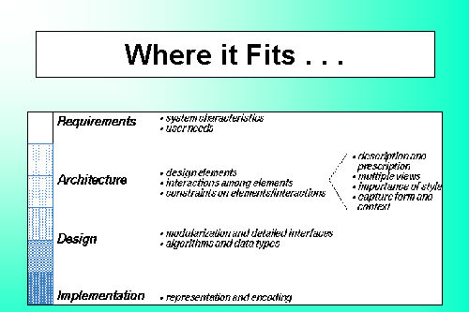

Slide 69
Promised Benefits of Architectural Modeling
update document (6%)
review document
(6%)
test & debug (28%)
define/analyze change
Requirements
(18%)
Architecture
trace logic
(23%)
Design
implement change (19%)
Reduce maintenance
costs, directly and
indirectly
Code/Integ
Clarify intentions
Make decisions and implications explicit
Permit system-level analysis
Test/Accept
Maintenance

Slide 70
Architecture in the Life-Cycle (1)
Views of a Software System
"An important objective of software architecture is the production of a consistent set of views of the system and its parts presented in a structure that satisfies the needs of both the end-user and later designers."(Witt et al.)

Slide 71
Architecture in the Life-Cycle (2)
Customer
Concern
Schedule and budget estimation
Feasibility and risk assessment
Requirements Traceability
Progress Tracking

Slide 72
Architecture in the Life-Cycle (3)
User
Concern
Consistency with requirements and usage scenarios
Future requirement growth accommodation
Performance, reliability, interoperability, etc.

Slide 73
Architecture in the Life-Cycle (4)
Architect
Concern
Requirements Traceability
Support of tradeoff analyses
Completeness, consistency of
architecture

Slide 74
Architecture in the Life-Cycle (5)
Developer
Concern
Sufficient detail for design
Reference for selecting/assembling components
Maintain interoperability with existing systems

Slide 75
Architecture in the Life-Cycle (6)
Maintainer
Concern
Guidance on software modification
Guidance on architecture evolution
Maintain interoperability with existing systems

Slide 76
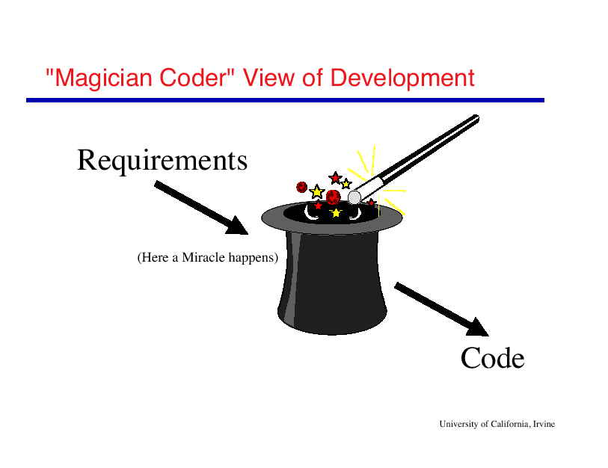

Slide 77
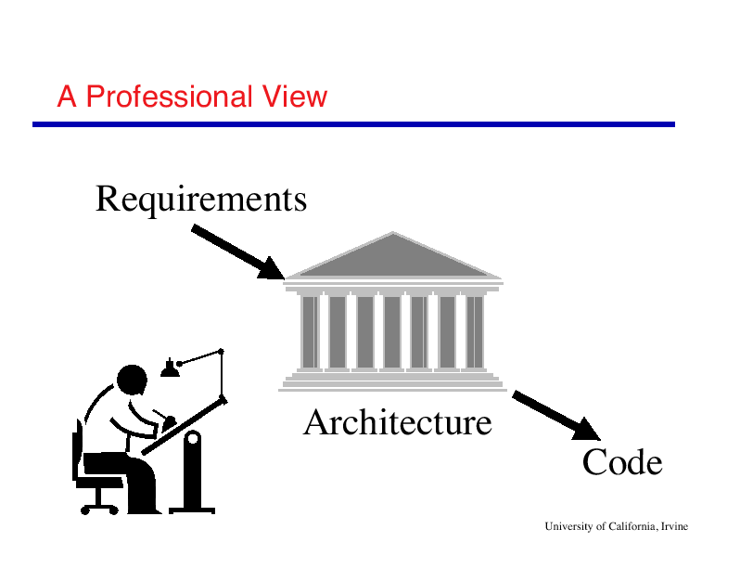

Slide 78
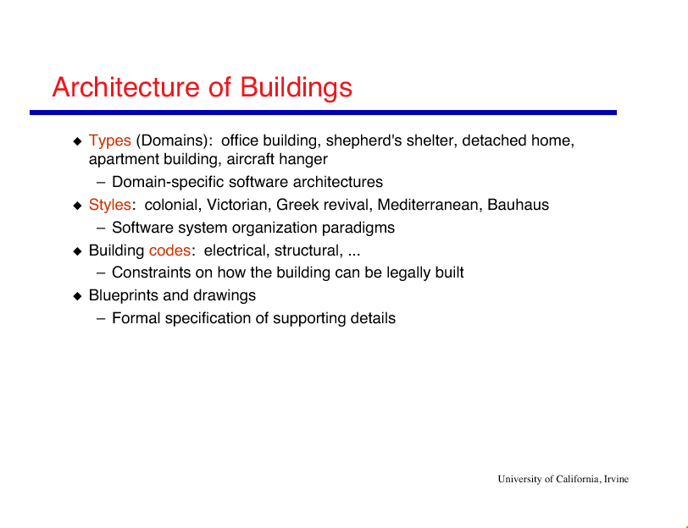

Slide 79
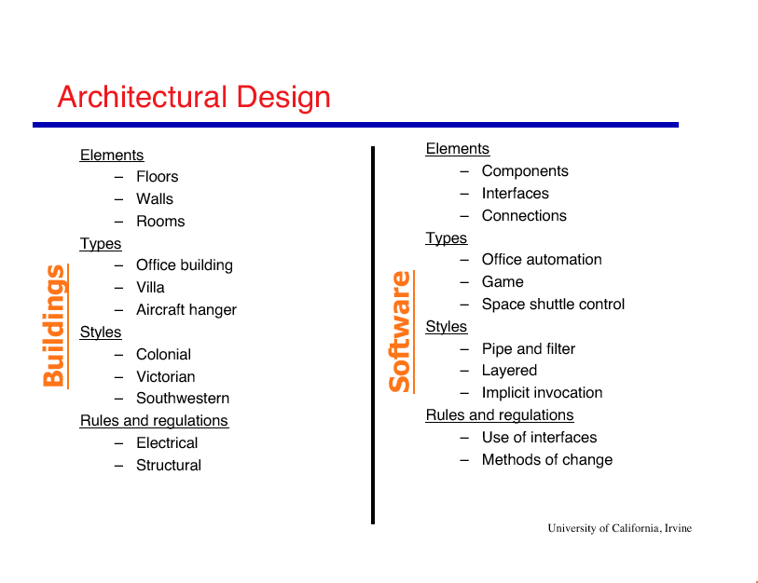

Slide 80
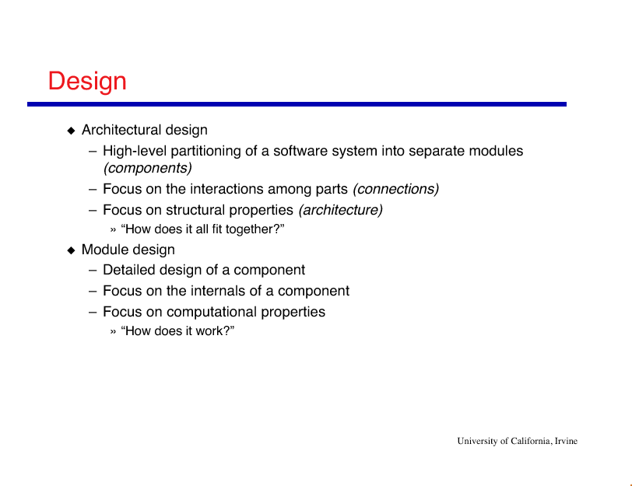

Slide 81
Software Architecture Definition
The software architecture of a system is the structure or structures of the system, which comprise software components, the externally visible properties of those components, and the relationships among them.
Len Bass, Paul Clements, and Rick Kazman. Software Architecture in Practice. SEI Series in Software Engineering. Addison-Wesley, Reading, Massachusetts, 1998.

Slide 82
Software Architecture Definition (cntd)
Important issues raised:
multiple system structures;
externally visible (observable) properties of components.
The definition does not include:
the process;
rules and guidelines;
architectural styles.

Slide 83
Software Architecture
The IEEE Architecture Working Group (P1471), the Recommended Practice for Architectural Description, has established the following definition of architecture and related terms:
Architecture is the fundamental organisation of a system embodied in its components, their relationships to each other and to the environment and the principles guiding its design and evolution.

Slide 84
Software Architecture (cntd)
IEEE architecture definition rationale:
To avoid the inclusion of the term ”structure” which is often associated with the physical structure of a system. An architecture is a property or concept of a system, not merely its structure.
The phrase ``highest-level'' is used to abstract away from low-level details.
An architecture can not be viewed in isolation, its environment in which it is embedded should be taken into account.

Slide 85
Software architecture (cntd)
Other IEEE related architecture definitions:
Architect: the person, team or organisation responsible for systems architecting.
Architecting: the activities of defining, maintaining, improving and certifying proper implementation of an architecture.
Architecture: the highest-level conception of a system in its environment.
Architectural description: a collection of products to document an architecture.

Slide 86
Software architecture
Other IEEE related architecture definitions (continued):
System stakeholder: an individual, team, or organisation (or classes hereof) with interests in, or concerns relative to, a system.
View: a representation of a whole system from the perspective of a related set of concerns.
Viewpoint: a pattern or template from which to construct individual views. A viewpoint establishes the purposes and audience for a view and the techniques or methods employed in constructing a view.

Slide 87
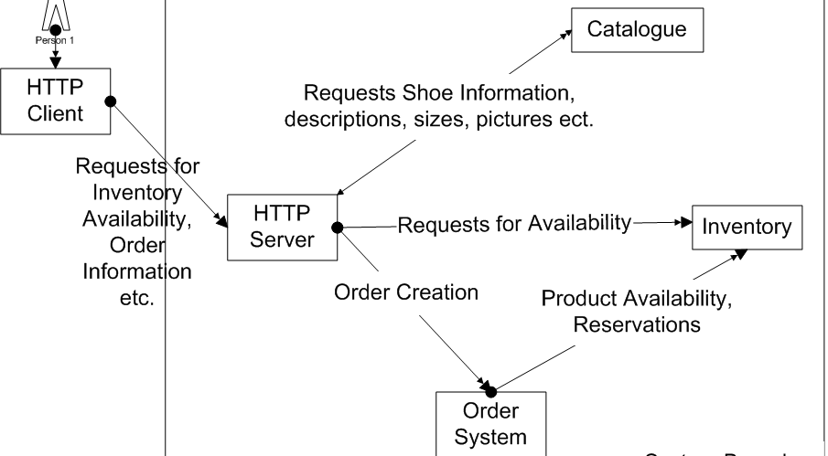
A Simple Architecture

Slide 88
Early Notions of Software Architecture
The earliest pioneers of what we now refer to as Software Architecture were Edgar Dijkstra, Fred Brooks Jr., and David Lorge Parnas
In programming the term architecture was first applied to descriptions covering more than one computer system
i.e. “families of systems”
Brooks and Iverson (1969) called architecture the “…conceptual structure of a system…as seen by the programmer”
Notes:
Brooks F., and Iverson K.1969. Automatic Data Processing (System/360 Edition). New York:Wiley p.250

Slide 89
Edgar Dijkstra 1968
Dijkstra stressed as early as 1968 that how software is partitioned and structured is important
Not merely simply programming a “correct” solution
He introduced the idea of “layered structures” for operating systems
Resulted in ease of development, maintenance
Notes:
Djikstra E.W. 1968. “The Structure of the ‘T.H.E.’ Multiprogramming System”. Communications of the ACM. 18(8):pp. 453-7
Note that Djikstra himself did not use the term “Software Architecture”

Slide 90
Fred Brooks Jr. on System Architecture (1975)
“By the architecture of the system I mean the complete and detailed specification of the user interface….”
“The architect of a system, like the architect of a building, is the user’s agent.” (“Aristocracy, Democracy and System Design” in The Mythical Man-Month, 1975)
Notes:
At first glance this “definition” seems way off, it is referred to but almost in a dismissive way in Best et al. Software Architecture in Practice. Brooks specified that “…for a computer this (i.e. the architecture – AOC) is the programming manual. For a compiler it is the language manual. For a control program it is the manuals for the language or languages used to invoke its functions. For the entire system it is the union of the manuals the user must consult to do his entire job”. In the next paragraph he quotes G.A. Blauw, “Where architecture tells what happens, implementation tells how it is made to happen”
Behind this, however, lies the notion that “conceptual integrity is the most important consideration in system design”.
He states that for a given level of function, however, that system is best in which one can specify things with the most simplicity and straightforwardness”

Slide 91
Brooks: Simplicity and Straightforwardness
“…It is not enough to learn the elements and rules of combination; one must also learn idiomatic usage, a whole lore of how the elements are combined in practice. Simplicity and straightforwardness proceed from conceptual integrity. Every part must reflect the same philosophies and the same balancing of desiderata….Ease of use, then, dictates unity of design, conceptual integrity”
Notes:
This stuff about “idiomatic usage, a whole lore….” recurrs when we look at patterns later on.

Slide 92
‘One Mind, Many Hands’
Conceptual integrity must proceed from one, or a small number of minds
e.g., Reims Cathedral’s Jean d’Orbais
But schedule pressures demand many hands
Two techniques proposed:
Separation of architectural effort from implementation
New structuring of software development teams
“The Surgical Team”
Notes:
Brooks F.1975. “The Surgical Team” in F. Brooks Jr. (ed) The Mythical Man Month Reading, Mass: Addison Wesley

Slide 93
The Surgical Team
The problem
The “small, sharp” team is ideal…
Ten or less excellent programmers
…but too slow for really big systems
The solution
The ‘surgical team’: one cutter, many supporters

Slide 94
Communication Patterns
Surgeon
Administrator
Co-pilot
Secretary
Programming Clerk
Editor
Toolsmith
Secretary
Tester
Language lawyer
Notes:
Brooks acknowledges Harlan Mills as the source of this idea, see
Mills H.1971. “Chief Programmer Teams, Principles and Procedures”. IBM Federal Systems Division Report. FSC 71-5108, Gaithersburg,Md.
Surgeon: Chief Programmer. Defines the functional and performance specification. Designs, codes, tests and documents the program. Writes in a structured programming language ad has access to a programming environment to run tests and version the program. Needs 10 years experience and considerable application knowledge in applied maths., or business data handling etc.
Co-pilot: Similar to surgeon but less experienced. Used to bounce ideas from by Surgeon. Often represents rest of team in discussions. Researches alternative design strategies. May write code, but is not responsible for it.
Administrator: Professional administrator to handle money, people, space and machines. Interfaces with admin. Machinery of rest of organisation
Editor: Editor takes drafts of surgeon’s documentation and reworks it, providing bibliography, references etc., manages versioning and document production
Program Clerk: Maintains archive of all technical records of a project. A trained secretary responsible for both machine-readable and human-readable files. Plays a key role in transforming programming “from private art to public practice” by making all computer input and output data the public property of the whole team.
Toolsmith: responsible for basic services for file-editing, text-editing, interactive debugging etc., and for constructing, upgrading and maintaining special tools such as utilities, reusable procedures, macro libraries etc.
Tester: devises system tests from functional specifications, designs the tests including component tests.
Language Lawyer: Syntax expert. “The language lawyer can find a neat and efficient way to use the language to do difficult, obscure or tricky things.”

Slide 95
How the Surgical Team works
10 people, seven professionals, work to a system which is the product of a single (or maybe two) mind.
Not a democracy of equals. The surgeon rules. No “division of problem”
Division of labour permits radically simpler communication patterns.
Notes:
For a case study see Baker F.T. 1972. “Chief Programmer Team Management of Production Programming”. IBM Systems Journal. 11 (1)

Slide 96
Brooks on Blaauw
Blaauw says total creative effort involves three distinct phases
Architecture
Writing all the external specifications
Implementation
Realisation
Three “common objections” noted by Brooks
The specifications will be too rich and costly
Creativity is confined to the architects
Implementors will sit idle waiting for the architecture
Notes:
BlaauW. G.A.1970. “Hardware Requirements for the Fourth Generation” in F.Greenberger (ed.) Fourth Generation Computers Englewood Cliffs, NJ:Prentice Hall
Note: Brooks is not agreeing with these objections, he merely notes that they are made by a lot of other people.

Slide 97
Refuting Common Objections
“…architects will get all the creative fun”
An illusion. Implementation is a creative activity that is undiminished by external specification: “Form is a liberator”
“…implementors will sit idly by…”
Another illusion. A matter of timing and phasing, i.e. project management. The three activities can “be begun in parallel and proceed simultaneously”
“The specifications will be too rich…”
A serious issue(dealt with by Brooks in “The Second-System Effect”)
Notes:
F.Brooks. 1975. “The Second-System Effect” in F. Brooks Jr. (ed) The Mythical Man Month. Reading, Mass: Addison Wesley

Slide 98
“Interactive Discipline for the Architect”
In building, contractors’ bids most often exceed the budget
Architect has two possible responses
Cut the design
Challenge the bid by suggesting cheaper implementations
The latter involves interactive dialogue with the builder

Slide 99
Architect vs. Builder
To be successful, the architect must
Suggest, not dictate, an implementation
“The builder has creative and inventive responsibility for the implementation”
Always be able to suggest a way of implementing a specification
Be prepared to accept alternatives
Deal privately and quietly in such suggestions
Be ready to forego credit for suggested improvements
“Often the builder will counter by suggesting changes to the architecture. Often he is right”

Slide 100
David Parnas 1971-79
Parnas developed these ‘architectural’ concerns and turned them into fundamental tenets of Software Engineering. The main principles included:
Information Hiding as the basis of decomposition for ease of maintenance and reuse [72]
The separation of Interface from implementation of components [71, 72]
Observations on the separate character of different program elements [74]

Slide 101
David Parnas 1971-79 (contin.)
Main principles (continued):
The “uses” relationship for controlling the connectivity between components [79]
To increase extensibility
Principles for the detection and handling of errors [72, 76]
i.e., exceptions
Identifying commonalities in “families of systems” [76]
To provide coarse-grained, stable common structures
Recognition that structure influences non-functional ‘qualities’ of a system [76]
Parnas D. 1972. “On the Criteria for Decomposing Systems into Modules”. Communications of the ACM. 15(12): pp.1053-8
Parnas D. 1974. “On a ‘Buzzword’: Hierarchical Structure”. Proceedings of the IFIP Congress. 74 pp.336-390
Parnas D. 1976. “On the Design and Development of Program Families”. IEEE Transactions of Software Engineering, SE-2(1):pp. 1-9
Parnas D. 1979. “Designing Software for Ease of Extension and Contraction”. IEEE Transactions on Software Engineering. SE-5(2) pp.128-137

Slide 102
Fundamental Understanding
Architecture is a set of principal design decisions about a software system
Three fundamental understandings of software architecture
Every application has an architecture
Every application has at least one architect
Architecture is not a phase of development

Slide 103
Wrong View: Architecture as a Phase
Treating architecture as a phase denies its foundational role in software development
More than “high-level design”
Architecture is also represented, e.g., by object code, source code, …

Slide 104
Context of Software Architecture
Requirements
Design
Implementation
Analysis and Testing
Evolution
Development Process

Slide 105
Requirements Analysis
Traditional SE suggests requirements analysis should remain unsullied by any consideration for a design
However, without reference to existing architectures it becomes difficult to assess practicality, schedules, or costs
In building architecture we talk about specific rooms…
…rather than the abstract concept “means for providing shelter”
In engineering new products come from the observation of existing solution and their limitations

Slide 106
New Perspective on Requirements Analysis
Existing designs and architectures provide the solution vocabulary
Our understanding of what works now, and how it works, affects our wants and perceived needs
The insights from our experiences with existing systems
helps us imagine what might work and
enables us to assess development time and costs
→ Requirements analysis and consideration of design must be pursued at the same time

Slide 107
Non-Functional Properties (NFP)
NFPs are the result of architectural choices
NFP questions are raised as the result of architectural choices
Specification of NFP might require an architectural framework to even enable their statement
An architectural framework will be required for assessment of whether the properties are achievable

Slide 108
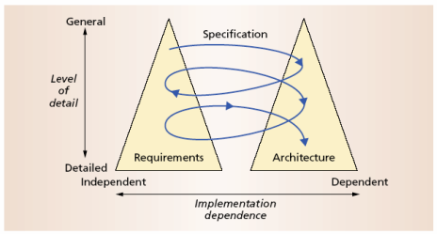
The Twin Peaks Model

Slide 109
Design and Architecture
Design is an activity that pervades software development
It is an activity that creates part of a system’s architecture
Typically in the traditional Design Phase decisions concern
A system’s structure
Identification of its primary components
Their interconnections
Architecture denotes the set of principal design decisions about a system
That is more than just structure

Slide 110
Architecture-Centric Design
Traditional design phase suggests translating the requirements into algorithms, so a programmer can implement them
Architecture-centric design
stakeholder issues
decision about use of COTS component
overarching style and structure
package and primary class structure
deployment issues
post implementation/deployment issues

Slide 111
Object-Oriented Design (OOD)
Objects
Main abstraction entity in OOD
Encapsulations of state with functions for accessing and manipulating that state

Slide 112
Pros and Cons of OOD
Pros
UML modeling notation
Design patterns
Cons
Provides only
One level of encapsulation (the object)
One notion of interface
One type of explicit connector (procedure call)
Even message passing is realized via procedure calls
OO programming language might dictate important design decisions
OOD assumes a shared address space

Slide 113
Implementation
The objective is to create machine-executable source code
That code should be faithful to the architecture
Alternatively, it may adapt the architecture
How much adaptation is allowed?
Architecturally-relevant vs. -unimportant adaptations
It must fully develop all outstanding details of the application

Slide 114
Faithful Implementation
All of the structural elements found in the architecture are implemented in the source code
Source code must not utilise major new computational elements that have no corresponding elements in the architecture
Source code must not contain new connections between architectural elements that are not found in the architecture
Is this realistic? Overly constraining? What if we deviate from this?

Slide 115
Unfaithful Implementation
The implementation does have an architecture
It is latent, as opposed to what is documented.
Failure to recognise the distinction between planned and implemented architecture
robs one of the ability to reason about the application’s architecture in the future
misleads all stakeholders regarding what they believe they have as opposed to what they really have
makes any development or evolution strategy that is based on the documented (but inaccurate) architecture doomed to failure

Slide 116
Implementation Strategies
Generative techniques
e.g. parser generators
Frameworks
collections of source code with identified places where the engineer must “fill in the blanks”
Middleware
CORBA, DCOM, RPC, …
Reuse-based techniques
COTS, open-source, in-house
Writing all code manually

Slide 117
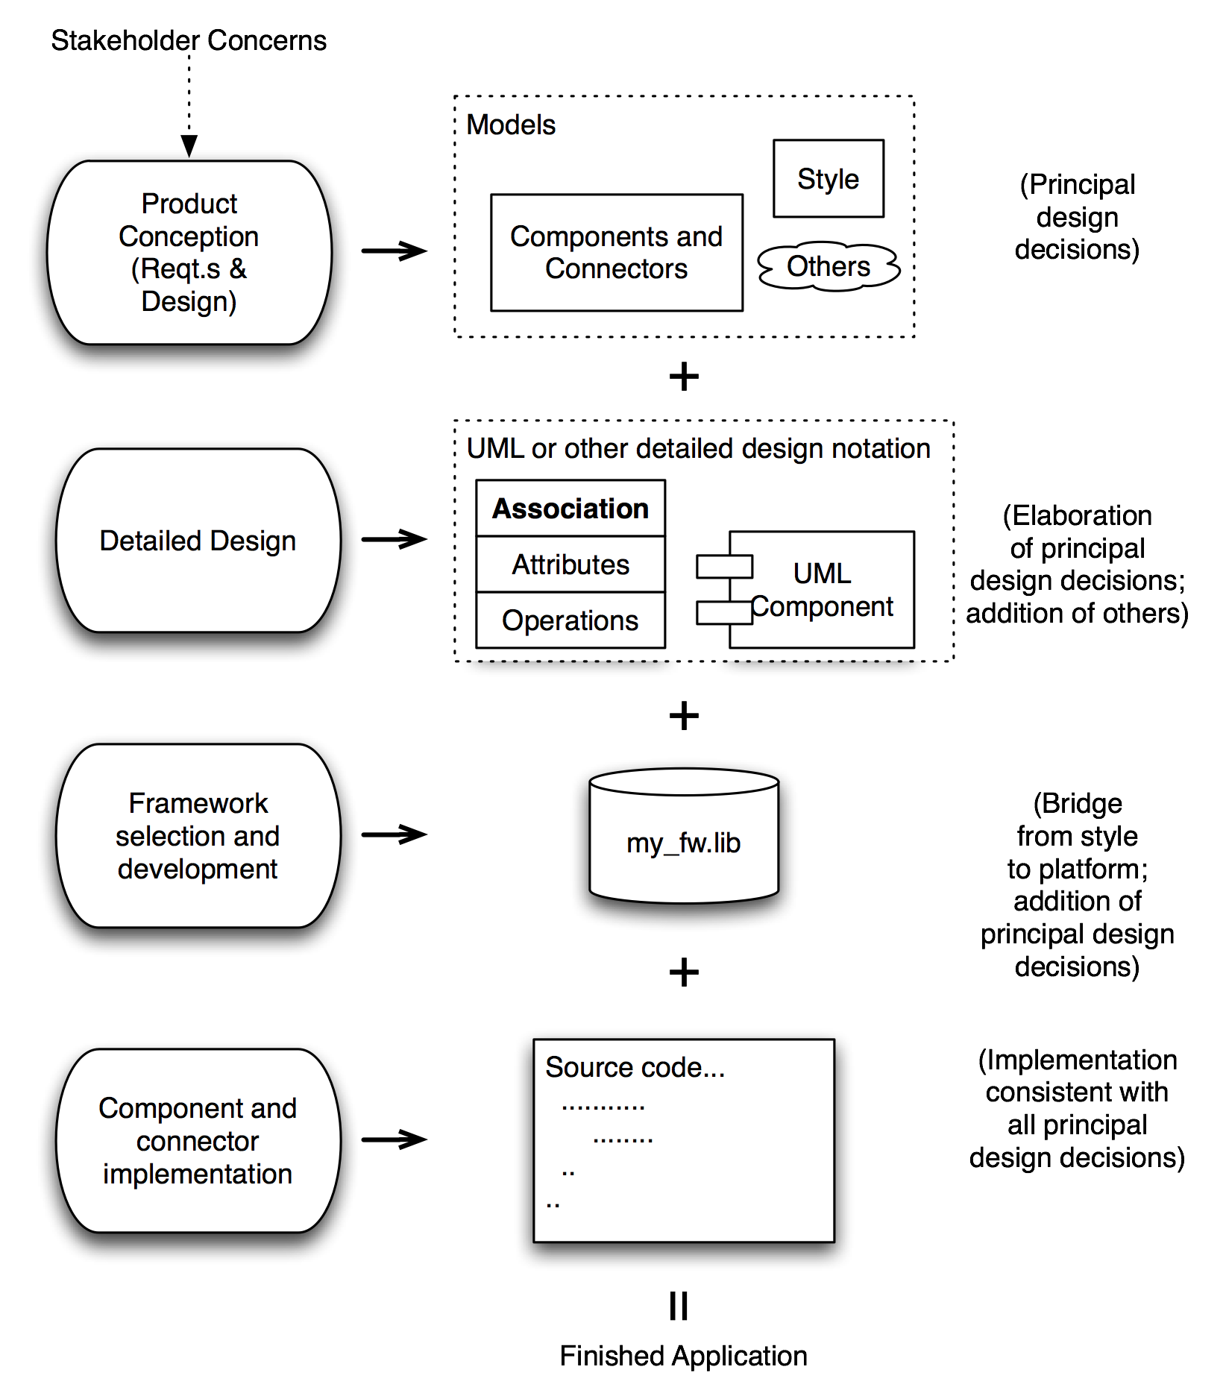
How It All Fits Together

Slide 118
Analysis and Testing
Analysis and testing are activities undertaken to assess the qualities of an artifact
The earlier an error is detected and corrected the lower the aggregate cost
Rigorous representations are required for analysis, so precise questions can be asked and answered

Slide 119
Analysis of Architectural Models
Formal architectural model can be examined for internal consistency and correctness
An analysis on a formal model can reveal
Component mismatch
Incomplete specifications
Undesired communication patterns
Deadlocks
Security flaws
It can be used for size and development time estimations

Slide 120
Analysis of Architectural Models (cont’d)
Architectural model
may be examined for consistency with requirements
may be used in determining analysis and testing strategies for source code
may be used to check if an implementation is faithful

Slide 121
Evolution and Maintenance
All activities that chronologically follow the release of an application
Software will evolve
Regardless of whether one is using an architecture-centric development process or not
The traditional software engineering approach to maintenance is largely ad hoc
Risk of architectural decay and overall quality degradation
Architecture-centric approach
Sustained focus on an explicit, substantive, modifiable, faithful architectural model

Slide 122
Turbine – A New Visualisation Model
Goals of the visualisation
Provide an intuitive sense of
Project activities at any given time
Including concurrency of types of development activities
The “information space” of the project
Show centrality of the products
(Hopefully) Growing body of artifacts
Allow for the centrality of architecture
But work equally well for other approaches, including “dysfunctional” ones
Effective for indicating time, gaps, duration of activities
Investment (cost) indicators

Slide 123
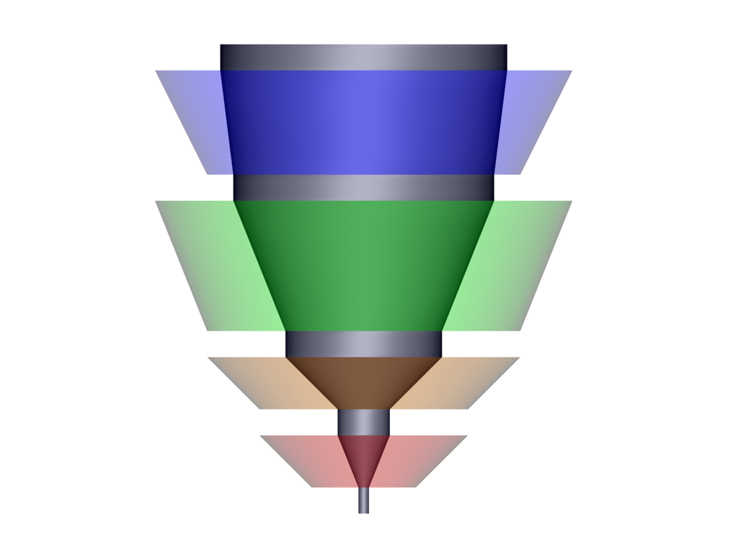
The Turbine Model
time
“Core” of project
artifacts
Testing
Gap between rotors
indicates no project
activity for that Δt
Coding
Radius of rotor indicates
level of staffing at time t
Design
t_{i}
Simplistic Waterfall,
Side perspective
Requirements

Slide 124
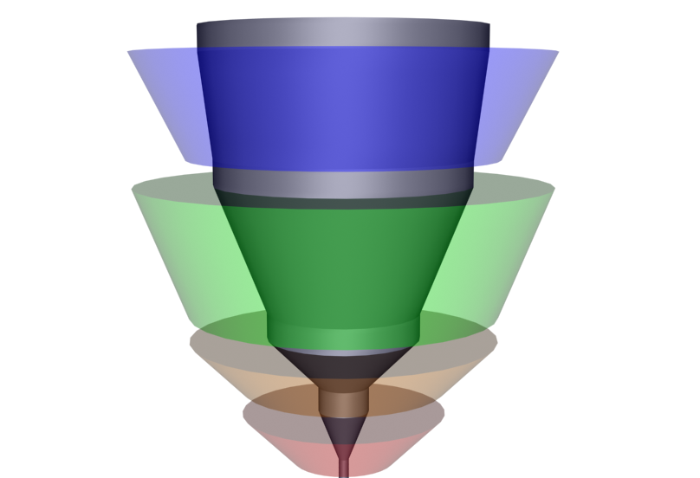
The Turbine Model
time
Waterfall example,
Angled perspective
Notes:
Rotors are the activities.
Core are the artifacts.
Time goes upward.
Volume of rotor represents cost.
Volume of core represents information content.
Wide rotor represents lots of investment of (people) resources.

Slide 125

A Richer Example
Assess/…
time
Test/Build/
Deploy
Build/Design/
Requirements/Test
Design/Build/
Requirements
S₁
Requirements/Architecture
assessment/Planning
Notes:
Rotor 1: Reqts 50%; Architecture assessment 30%; Project planning 20%.
Rotor 2: Design: 50%; Impl. 25%; Reqts 12.5%; Other 12.5%
Rotor 3: Design 15%; Impl. 50%; A&T: 25%; Reqts 5%; Other 5%
Rotor 4: Impl. 15%, A&T 50%; Deployment 20%; Other 15%
Rotor 5: Analysis of lessons learned: 85%; Other 15%
GAP rotor (i.e. some amount of the core sticks out above the top rotor

Slide 126
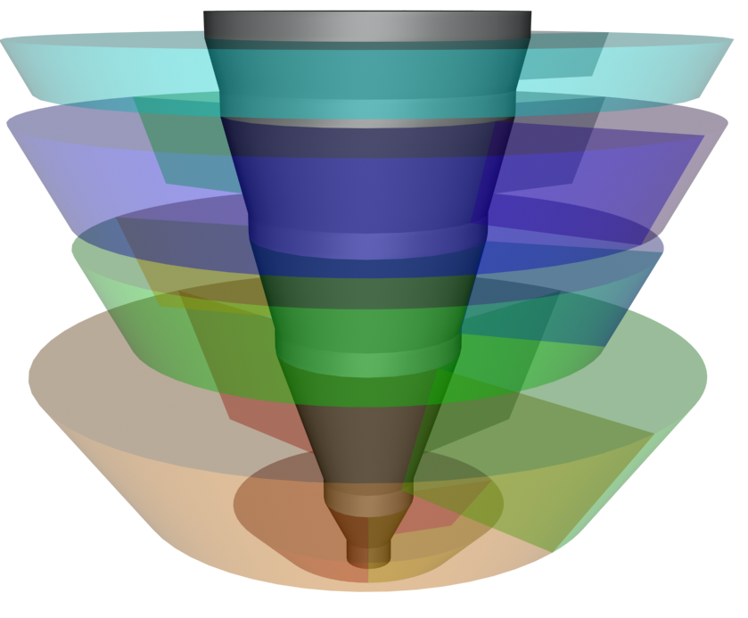
Volume Indicates Where Time was Spent
Assess/…
Test/Build/
Deploy
Build/Design/
Requirements/Test
Design/Build/
Requirements
Requirements/ Architecture Assessment / Planning
Notes:
Rotor 1: Reqts 50%; Architecture assessment 30%; Project planning 20%.
Rotor 2: Design: 50%; Impl. 25%; Reqts 12.5%; Other 12.5%
Rotor 3: Design 15%; Impl. 50%; A&T: 25%; Reqts 5%; Other 5%
Rotor 4: Impl. 15%, A&T 50%; Deployment 20%; Other 15%
Rotor 5: Analysis of lessons learned: 85%; Other 15%
GAP rotor (i.e. some amount of the core sticks out above the top rotor

Slide 127
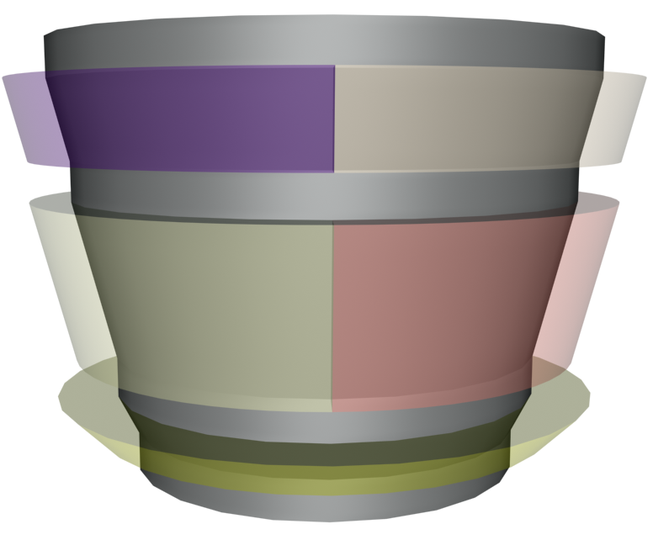
A Technically Strong Product-Line Project
Deployment
Capture of new
Work
Parameterization
Customization
Assessment
Notes:
Lots of substance coming in.
Small volume (cost) in the rotors.
Rotor 1: Assessment: 100%
Rotor 2: Parameterization: 50% Customization: 50
Rotor 3: Deployment: 50 Capture: 30 Other: 20
Capture is the work to take what was customization here and package it so that it is reusable in future projects.

Slide 128
Summary (1)
A proper view of software architecture affects every aspect of the classical software engineering activities
The requirements activity is a co-equal partner with design activities
The design activity is enriched by techniques that exploit knowledge gained in previous product developments
The implementation activity
is centered on creating a faithful implementation of the architecture
utilises a variety of techniques to achieve this in a cost-effective manner

Slide 129
Summary (2)
Analysis and testing activities can be focused on and guided by the architecture
Evolution activities revolve around the product’s architecture.
An equal focus on process and product results from a proper understanding of the role of software architecture

Slide 130
Topic 2: Modern Software Architecture

Slide 131
Leading Contributors
The leading contributors of the modern discipline of Software Architecture to date are:
Dewayne Perry and Alexander Wolf
Mary Shaw and David Garlan
Len Bass, Paul Clements, Rick Kazman and Linda Northrup
Frank Buschmann et al.,
James O. Coplien

Slide 132
Foundations of Study
The seminal work is a 1992 paper by Dewayne E. Perry and Alexander L. Wolf
“Foundations for the Study of Software Architecture”. ACM SIGSOFT Software Engineering Notes 17(4) pp.40-52
Constructed a model of Software Architecture consisting of 3 components:
Elements
Form
rationale

Slide 133
Perry and Wolf, 1992
“We use the term ‘architecture’ rather than ‘design’ to evoke notions of codification, of abstraction, of formal training (of software architects), and of style”
Benefits sought
Architecture as a framework for satisfying requirements
Architecture as the technical basis for design
Architecture as an effective basis for reuse
Architecture as the basis for dependency and consistency analysis

Slide 134
Basis of the Intuition
Perry and Wolf examined other “architectural disciplines” for lessons
Computing hardware architecture
Small number of design features
Scale achieved by replication of the design elements
Network architecture
Two kinds of components – nodes and connections
Only a few topologies to be considered
Building architecture
Multiple views
Architectural styles
Style and engineering
Style and materials

Slide 135
The Context of Architecture
Requirements are concerned with the determination of the information, processing and characteristics of that information needed by the user of the system
Architecture is concerned with the selection of architectural elements, their interactions, and the constraints on those elements and their interactions necessary to provide a framework in which to satisfy the requirements and serve as a basis for design
Design is concerned with the modularisation and detailed interfaces of the design elements, their algorithms and procedures, and the data types needed to support the architecture and to satify the requirements; and
Implementation is concerned with the representations of the algrithms and data types that satisfy the design, architecture and requirements.

Slide 136
The Purpose of Architectural Specification
Architectural specifications are required to be of such a character that we can
Prescribe the architectural constraints to the desired level
Separate aesthetics from engineering
Express different aspects of architecture in an appropriate manner
Perform dependency and consistency analysis

Slide 137
The Model: elements
Software Architecture = {elements, form, rationale}
Elements:
Processing elements
Data elements
Connecting elements

Slide 138
The Model: form
Form
Consists of weighted properties and relationships
Weighting is either:
Importance of property or relationship
Or necessity of selecting among alternatives
Properties
Define the minimum constraints on the choice of architectural elements
Relationships
used to constrain the “placement” of architectural elements and how they interact

Slide 139
The Model: rationale
Rationale:
Is underlying, but integral
Captures the motivation for the choice of style, elements and form
In building architecture
Rationale explicates underlying philosophical aesthetics
In software architecture
Instead explicates the satisfaction of system constraints
Functional and non-functional

Slide 140
Architectural Style
Perry and Wolf noted that, distinct from other architectural disciplines, software architecture had no named styles
They proposed that architectural styles be used as constraints on an architecture
“The important thing about an architectural style is that it encapsulates important decisions about the architectural elements and emphasises important constraints on their elements and their relationships”

Slide 141
Garlan and Shaw
David Garlan and Mary Shaw, both of Carnegie Mellon University, wrote a book, Software Architecture: Perspectives on an Emerging Discipline in 1996
Identified three levels of software design
Introduced four categories of research/development on software architecture
Presented a number of common “architectural styles”

Slide 142
Levels of Software Design
The three levels of software design identified by Garlan and Shaw are:
Architecture
Issues involve the overall association of system capability with components
Components are modules
their interconnections can be handled in different ways
Operators guide the composition of systems from subsystems

Slide 143
Levels of Software Design
Code
Issues involve algorithms and data structures
Components are programming language primitives
Composition mechanisms include records, arrays, procedures etc.,

Slide 144
Levels of Software Design
Executable
Issues involve memory maps, data layouts, call stacks and register allocations
Components are bit patterns supported by hardware
Composition and operations described in the machine code

Slide 145
Architectural Styles
Garlan and Shaw identify a number of common architectural styles, characterised by their respective components and connectors
These styles include:
Dataflow systems
Batch Sequential
Pipes and Filters
Call-and-Return Systems
Main program and subroutine
OO Systems
Hierarchical systems

Slide 146
Architectural Styles
Independent Components
Communicating processes
Event systems
Virtual Machines
Interpreters
Rule-based Systems
Data-Centred Systems
Database
Hypertext Systems
Blackboards

Slide 147
Bass, Clements and Kazman
Len Bass, Paul Clements and Rick Kazman wrote a book Software Architecture in Practice in 1998
From the Software Engineering Institute, based at Carnegie Mellon University
Presented a taxonomy for “architecture”
Introduced an “Architectural Business Cycle (ABC)
Explained the Software Architecture Analysis Method (SAAM)
Described some Architectural Description Languages (ADLs)

Slide 148
A Taxonomy of “Architecture”
Reference Model
Software Architecture
System Architecture
Reference Architecture
Architectural Style
“Reference models, architectural styles and reference architectures are NOT architectures: they are useful steps towards architectures….At each successive phase in this progression, more requirements are addressed, and more design and development have taken place”

Slide 149
Taxonomy
Architectural Style
“A description of component types and a pattern of their run-time control and/or data transfer”
Effectively a set of constraints on the architecture that define a family of architectures
Reference Model
“A division of functionality together with dataflow between the pieces”
A standard decomposition of a known problem into parts that co-operatively solve the problem
Reference Architecture
“A reference model mapped onto components …and the data flow between the components”

Slide 150
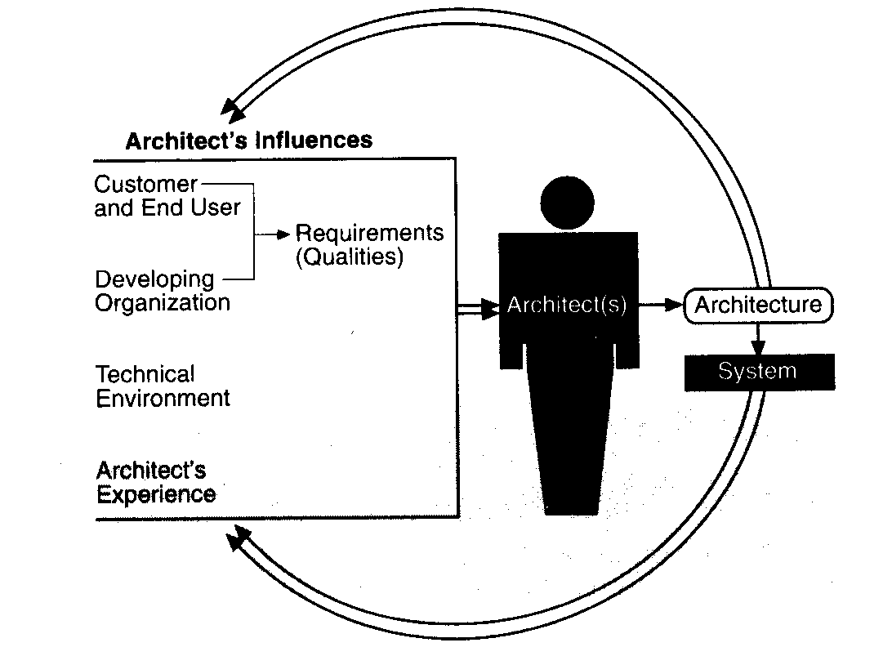
The Architectural Business Cycle

Slide 151
The Architectural Business Cycle
The architecture affects the structure of the developing organisation
Software units prescribed correspond to work assignments
The architecture can affect the enterprise goals of the developing organisation
E.g., open up market opportunities, aid efficient development of product families etc.
The architecture can effect customer requirements for the next system
E.g., through upgradeability etc.,
The architecture adds to the corporate base of experience
The architecture may actually change software engineering culture

Slide 152
Topic 3: Software Architecture and the Built Environment

Slide 153
Architectural Knowledge
ADLs and Notions of ‘Software Architecture Styles’ help us analyze structure better… but how do they help us create architectures?
The built environment has a notion of architecture that goes back to Ancient Egypt
And recently the Royal Institute of British Architects (RIBA) has tried to define what an architect needs to know
Perhaps architecture offers real lessons, not just a metaphor?
It is interesting and important to examine the fundamentals of building construction
Derive a notion of “architectural knowledge” as distinct from “vernacular design”
Notes:
The metaphor of course comes from the built environment. In this section we explore some lessons from that discipline, which has accumulated them from thousands of years of human effort in all parts of the globe, and see if any of them are applicable to Software Architecture.
The approach is determined by a view that it is more useful to ask the question “What is architectural knowledge?” than “What is architecture?”. This in turn is based in part on research of the history of the Royal Institute of British Architects (RIBA) which in the late eighties and early nineties was forced to define architectural knowledge in order to defend its legal rights against the Thatcher Government. In the UK architects are protected by title, not by function. You can only call yourself an architect if you have the appropriate RIBA-endorsed qualifications and credentials, but there is nothing to stop anyone designing a building or a bridge as long as they don’t call themselves architects (exceptions are apparently Naval architects and landscape architects!)
Vernacular design is usually thought to be “design without (explicit) architecture”

Slide 154
Structure
An architecture defines the arrangement of structural elements in a system
Relates to form, function and characteristics
Architectural style is the underlying structuring principle and philosophy
But any structure contains a distribution of responsibility
In complex structures this is often
a sociological as much as a
technical choice
Notes:
Clearly is about building structures in some way, but it is not reducible to the question of structure. Building architects have social and even moral obligations (especially to the environment) and their ‘structural’ decisions have big implications for how the work of construction is organised too.

Slide 155
Space
Construction is both a physical and spatial transformation of a pre-existing situation
At the most elementary level, a building is a construction of physical elements or materials into a more or less stable form, as a result of which space is created which is distinct from the ambient space.
[Hillier1996]
Notes:
This idea of architects carving social space out of ambient space by their building designs is crucial to understanding what architecture is really about. There has been some debate, both historically and currently, about this. Some regard, following Vitruvius presumably, that the building is the machine, but others (Bob Hillier among them) claim that, on the contrary, “space is the machine”. We take the latter view.

Slide 156
Boundaries
Building has a logical aspect too
Separates notions of “inside” and “outside”
Architecture addresses the complex whole of interrelationship between such domains
The drawing of a boundary establishes not only a physical separateness, but also the social separateness of a domain – the protected space – identified with an individual or collectivity which creates and claims special rights in that domain.
[Hillier1996]
Notes:
Boundaries, both physical and virtual, define these social spaces.

Slide 157
Neighborhoods as Domains
The logical structure of an architecture is based on spatial domains…
Buildings, rooms, alcoves, etc.
And connection domains between them...
Streets, alleys, hallways, corridors, doors, etc.
And on how they are configured as a whole
Christopher Alexander strongly reflects this idea of a configuration based on logical coupling, cohesion, and connections in some patterns
Notes:
Clearly then, architecture is expressed through structure, but the configurations of such structures (which themselves define the social spaces) is more to do with the essence of architectural knowledge.

Slide 158
Neighborhood Boundary
“ The strength of the boundary is essential to a neighborhood. If the boundary is too weak the neighborhood will not be able to maintain its own identifiable character….”
“ … Encourage the formation of a boundary around each neighborhood, to separate it from the next door neighborhoods. Form this boundary by closing down streets and limiting access to the neighborhood….”
“ … Place gateways at those points where the restricted access paths cross the boundary; and make the boundary zone wide enough to contain meeting places for the common functions shared by several neighborhoods.”
[Alexander+1977] (pp89-90)
Notes:
It is not too difficult to see in Christopher Alexander’s Neighborhood Boundary pattern some lessons directly applicable to software construction.

Slide 159
Exercise: Configurational Knowledge
Consider the squares in this grid to be spaces; the yellow lines to be walls.
At B3 is an external entrance; use exactly 8 other internal entrances to connect the rooms so that every room is accessible
A
B
C
1
2
3

Slide 160
Configuration of Space
a
b
c

Slide 161
Configuration of Space
In the previous slide 3 notional courtyard buildings are shown
Same basic physical structures and cell division
Same number of internal, external openings
Lower figure highlights space as against normal view of ‘structure’ above
‘Only’ difference is the location of cell entrances
But this radically changes the patterns of movement through the buildings
Which offers more opportunities for “private” space?

Slide 162
Dependencies
Consider rooms A2, B2 and C2 in each of the configurations a, b and c and the routes by which they can be reached etc.
Which other rooms is each directly dependent on?
Which other rooms is each indirectly dependent upon?
Which other rooms directly depend on A2,B2 and C2?
Are there any parallels with software?

Slide 163
Software and “Space”
Software does not deal with physical spaces
But space is not merely a physical construct in architecture of the built environment
Also embodies notions of logical and social spaces
We can consider modules, packages, components etc., to occupy virtual spaces in software
And connectors to be access paths to these spaces which make them interdependent
Therefore the knowledge of how to put modules and connectors together appropriately is configurational

Slide 164
Software, Space and Dependency
A
B
A
B
A
B
C
Notes:
These computational elements (“components”) might be object classes, modules , software components (executables) or layers. But the logical associations between them (“connectors”) are also dependencies. E.g., the top left diagram means A holds a reference to B and B holds a reference to A. Neither can be reused independently of the other. Whereas in the bottom left B can exist independently of A. Cyclical dependencies (right) also compromise reuse, independence and changeability

Slide 165
Architecture Enables Creative Design
Design is a creational and intentional act
Conception and construction of a structure on purpose for a purpose
‘Good’ architecture provides forms which enables creativity rather than dictate design
Form is liberating
Design is the activity of aligning the structure of the application analysis with the available structures of the solution domain
[Coplien1999]

Slide 166
Significance of Office Buildings
Icons of the 20th Century
Office towers dominate the skylines of cities on every continent
At least 50% of the population of industrialised countries work in offices
In function they stand closest to computing
As foci for administrative and information generating work
“Computer” originated as a term for number crunching clerks!
Notes:
The connection between office work, the design of offices and software development has been part of the Janus project for at least two years.

Slide 167
Office Architecture: 2 Traditions
North American vs. North European
Skyscrapers in Chicago, ground hugging buildings in Stockholm
City centre in NA, suburban in NE
Tall and deep in NA, short and narrow in NE
Space efficient in NA, rambling in NE
Corporate domination of requirements in NA, workers’ requirements better reflected in NE

Slide 168
The North American Tradition
Forces driving the North American tradition
Late 19th century economic boom in Chicago and New York
Rapid exploitation of new technology
Steel frame, elevator, electricity, air conditioning
Advances in real estate financing, city planning
Buildings as multipliers of land value, speculator and regulator struggle, “form follows finance”
Taylorist management theory

Slide 169
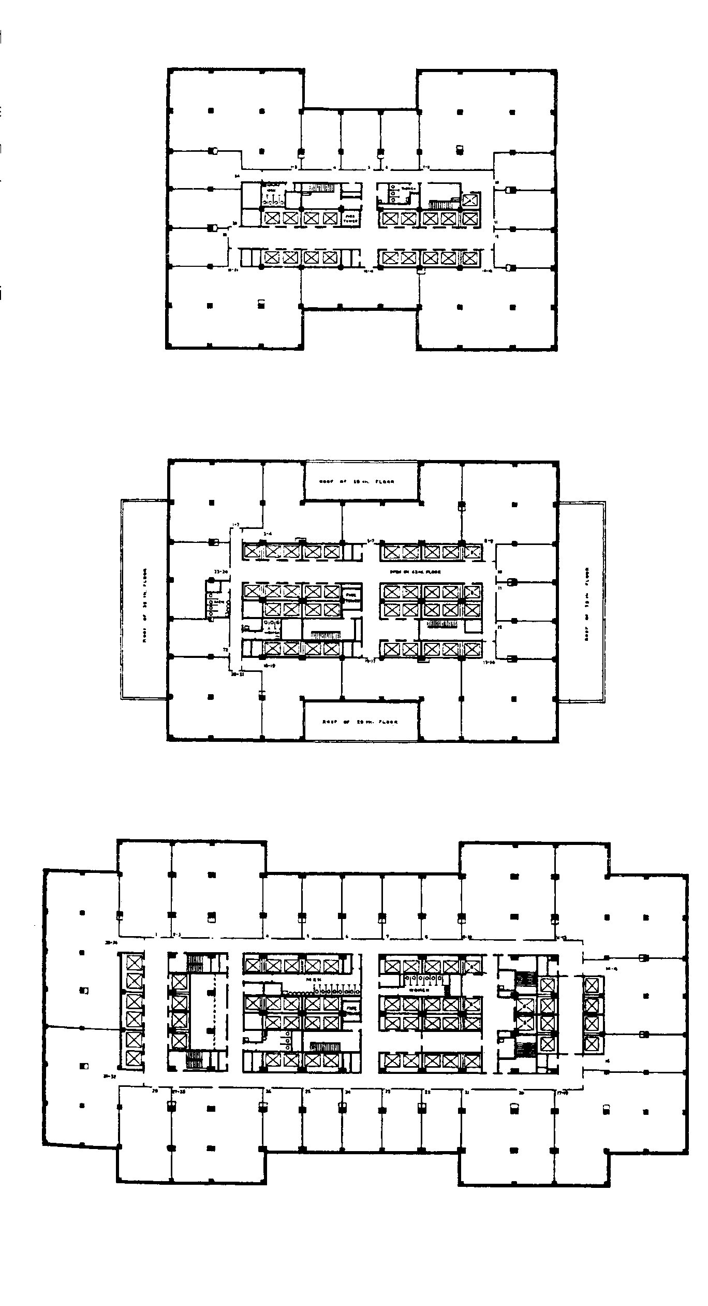
Exemplar: Empire State Building

Slide 170
Exemplar: Empire State Building
Architectural features of the Empire State Building 1930-31
Standardised construction elements to maximise efficiency
Highly service central core on each floor
Surrounded by continuous “race track” of subdivisible, rentable space
Relations between landlord and tenant dominate other (e.g. functional) concerns

Slide 171
The North European Tradition
Forces driving the North European tradition
North European cities have long histories
Historically established patterns of land ownership
Financing
Direct Bank loans, rather than share issues, dominate the financing of construction
Offices often customised for specific uses by client
Social democratic political climate
Statutory based negotiating procedures for working conditions, etc.

Slide 172
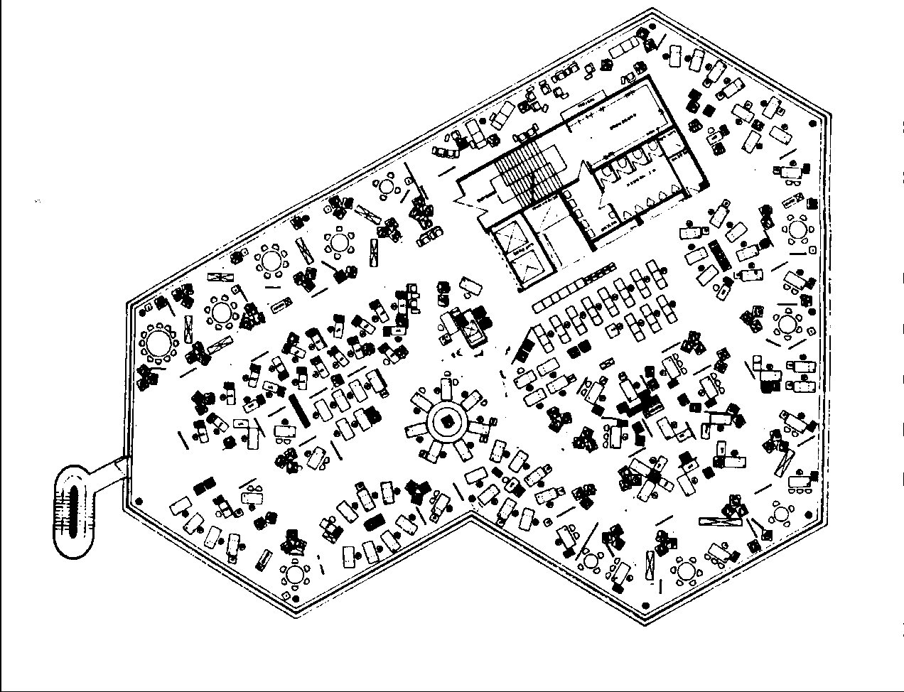
Exemplar: Ninoflex Building

Slide 173
Exemplar: Ninoflex Building
Architecture of the Ninoflax Building, 1962
“Office landscaping”, open plan interiors, wall to wall carpeting, break areas
Complex, dynamic, “more organic” geometry
Based on a theoretical understanding of office processes and communication, rather than needs of syndicated investors/speculators

Slide 174
Office Architecture vs. Design
Complex forces shaping the two traditions reveal themselves only in retrospect
Most office architects took (at least some) of the prevailing forces for granted
The essentially architectural knowledge was hidden, and transmitted culturally
It is clear from this analysis that architecture does not depend on architects, but can exist within the context of what we would normally call the vernacular.
[Hillier1996]
Notes:
Of course there was other aspects of architectural knowledge was involved too, not least of all technical knowledge which was acquired through formal education. One view of design is as a “conversation with materials”. Materials always impact on design possibilities and vice versa.

Slide 175
Architecture as Configurational Knowledge
To summarise, architectural knowledge
Deals with process, organisation as well as “product”
Recognises that the “whole” is greater than the sum of its parts
structure “carves out” space
That a design choice in one place will have unintended side effects elsewhere that have to be imagined
and dealt with in design
Deals with multiple kinds of “spaces”
Physical, logical, social

Slide 176
Architecture as Non-discursive Knowledge
Architecture is knowledge “to-design-with” rather than knowledge “of” a design
This kind of knowledge is inherently difficult to express (“non-discursive”)
Creative, not analytical thought
Is typically acquired socially
“learning-by-doing”
Only becomes explicit when different sets of configurational rules are compared and contrasted
E.g., different “styles” of office building

Slide 177
Exercise: Non-discursive Knowledge
1
5
9
2
4
8
12
14
?
6
3
7
1
5
9
2
4
8
1
25
?
6
3
7
1
5
9
2
4
8
14
15
?
6
3
7
Notes:
The answers will be given in the tutorial. If you timed yourself you probably found the first answer quickly, the second one took more time and the third more time still (assuming you got the right answer!)
Why? Because the configurational knowledge needed to solve the problems changed. Simple additions of the numbers at each side of the triangle gives you the answer at its centre for the yellows.
You probably tried the same schema for the greens and saw it didn’t work using substraction etc. but after a while maybe you multiplied the left-side number by the base-side number and substracted the right-side number to get the result. It worked, so you applied this to the next triangle and so you validated the rule.
So why are the pink triangles so different? Because, misled by your experience of what you did for yellows and greens you probably looked at each triangle independently. But the number in the centre of the first triangle is the sum of all left-sided numbers, the second is the sum of all right-sided numbers and the last is, therefore, the sum of the base-side numbers.
Aside: If you have moved to OO development, having previously been trained in structured methods, you might remember how your previous mindset originally slowed down your ability to solve problems effectively with OO for the same reasons.

Slide 178
Explicit Architecture
Architectural knowledge is, therefore, normatively
Configurational
Non-discursive
It tends to be made explicit only when there is a need to contrast normative approaches
To distinguish Gothic and Romanesque cathedrals
…But it always exists, even in vernacular design
Where it is implicit: “the way things are done here”

Slide 179
Three Filters of Applied Architectural Knowledge
Function imposes restraints on the configuration of space. Hillier (1996) suggests that three ‘filters’ are applied between the ‘field of possibility’ and the architectural reality:
Generic Function
What type of building is it?
Cultural requirements for that type of building
What aspects are typical for this kind of building?
Idiosyncrasies of structure and expression
What uniquely distinguishes this building from all others?

Slide 180
Building for Change
Usage centered approach to office building requires a process that embraces change over time
Changeability is also a feature of the product
The crux both builders and architects face is coming to terms with time. In technical terms this means shifting from a professional industry based on the assumption that the relationship with the client is synchronic (that is, each transaction is separate and each comes at a unique moment in time) whereas we should be trying to devise professional professional and technical services which are diachronic (that is, continuing and developing through time).
[Duffy+1998]

Slide 181
Designing in Slippage
Flexible process requires building in slippage
Recognising that change is both inevitable and necessary over time
“Leeway” has to be designed in so that products do not become brittle when faced with change
We don’t want to have to start again from scratch

Slide 182
Shearing Layers
Shearing layers [Brand1994] underpin the process of new office design
Build in slippage between “layers” so that buildings don’t tear themselves apart as usage changes
Layers constructed on the basis of different change rates
Changes therefore get localised to particular layers
Notes:
This is also a characteristic of eco-systems. In the Amazon rainforests, for example, lifecycles in the canopy are similar to each other: relatively long-lived.At ground-level humming-birds and the flowers they depend upon have similar life-times. Slow-changing “layers” constrain the faster-moving ones.

Slide 183
Lessons for Software Architecture
‘Architectural Knowledge’ is fundamental to successful, usable design in the new millenium
It can be regarded as design imagination
It is by nature ‘configurational’ and often tacit
Especially in vernacular design
It is knowledge that is socially acquired
“Culturally transmitted”
It is both deontic and time-ordered
It is not reducible to “high level structure”
Affects process and organisation too

Slide 184
Topic 4: Masterplans and Piecemeal Growth

Slide 185
The Current Debate on Software Architecture
October 1999 special issue of IEEE Software exposed a debate
Edited by J.O. Coplien
Editorial entitled “Re-eveluating the Metaphor…”
Included text of Chris Alexander’s speech to OOPSLA 1996 conference
Identified two “camps”
Masterplan vs Piecemeal Growth
In the Masterplan camp: Carnegie Mellon’s SEI
In the Piecemeal Growth camp: The Patterns Movement

Slide 186
Characteristics of the Masterplan “camp”
Considers “Architecture” to be gross structure
Constrains, but is separate from, “lower levels of design”
Utilises formal methods to present the semantics of architecture
Emphasis is on design in the abstract
Drawings, models as “blueprints” to be completed before implementation
“Architecture is in the documentation”- Kazman
Formal software engineering processes used to guide practical software building
E.g., Capability Maturity Model (CMM)
Architectural Tradeoff Analysis Method (ATAM)

Slide 187
Characteristics of Piecemeal Growth approach
Rejection of abstract design
Cognitive complexity overcomes individual capacity to understand
Stress on architecture existing at all levels of scale
Including “fine detail”
Emphasis on an holistic, human-centred approach to design
Implies a crisis of traditional Computer Science
Utilisation of “lightweight” processes
E.g., Scrum, DSDM, Xtreme Programming

Slide 188
Philosophical Differences
Carnegie Mellon’s SEI sees architecture as an extension of “software engineering”
Hence reliance on traditional Computer Science themes of formality, automation, process
Holds to a “Logical Positivist” structure of knowledge

Slide 189
Logical Positivism
Logical Positivism is a philosophy of science
Roots date back to Decartes
Dominated academia in the nineteenth, early twentieth century
Now in retreat in all disciplines except Computer Science
Positivism underpins “The Scientific Method”
Scientist is neutral observer/recorder of scientific truths
Theories are established by reproducing observed phenomena in controlled laboratory experiments to test hypotheses

Slide 190
The Positivist Hierarchy of Knowledge
Practical knowledge follows a linear, hierarchical model in this philosophy
First science, then engineering (“applied science”),then problem-solving
Form of Knowledge | Role performed
Science | Discovered by scientist
Engineering | Science applied by engineers
Problem Solving | Techniques applied by craftspeople

Slide 191
Critique of “Computer Science”
The alternative philosophy is “holistic”
Allows for different forms of knowledge
Utilises science from many different disciplines
E.g., anthropology, sociology
Regards computing as a design discipline
As opposed to a branch of mathematics
N.B., this critique is broader than the debate in Software Architecture
E.g., Client-led Design, Human Computer Interaction, criticisms of Prof. Bruce Blum,Michael Jackson’s Problem Frames

Slide 192
Software Development: Blum’s Critique
The essential aim of any software development is the construction of a solution(So) in software that meets a perceived need(N)
N → So
Practically, most processes involve specifying (Sp) the solution (So) in advance of constructing it
N → So {N → Sp,Sp → So}
Notes:
The consideration of Software Architecture requires a return to basics and have a critical attitude to the received wisdom of Computer Science. Most crucially of all this means understanding that the building of software is not an end in itself but only a means to an end. Ends justify means provided, of course, the means lead to the End! In software this means ultimately that the test of a programme is its usability for some task or set of tasks. Typically these reflect “business needs” of one kind or another.

Slide 193
Needs Imply Solutions
(business)
Need
0..1
implies
*
*
(requirements) Specification
0..1
(software) Solution
implies
Notes:
A UML diagram reflecting the generic relationship between Needs, Specifications and Solutions.
The cardinality constraints reflect reality, not some desirable situation. Therefore many software “solutions” get constructed without a Specification, and many Specifications are developed without considering whether they meet real Needs! In general, however, for every Need there is a ‘fan-out’ to many Specifications that could meet that Need, and similarly for every Specification a number of theoretical or real Solutions are possible.
A complicating issue is that Needs tend to be fundamental business needs and are slow-changing, but the processes by which they are accomplished change more rapidly. Changes in business processes always cause changes in tasks and, where any part of such tasks are automated, lead inevitably to changes in the Specifications of the system and software solutions. Solutions, once constructed are also slow moving (typically they are resistant to change)and so the situation arises where the Specification changes more rapidly than either of the two entities (the Need and the Solution) that it supposedly mediates between!

Slide 194
The Process of Software Development
Identify Needs
Specify Requirements
Transformations
Design and Construct Solution
Notes:
If we accept that software developments deliver “Solutions” to “Needs” via “Specifications” then the generic software development process involves these two transformations. The first is heuristical and relatively informal, the second can be rule-based and formal and, to a degree, is automatable.

Slide 195
The Key Transformations
Recall that the mapping of a Need (N) to a Software Solution (So) involves two transformations
N → So {N → Sp,Sp → So}
Computer Science has developed formal means to aid in the production of a solution that meets a requirement
Sp → So
“The program in the computer” (Bruce I. Blum)
We are historically weak in ensuring that the specification meets a need in the first place!
N → Sp
“The program in the world” (Bruce I. Blum)
Notes:
A constructed program therefore has to meet two kinds of tests: as the “program in the computer” it is subject to the formal laws of the machine world in which it must run but as “program in the world” it has to pass the test of usability.
Computer Science, the roots of which lie in mathematical sciences, has made huge advances in ensuring that the “program in the computer” runs according to a given specification. Compilers and other tools are highly automated and have a degree of reliability that was unimaginable in the not too dim and distant past. But we are quite weak in ensuring that the specification being met delivers a useful product. We have seen quoted recently a figure of 16% of software being used “as is” and therefore qualifying as fit for purpose. In fact most software development processes, be they proprietory or non-proprietory, start with a specification and then focus on the difficulties of construction, without any traceability to the business need this specification is supposed to be serving.

Slide 196
Software Development Processes
Most software development processes are
Solution-oriented
The focus is on the ‘program-in-the-computer’ as an end-product
Specification-driven
The process is initiated by a functional specification and tested against it
Deadlines tend to squeeze out design
Since many solutions can meet a specification, effort spent on choosing the best solution is not on the critical path of the project
N.B.All other design disciplines recognise that “problem setting” (creating the spec.) is also part of design
Notes:
The characterisation of most software development being solution-oriented and specification-driven is no compliment. Design is fundamentally problem-centred in every other construction discipline.
The realities of delivery deadlines, and the implications of their enforcement, tend to force design (and by definition) architecture off the critical path of most development projects. Any solution that meets a given specification is theoretically acceptable, and therefore – given general economic and social pressures – those with least cost in money or effort tend to get delivered, not those that offer the best design on offer.

Slide 197
Characteristics of a New Paradigm
‘Use value’ carries a higher premium than ‘provable correctness’
The ultimate test of the ‘program in the computer’ is its usefulness as a ‘program in the world’
An increased attention to Non-functional Requirements
Operational (performance, robustness etc.)
Developmental (reuse, ease-of-maintenance etc.)
The importance of ‘Design’
‘form-fitting’ to meet the above is non-trivial
Notes:
In sum, OO and the technologies it has subsequently enabled, at last gave our industry the freedom to do real design (unfortunately most of us are not trained to design)

Slide 198
Alexander and Piecemeal Growth
Christopher Alexander’s view can be found in his pattern, Gradual Stiffening
He contrasts the work of the master carpenter…
Seems to work smoothly, effortlessly to construct a quality product
But actually builds in slippage and makes corrections through each “iteration”
… with the novice apprentice
“panic stricken by detail”
Needs a complete blueprint before making first step
For FEAR of irrecoverable failure

Slide 199
Alexander: Gradual Stiffening
“ The fundamental philosophy behind the use of pattern languages is that buildings should be uniquely adaptable to individual needs and sites; and that plans of buildings should be rather loose and fluid, in order to accommodate these subtleties…”
“ … Recognise that you are not assembling a building from components like an erector set, but that you are instead weaving a structure which starts out globally complete, but flimsy; then gradually making it stiffer but still rather flimsy; and only finally making it completely stiff and strong….”

Slide 200
What is a Design Pattern (1)?
“There are millions of particular solutions to any given problem; but it may be possible to find some one property which will be common to all these solutions. That is what a pattern tries to do”
Notes:
This quotation appears in the opening chapters of the GOF book.

Slide 201
What is a Design Pattern(2)?
“ Each pattern describes a problem which occurs over and over again in our environment, and then describes the core of the solution to that problem, in such a way that you can use this solution a million times over without ever doing it the same way twice”
Notes:
Also appear in the GOF book. Taken together they give a good overview of the value of catalogue patterns.

Slide 202
What is a Design Pattern (2)?
“…towns and buildings will not be able to come alive unless they are made by all of the people in society and unless these people share a common pattern language within which to make these buildings, and unless the pattern language is alive itself.”
“…we present one possible pattern language….the elements of this language are so-called patterns….”
“Each pattern describes a problem which occurs over and over again in our environment, and then describes the core of the solution to that problem, in such a way that you can use this solution a million times over without ever doing it the same way twice”
Notes:
But this is how the same paragraph is seen in context in Alexander’s original work. Notice the crucial parts of these paragraphs which are not referred to in the GOF book. For Alexander at least a pattern cannot exist outside of a pattern language.

Slide 203
Patterns vs. Pattern Languages
For Alexander
Patterns do not exist outside of a wider “pattern language”
In which the use of one pattern sets the context for the use of others
The pattern language is shareable amongst all “stakeholders” in a development
ADAPTOR represents (part of) an attempt to see whether pattern languages exist for software development

Slide 204
Pattern Languages as Process
A Pattern Language is a system of patterns
But recall that patterns are abstract solutions
They cannot be composed together in advance to produce a solution
Rather each pattern when applied changes the context of the solution
And creates a new context for the next pattern to be applied
Solution is therefore “emerges” from the process itself
N.B. This corresponds to modern “reflective design” theory
E.g., D. Schön “The Reflective Practitioner”

Slide 205
Example of Two Organisational Patterns
Sometimes
development teams
especially in a migration
pilot project are distracted by
“noise”
So - use “Firewall”
to insulate the group
from unwarranted
distractions
Then use a “Gatekeeper”
to filter incoming
information and present it

Slide 206
System Composite
A variation of the Composite pattern [Gamma 1995] allows us to describe any system as recursively composed of subsystems
We can utilise high-level system-wide techniques recursively
Software System
1..*
Component
1..*
links
Connector
Package
1..*
2

Slide 207
Developing an Object Model of the Legacy System
Using Scenarios Define the Problem [Coplien 1995] we employ Use Case analysis to develop descriptions of system and sub-system functionality
(Perhaps using Form Follows Function to partition)

Slide 208
Separating Concerns
The ‘Shamrock’ pattern identifies 3 kinds of packages
The Concept Model(s)
The Interaction Domain(s)
E.g., GUI’s, protocols etc.,
The Infrastructure Domain(s)
Concurrency, Persistence etc.
‘Time-Ordered Coupling’
Reflects Brand’s Shearing Layers
See Appendix A

Slide 209
Encapsulating and “Wrapping” Subsystems
To each subsystem add a Façade object which will present itself as the (sub) system interface to all of its clients. At this stage, the system will be a set of interdependent facades behind which sits legacy code
Notes:
This pattern implements ‘Scaffolding of Interfaces’, another ADAPTOR pattern

Slide 210
Develop Semantic Wrappers
For the parts of the system which will be wrapped, develop objects that reflect the key abstractions
N.B. This requires building an Object analysis model of the legacy system
The implementation of these objects calls existing legacy code…until you want to change that, too! (Semantic Wrapper)

Slide 211
Topic 5: Architecture Description Language (ADL)

Slide 212
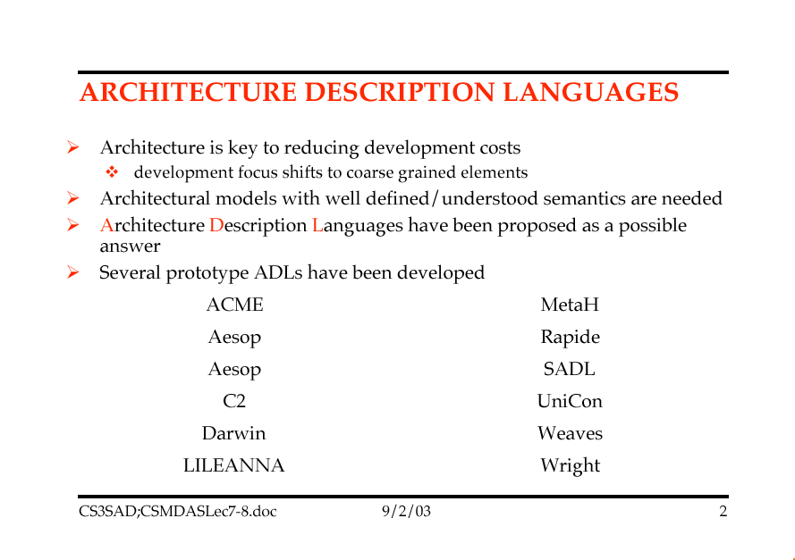

Slide 213
Architecture Definition Languages
An architecture is generally considered to consist of components and the connectors (interactions) between them however we are inconsistent and informal in their use and therefore
Architectural designs are often poorly understood and not amenable to formal analysis or simulation.
(Remember.. How can I evaluate on Architecture over another?)
Architectural design decisions are based more on default than on solid engineering principles.
Architectural constraints assumed in the initial design are not enforced as the system evolves.
Unfortunately there are few tools to help the architectural designers with their tasks.
To address these problems, formal languages for representing and reasoning about software architecture have been developed.
These languages, called architecture description languages (ADLs), seek to increase the understandability and reusability of architectural designs, and enable greater degrees of analysis.
In contrast to Module Interconnection Languages (MILS), which only describe the structure of an implemented system, ADLs are used to define and model (the) system architecture prior to system implementation.

Slide 214
ADL Requirements
Our Original Dilemma
When to pick our architecture over another ?
Characteristics of Architectural Descriptions
Common Patterns of Software Organization
What do all these boxes and interconnecting lines really mean?
Data flow ? Data dependencies?, Control ? , Functional dependencies ? Functional Sequences ?. States & Modes ?
therefore we really do need a more precise way in which to capture and describe an architecture
Examples of Common Components and Interconnections:
Examples of Interactions between these components
Critical Elements of a Design Language
The Language Problem for Software Architecture

Slide 215
ADL Requirements
Examples of Common Components and Interconnections
Computation, Memory, Server, Controller, Link (Interfaces), (list others)
Examples of Interactions between these components
Procedure Call, Data Flow, Message Passing, Shared Data, .. (list Others)
Note that components and interactions are evident across all the architecture styles and their variants.
The good thing .. A common set of primitives (Abstract concepts in an earlier lecture).
Critical Elements of a Design Language
The Language Problem for Software Architecture

Slide 216
ADL Requirements
Critical Elements of a Design Language
Components: Primitive elements and their values
(give examples)
Operators: Functions that combine Components
(give examples)
Abstraction: Naming rules for components and operators
(give examples)
Closure: Rules that determine which abstractions can be added to the classes of components and operators
(give examples)
Specification: Association of semantics with syntactic forms.
(give examples)

Slide 217
ADL Requirements
The Language Problem for Software Architecture
Note: SWA deals with the overall allocation of functions to components, with data and interface connectivity and overall system balance (task allocation, file allocation, dead-lock recovery, fault-tolerance, etc….)
Do conventional programming languages support this ?
Does UML support this ?
Does “Z” support this ?
So where do we go from here ?
So we need a way to allow us to combine the components, operations, interfaces etc into an ARCHITECTURE.
So then why not just use Ada, and CORBA, … etc.?
So where do programming languages fit in the scheme of things ?

Slide 218
ADL Requirements
An ADL therefore must:
Support the description of components and their interactions
Why ?
Handle large-scale, high-level designs
Why?
Support Translation of Design to a Realization
Why ?
Support user-defined or application Specific Abstractions
Why?
Support the Disciplined selection of architectural styles.
Why ?

Slide 219
ADL Requirements
Composition:
“It should be possible to describe a system as a composition of independent components and connections”
This allows us to combine independent elements into larger systems (this is really critical in Network centric independent systems that demonstrate new emergent capabilities when combined together)
An ADL therefore:
Must allow the hierarchical decomposition of and assembly of a system.
Final Decomposed elements must be independent (stand-alone) pieces in their own right.
Must be able to separate architectural design approach from realization approach.
Note: the ADL closure rule must allow us to view entities of an architectural description as primitive at one level and as composite structures at a lower level of decomposition.
Why is this important ?

Slide 220
ADL Requirements
Abstraction:
“It should be possible to describe the components and their interactions within the software architecture in a way that clearly and explicitly describes their abstract roles in a system”
This property will allow us to describe explicitly the kind of architectural elements used and the relationships between the elements
Note the contrast with high level programming languages vs ADL.
For example:
It should be possible to describe an architecture without having to relay on implicit coding conventions or unstated assumptions about the intended realization.
(Remember how benign ACME looks)
Note: It should be able to indicate explicitly that components are related via a Client-Server relationship (regardless of how they might be implemented) NOT implicitly by looking at lower level IDL or procedure calls.
For example I could implement a C-S relationship in “C”. But you would not know that we have C-S relationship unless you went digging through the low level code.)
We want to get away from the code and IDL level. (those are implementation realization, not abstract roles. Ie. We want to be at the Client module and a Server Module level.
Service based Architecture ?

Slide 221
ADL Requirements
Reusability:
“It should be possible to reuse components, connectors, and architectural patterns in different architectural descriptions, even if they were developed outside the context of the system”
This property will allow us to describe families of architectures as an open-ended collection of architectural elements, together with constraints on the structure and semantics.
These Architectural patterns require further instantiation of substructure and indefinite replication of relations.
See the GOF book.
Note that programming languages permit reuse of individual components, FEW make it possible to describe generic patterns of components and connectors.
Programming languages provide module constructs only (Ada) few allow us to talk about collections of modules or structural patterns.
For example a pipeline architecture uses pipes & filters AND also constrains the topology to be a linear sequence (but we cannot describe the topology).

Slide 222
ADL Requirements
Configuration:
“Architectural Descriptions should localize the description of system structure independently of the elements being structured. They should also support dynamic reconfiguration.”
This property allows us to understand and change the architectural structure of a system without having to examine each of the systems individual components.
Therefore an ADL should separate the description of composite structures from the elements in these compositions so that we can reason about the composition as a whole.
See the comment on dynamic architectures in your text.

Slide 223
ADL Requirements
Heterogeneity:
“It should be possible to combine multiple, heterogeneous architectural descriptions”
This property will allow us to:
Combine single combined different architectural patterns into a single system.
Combine components written in different languages
(marshaling).
Module connection systems that support interaction between distinct address spaces often provide this capability (see book examples)

Slide 224
ADL Requirements
Analysis:
“It should be possible to perform rich and varied analyses of architectural descriptions”
Note that current module connection languages (Ada) provide only weak support for analysis. (only type checking at component boundaries)
Note how JINI has started to address the issue of event broadcast.
Need to associate an specification with an architecture as they become relevant to a particular components, connections, and patterns.

Slide 225
Problems with Existing Languages
Informal Diagrams
Programming Language Modularization Facilities
Module Interconnect Languages
Support for Alternative Kinds of Interaction
Specialized Notation for Certain Architectural Styles

Slide 226
Informal Diagrams
Informal diagrams are used to express many ideas:
the boxes can represent anything from components to functions,
the interconnections are equally vague at identifying the interaction they were meant to convey.
Data flow? , Control Flow? , Event Handling? Inheritance ? , etc.
Note that although they intuitively convey the architecture, they are limited in the use for analysis
WS (1)
WS (…)
WS (n)
UI
UI
UI
Functions..
Functions..
DBMS
The System
UI
Functions..
DBMS
UI
Functions..
DBMS

Slide 227
SADL: Structural Architecture Description Language
SADL (Stanford): A Language for Specifying Software Architecture Hierarchies
Sadl is programming language independent, intended for both abstract and concrete modeling of system architectures.
The Sadl language provides a precise textual notation for describing software architectures while retaining the intuitive box­and­arrow model.
(Sadl) makes a clean distinction between several kinds of architectural objects (e.g., components and connectors) and make explicit their intended uses.
The Sadl language provides facilities for specifying architectures and for also specifying well­formed ness constraints on particular classes of architectures.
For example, it is possible to specify not only the kinds of components and connections in, client­server and blackboard systems, but also the intended configurations of the components and connections.
Sadl can be used to describe the architecture of a specific system or a family of systems.

Slide 228
SADL: Structural Architecture Description Language
A vertical hierarchy serves to bridge the gap between abstractions in architectures and the more primitive structural concepts in conventional programming languages.
Each level in a vertical hierarchy typically is described using a different vocabulary, reflecting a change in representation.
For example, a pipe­and­filter architecture would be described using a different vocabulary than an event­based architecture.
A horizontal hierarchy is analogous to ``bubble decomposition'' in dataflow modeling, where the same vocabulary is used to describe every level in the decomposition.

Slide 229
SADL: Structural Architecture Description Language
The Sadl language is intended to be used in describing both vertical and horizontal hierarchy and in relating different levels of representation by means of mappings.
They also make it possible to reason about the relationship among architectures in a hierarchy and the relation between the hierarchy and its implementation.
For example, we can determine whether the architectural objects in one architecture are present in the other even if there is a change in representation.
We also can show that, if a particular communication path is not allowed in one architecture, it is not allowed in others in the hierarchy.
An architecture hierarchy may describe a specific system or a family of systems.

Slide 230
SADL: Structural Architecture Description Language
Sadl can be used to represent the following architectural elements.
1. Architecture. An architecture is a, possibly parameterized, collection of the following items.
(a) Component. A component represents a locus of computation or a data store.
The various types of components include a module, process, procedure, or variable.
A component has a name, a type (a subtype of type COMPONENT), and an interface, the ports of the component.
A port is a logical point of interaction between a component and its environment.
A port has a name, a type, and is designated for input or output.

Slide 231
SADL: Structural Architecture Description Language
(b) Connector.
A connector is a typed object (a subtype of type CONNECTOR) relating ports.
Every connector is required to accept values of a given type on one end and to produce output values of the same type on the other.
(c) Configuration.
A configuration constrains the wiring of components and connectors into an architecture.
A configuration can contain two kinds of elements.
Connections. A connection associates type­compatible connectors and ports.
Constraints. Constraints are used to relate named objects or to place semantic restrictions on how they can be related in an architecture.

Slide 232
SADL: Structural Architecture Description Language
Mapping.
A mapping is a relation that defines a syntactical interpretation from the language of an abstract architecture to the language of a concrete architecture.
Architectural style.
A style consists of a vocabulary of design elements, well formed-ness constraints that determine how they can be used, any semantic constraints needed for refinement, and a logical definition of the semantics of the connectors associated with the style.
A constraint is declarative and might say, for example, that clients initiate communication with servers, but not vice versa.
A given architecture may be homogeneous, involving one style, or heterogeneous, involving multiple styles.

Slide 233
SADL: Structural Architecture Description Language
Refinement pattern.
A refinement pattern consists of two architecture schemas, an association of the objects in the two schemas, and possibly constraints on one or both schemas.
An instance of a pattern is formed by matching schema variables against the appropriate portions of Sadl specifications.
Components, interfaces, connectors, and constraints:
Are treated as first­class objects --- i.e., they are named and typed objects that can appear as parameters.
They can be refined into (decomposed, aggregated, or eliminated) objects in more concrete architectures.

Slide 234
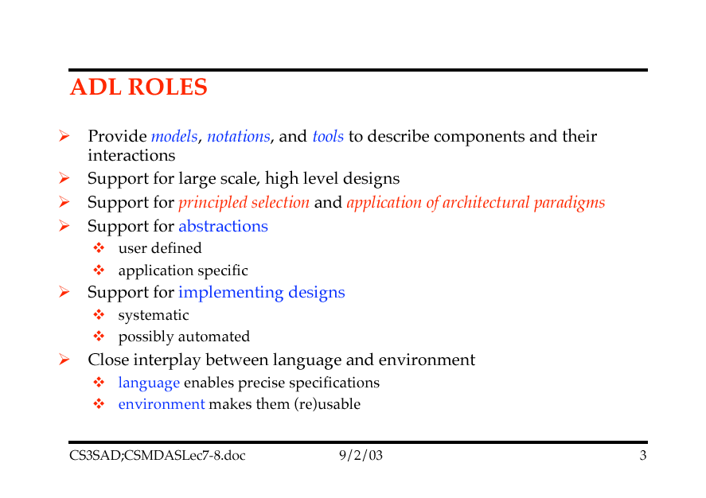

Slide 235
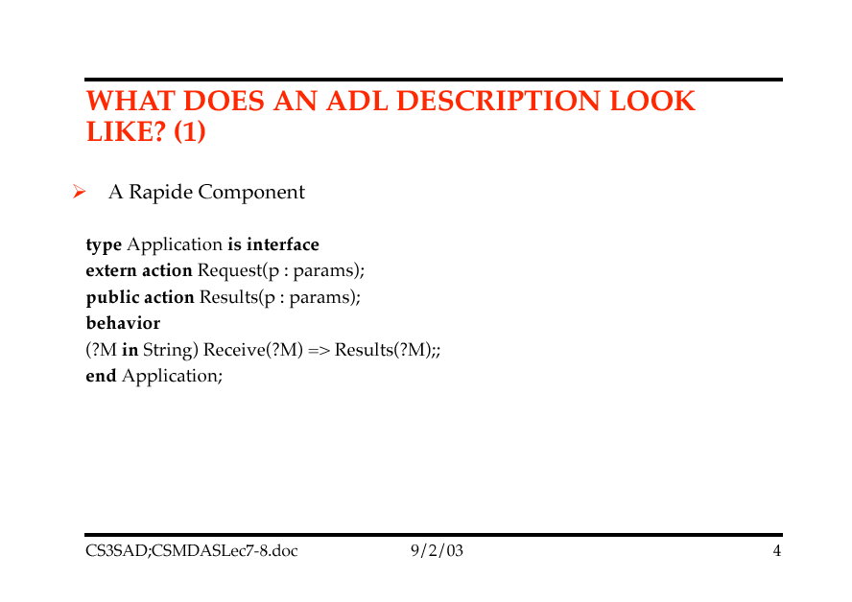

Slide 236
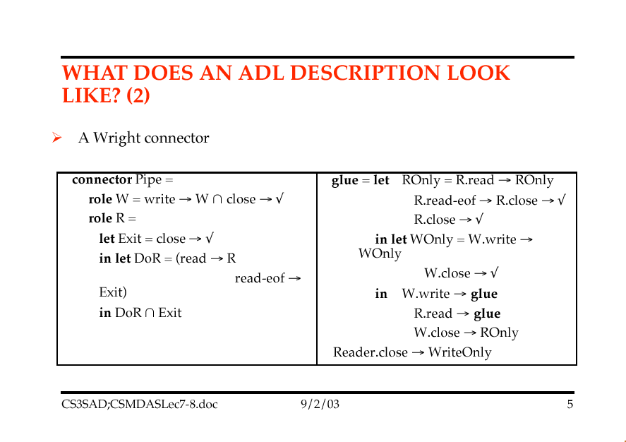

Slide 237
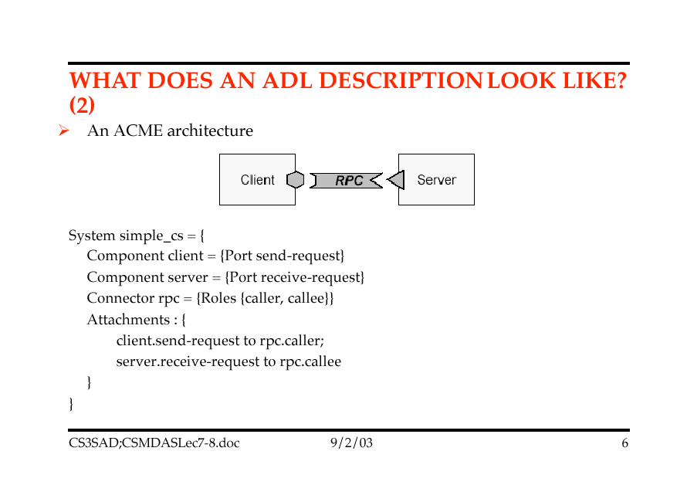

Slide 238
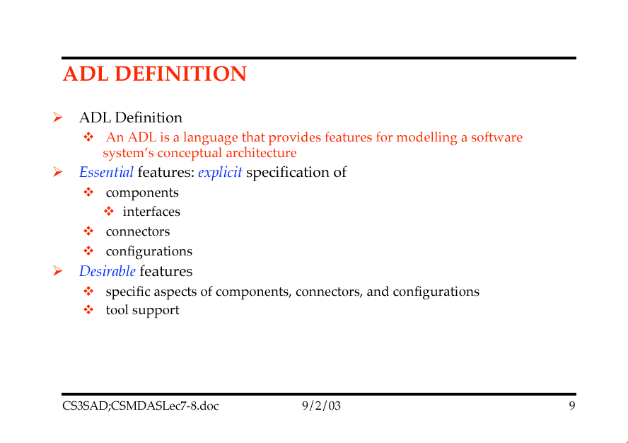

Slide 239
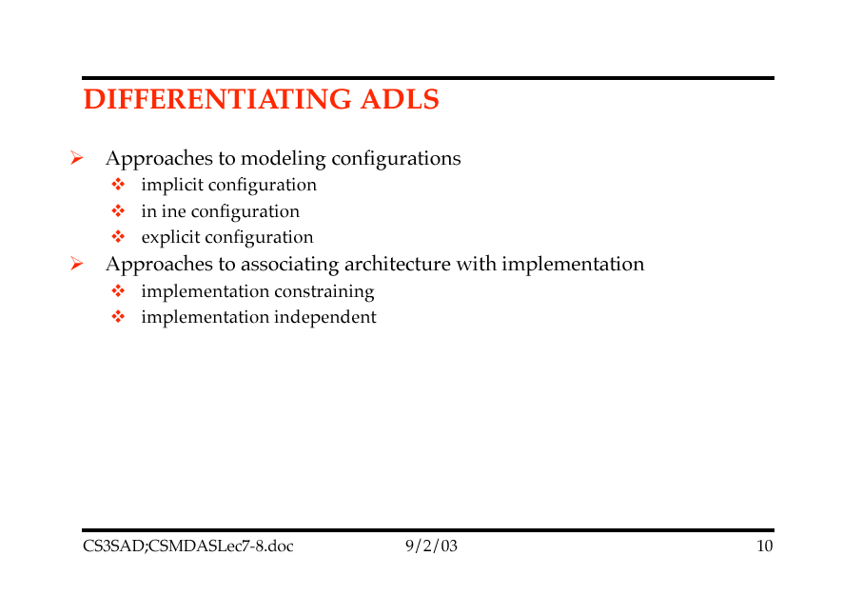

Slide 240
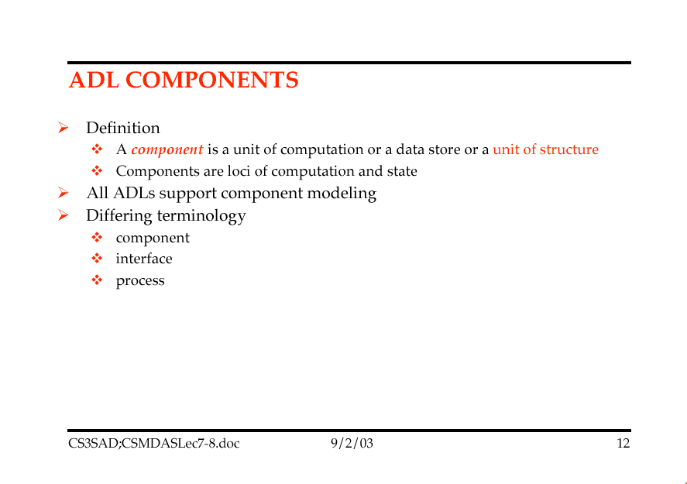

Slide 241


Slide 242


Slide 243


Slide 244


Slide 245


Slide 246


Slide 247


Slide 248
Architectural Description Languages
Architectural Description Languages can be evaluated or described by listing the following:
System-oriented attributes
Language-oriented attributes
Process-oriented attributes

Slide 249
ADLs: System-Oriented Attributes
How suitable is the ADL for representing a particular type of application?
How well does the ADL allow descriptions of architectural style?
What broad classes of system can have their architectures represented in the ADL?
E.g., hard real-time, distributed, embedded etc.,

Slide 250
ADL’s: Language-Oriented Attributes
Syntax and semantics formally defined?
Does the ADL define completeness for an architecture
Does the ADL support the ability to add new types of components, connectors
How easily is the software architecture description modified?
How saleable are its descriptions etc.,

Slide 251
ADL’s: Process-Oriented Descriptions
Is there a textual editor or tool for manipulating ADL text?
Is there a graphical editor?
Can the tool import information from other descriptions into the architecture?
Does the ADL support incremental refinement?
Does the ADL support comparison between two architectures?

Slide 252
Topic 6: Architectural Styles

Slide 253
Architectural Styles
Shaw and Garlan present a number of architectural styles, identified by asking:
What is the design vocabulary ?
types of connectors and components
What are the allowable structural patterns?
What is the underlying computational model?
What are the essential invariants of the style?
What are some common examples of its use?
What are the advantages/disadvantages of use?
What are the common specialisations?

Slide 254


Slide 255


Slide 256


Slide 257


Slide 258


Slide 259


Slide 260


Slide 261


Slide 262


Slide 263


Slide 264


Slide 265


Slide 266


Slide 267


Slide 268


Slide 269


Slide 270


Slide 271


Slide 272


Slide 273


Slide 274


Slide 275


Slide 276


Slide 277


Slide 278

Software architecture styles
Aim similar to Design Patterns work: classify styles of software architecture
Characterizations are more abstract; no attempt to represent them directly as code

Slide 279





Software architecture styles
An architectural style is defined by
Type of basic architectural components
(e.g. classes, filters, databases, layers)
Type of connectors
(e.g. calls, pipes, inheritance, event broadcast)

Slide 280
Architecture styles
Overall system organization:
Hierarchical
Client-server
Cloud-based
Peer-to-peer
Individual program structuring:
Control-based
Call-and-return (Subroutine-based)
Coroutine-based
Dataflow:
Pipes and filters
Blackboard
Event-driven
Object-oriented

Slide 281
Hierarchical
Each layer provides services to the layer above it and acts as a client of the layer below
Each layer collects services at a particular level of
abstraction
A layer depends only on lower layers
Has no knowledge of higher layers
Example
Communication protocols
Operating systems

Slide 282
Hierarchical
Components
Group of subtasks which implement an abstraction at some layer in the hierarchy
Connectors
Protocols that define how the layers interact

Slide 283
Hierarchical: examples
THE operating system (Dijkstra) The OSI Networking Model
Each level supports communication at a level of
abstraction
Protocol specifies behavior at each level of abstraction
Each layer deals with specific level of communication
and uses services of the next lower level
Layers can be exchanged
Example: Token Ring for Ethernet on Data Link
Layer

Slide 284
OSI model layers
Application
The system you are designing
Data transformation services, such as byte swapping and encryption
Initializes a connection, including authentication
Reliably transmits messages
Presentation
Session
Transport
Network
Transmits & routes data within network
Data Link
Sends & receives frames without error
Physical
Sends and receives bits over a channel

Slide 285
Hierarchical style example
Application
Use service of
lower layer
Application
Presentation
Presentation
Session
Virtual
connection
Session
Transport
Transport
Network
Network
Network
Data Link
Data Link
Data Link
Physical
Physical
Physical

Slide 286
Hierarchical: discussion
Strengths:
Separation into levels of abstraction; helps partition complex problems
Low coupling: each layer is (in principle) permitted to interact only with layer immediately above and under
Extendibility: changes can be limited to one layer
Reusability: implementation of a layer can be reused
Weaknesses:
Performance overhead from going through layers
Strict discipline often bypassed in practice

Slide 287





Client-server
Components
Subsystems, designed as independent processes
Each server provides specific services, e.g. printing,
database access
Clients use these services Connectors
Data streams, typically over a communication
network
Client
Client
Network
Server
Client

Slide 288
Client -server example: databases
Clients: user applications
Customized user interface
Front-end processing of data
Initiation of server remote procedure calls
Access to database server across the network
Server: DBMS, provides:
Centralized data management
Data integrity and database consistency
Data security
Concurrent access
Centralized processing

Slide 289
Client-server variants
Thick / fat client
Does as much processing as possible
Passes only data required for communications and
archival storage to the server
Advantage: less network bandwidth, fewer server requirements
Thin client
Has little or no application logic
Depends primarily on server for processing
Advantage: lower IT admin costs, easier to secure, lower hardware costs.

Slide 290
Client-server: discussion
Strengths:
Makes effective use of networked systems
May allow for cheaper hardware
Easy to add new servers or upgrade existing servers
Availability (redundancy) may be straightforward
Weaknesses:
Data interchange can be hampered by different data layouts
Communication may be expensive
Data integrity functionality must be implemented for each server
Single point of failure

Slide 291
Client-server variant: cloud computing
The server is no longer on a company’s network, but hosted on the Internet, typically by a providing company
Example: cloud services by Google, Amazon, Microsoft
Advantages:
Scalability
Many issues such as security, availability, reliability
are handled centrally
Disadvantages:
Loss of control
Dependency on Internet

Slide 292






Peer-to-peer
Similar to client-server style, but each component is both client and server
Pure peer-to-peer style
No central server, no central router Hybrid peer-to-peer style
Central server keeps information on peers and responds to requests for that information
Examples
File sharing applications, e.g., Napster
Communication and collaboration, e.g., Skype

Slide 293
Peer-to-peer: discussion
Strengths:
Efficiency: all clients provide resources
Scalability: system capacity grows with number of clients
Robustness
Data is replicated over peers
No single point of failure (in pure peer-to-peer style)
Weaknesses:
Architectural complexity
Resources are distributed and not always available
More demanding of peers (compared to client-server)
New technology not fully understood

Slide 294
Call-and-return
Components: Objects
Connectors: Messages (routine invocations) Key aspects
Object preserves integrity of representation
(encapsulation)
Representation is hidden from client objects Variations
Objects as concurrent tasks

Slide 295
Call-and-return
Strengths:
Change implementation without affecting clients
Can break problems into interacting agents
Can distribute across multiple machines or networks
Weaknesses:
Objects must know their interaction partners; when partner
changes, clients must change
Side effects: if A uses B and C uses B, then C’s effects on B
can be unexpected to A

Slide 296






Subroutines
Similar to hierarchical structuring at the program level
Functional decomposition
Topmost functional abstraction
A
B
C
D
E1
I
I1
C2
I2

Slide 297
Subroutines
Advantages:
Clear, well-understood decomposition
Based on analysis of system’s function
Supports top-down development
Disadvantages:
Tends to focus on just one function
Downplays the role of data
Strict master-slave relationship; subroutine loses context each time it terminates
Adapted to the design of individual functional pieces, not entire system

Slide 298
Dataflow systems
Availability of data controls the computation
The structure is determined by the orderly motion of data from component to component
Variations:
Control: push versus pull
Degree of concurrency
Topology

Slide 299




Dataflow: batch-sequential
Frequent architecture in scientific computing and business data processing
Components are independent programs
Connectors are media, typically files
Each step runs to completion before next step begins
File
Program
Program
Program
Component

Slide 300
Batch-sequential
History: mainframes and magnetic tape
Business data processing
Discrete transactions of predetermined type and
occurring at periodic intervals
Creation of periodic reports based on periodic data updates
Examples
Payroll computations
Tax reports

Slide 301


Dataflow: pipe-and-filter
Component: filter
Reads input stream (or streams)
Locally transforms data
Produces output stream (s)
Connector: pipe
stream, e.g., FIFO buffer
Pipe
Filter
Filter
Filter
Filter
Filter

Slide 302
Pipe-and-filter
Data processed incrementally as it arrives Output can begin before input fully consumed
Filters must be independent: no shared state
Filters don’t know upstream or downstream filters
Examples
lex/yacc-based compiler (scan, parse, generate…)
Unix pipes
Image / signal processing

Slide 303







Push pipeline with active source
Source of each pipe pushes data downstream Example with Unix pipes:
grep p1 ∗ | grep p2 | wc | tee my_file
dataSource
filter1
filter2
dataSink
f1( data )
write( data )
f2( data )
write( data )
Active source
Push

Slide 304






Pull pipeline with active sink
dataSink
filter1
filter2
dataSource
data := next
data := next
data := next
Active
Pull
f2 (data)
sink
f1 (data)
Sink of each pipe pulls data from upstream
Example: Compiler: t := lexer.next_token

Slide 305






Combining push and pull
Synchronization required:
dataSink
filter1
filter2
dataSource
data := read( )
Active filter
data := read( )
Pull
f2( data )
Push
f1( data )
write( data )

Slide 306
Pipe-and-filter: discussion
Strengths:
Reuse: any two filters can be connected if they agree on data format
Ease of maintenance: filters can be added or replaced
Potential for parallelism: filters implemented as separate
tasks, consuming and producing data incrementally
Weaknesses:
Sharing global data expensive or limiting
Scheme is highly dependent on order of filters
Can be difficult to design incremental filters
Not appropriate for interactive applications
Error handling difficult: what if an intermediate filter
crashes?
Data type must be greatest common denominator, e.g.
ASCII

Slide 307




Dataflow: event-based (publish-subscribe)
A component may:
Announce events
Register a callback for events of other components
Connectors are the bindings between event announcements and routine calls (callbacks)
Routine
Routine
Routine
Routine

Slide 308
Event-based style: properties
Publishers of events do not know which components (subscribers) will be affected by those events
Components cannot make assumptions about ordering of processing, or what processing will occur as a result of their events
Examples
Programming environment tool integration
User interfaces (Model-View-Controller)
Syntax-directed editors to support incremental semantic checking

Slide 309
Event-based style: example
Integrating tools in a shared environment
Editor announces it has finished editing a module
Compiler registers for such announcements and
automatically re-compiles module
Editor shows syntax errors reported by compiler Debugger announces it has reached a breakpoint
Editor registers for such announcements and
automatically scrolls to relevant source line

Slide 310
Event-based: discussion
Strengths:
Strong support for reuse: plug in new components by registering it for events
Maintenance: add and replace components with minimum
effect on other components in the system
Weaknesses:
Loss of control:
What components will respond to an event?
In which order will components be invoked?
Are invoked components finished?
Correctness hard to ensure: depends on context and
order of invocation

Slide 311






Data-centered (repository)
Components
Central data store component represents state
Independent components operate on data store
Knowledge Source
Direct access
Knowledge
Source
Repository
Knowledge
Source
Computation

Slide 312
Data-Centered: discussion
Strengths:
Efficient way to share large amounts of data
Data integrity localized to repository module
Weaknesses:
Subsystems must agree (i.e., compromise) on a
repository data model
Schema evolution is difficult and expensive
Distribution can be a problem

Slide 313
Blackboard architecture
Interactions among knowledge sources solely through repository
Knowledge sources make changes to the shared data that
lead incrementally to solution
Control is driven entirely by the state of the blackboard
Example
Repository: modern compilers act on shared data:
symbol table, abstract syntax tree
Blackboard: signal and speech processing

Slide 314
Interpreters
Architecture is based on a virtual machine produced in software
Special kind of a layered architecture where a layer is implemented as a true language interpreter Components
“Program” being executed and its data
Interpretation engine and its state
Example: Java Virtual Machine
Java code translated to platform independent bytecode
JVM is platform specific and interprets the
bytecode

Slide 315
Object-oriented
Based on analyzing the types of objects in the system and deriving the architecture from them
Compendium of techniques meant to enhance extendibility and reusability: contracts, genericity, inheritance, polymorphism, dynamic binding…
Thanks to broad notion of what an “object” is (e.g. a command, an event producer, an interpreter…), allows many of the previously discussed styles

Slide 316
Conclusion: assessing architectures
General style can be discussed ahead of time Know pros and cons
Architectural styles → Patterns → Components

Slide 317
Architectural Style
An architectural style is a description of component types and their topology.
It also includes a description of the pattern of data and control interaction among the components and an informal description of the benefits and drawbacks of using that style.
Architectural styles define classes of designs along with their associated known properties.
They offer experience-based evidence of how each class has been used historically, along with qualitative reasoning to explain why each class has its specific properties. (patterns)

Slide 318
Architecture Styles
Looking for a Uniform Description of an Architecture
Which kinds of Components and connectors are used in the style
Examples: programs, objects, processes, filters
The allowable kinds of components and connectors are primary discriminants among the styles, however the following four items also contribute to defining the particular style
How is control shared, allocated m and transferred among the components
Topology : ? Linear (non-branching) , ? A cyclical, ? Hierarchical, ? Star , ? Arbitrary, ? Static or Dynamic
Synchronicity: ? Lockstep (sequential or parallel depending on the threads of control) , ? Synchronous, ? Asynchronous
How is data communicated through the system
Data Flow Topology as above for control
Continuity: Continuous Flow: fresh data available at all times, Sporadic Flow, High-Volume vs Low Volume (see USB)
(? How much network band-with is / can be dedicated to data synchronization)
Mode: Describes how data is made available throughout the system
Object style: data is passed from component to component
Shared data style: data is made available in a place accessible to all
Copy out- Copy In mode, vs. broadcast or multicast,
How do Data and control interact
(data flow & topology vs. control flow & topology)
Pipe & Filter (data & control pass together) vs. Client-Server control flows into the servers and data flows in to the clients.
What type of reasoning (analysis) is compatible with the style
Asynchronously operating components (Non-deterministic) vs. fixed sequence of atomic steps,

Slide 319
A View of Architecture Styles
Data Flow
(1) Batch Sequential (traditional systems) & Pipeline Systems
(2) Pipes & Filters (Linked Stream transformers)
Call & return
(3) Main Program & Subroutine
(4) OO Systems
(5) Hierarchical Layers
Independent Components
(6) Communicating Processes
(7) Event Systems
Virtual Machines
(8) Interpreters
(9) Rule-Base systems
Data-Centered Systems (Repository)
(10) Databases
(11) Hypertext Systems
(12) Blackboards
(13) Distributed Processing Styles
(14) Process Control Styl

Slide 320
Batch Sequential
General Constructs:
Processing Steps are independent programs
Each steps runs to completion before the next program starts
Data is transmitted in complete data sets between programs
Historically used in Data processing
Needs a scheduler to submit the jobs (jcl)
Advantages:
Allows the designer to understand the system in terms of business process steps.
Easy to maintain (supposedly) and add new or replace programs. However experience has shown that program and data stores are really tied to the business process.
Disadvantages:
Not good at interactive applications
Limited Support for concurrent execution as each program needs ALL the data before it starts.
Need to get ALL the data through the system before we can really see results.
Not responsive to changes, No Event Handling, No Fault Tolerance, Many many problems if tapes are run out of sequence.

Slide 321
Suggested Batch Sequential Style
Scheduler
Data
Store
(1)
Data
Store
(2)
Program 1
Program 2
Program (n)
Components are the Programs and Data stores.
Connectors are one way pipes that transfer bulk data sets.

Slide 322
Pipe & Filter (Pipeline)Architecture Styles
General Constructs:
Pipes move data between filters.
The Filters must be independent entities and do NOT share state with other filters.
Filters Do NOT know their sources and sinks of data.
The correctness of the output of a pipe & filter network should not depend on the order in which the filters preformed their processing.
Examples: Image Processing, Unix pipe shell programs, Compilers
Advantages:
Allow the designer to to understand the system in terms of composition of filters.
Support Re-Use
Easy to maintain and add new or replace old filters.
Permit specialized analyses: (Throughput & deadlock)
Each filter can be implemented as a separate task and executed in parallel with other filters.
Disadvantages:
Not good at interactive applications, incremental display updates
May need to maintain connections between separate yet related streams.
Different filters types may therefore require a common representation (packing & unpacking costs)
Each event handled from font to back.
Program 1
Program 2
Program (n)

Slide 323
One way Data Flow Through a Network of Filters
Filters can be interconnected in different ways
As long as the input assumptions and output behaviors are the same, one filter process or a network of filters can be replaced by a different implementation of a filter process or network that accomplish the same tasks.
The output of a filter process is a function of its input
This specification relates the value of messages sent on output channels to the values of messages received on input channels.
The actions a filter takes in response to receiving input must ensure this relation every time the filter sends output.
Requires us to understand and specify our communication and underlying data assumptions.
The output produced by one filter meet the input assumptions of another.

Slide 324
Call & Return Style: Mainframe
General Constructs:
All intelligence is within the central host computer.
Users interact with the host through a terminal that captures keystrokes and sends that information to the host.
Advantages:
Mainframe software architectures are not tied to a hardware platform.
User interaction performed with workstations.
Disadvantages:
A limitation of mainframe software architectures is that they do not easily support graphical user interfaces or access to multiple databases from geographically dispersed sites.
Mainframes have found a use as a server in distributed client/server architectures
UI
Note the connectors may be two-way as contrasted with the dataflow style as we have control from UI to Mainframe and Data from the Mainframe to UI
Main Frame

Slide 325
Call & Return Style: File Sharing
General Constructs:
The original PC networks were based on file sharing architectures, where the server downloads files from the shared location to the desktop environment.
The requested user job is then run (including logic and data) in the desktop environment.
Advantages:
File sharing architectures work if shared usage is low, update contention is low, and the volume of data to be transferred is low.
Disadvantages:
In the 1990s, PC LAN (local area network) computing changed because the capacity of the file sharing was strained as the number of online user grew (it can only satisfy about 12 users simultaneously) and graphical user interfaces (GUIs) became popular (making mainframe and terminal displays appear out of date).
Addendum:
PCs are now being used in client/server architectures.

Slide 326
Suggested File Sharing Architecture
Application
Application (n)
Buffer
:
Buffer
Data
Control
Buffer
:
Buffer
:
Main frame
File
File (n)

Slide 327
Data Abstraction & OO Architecture
General Constructs:
Data representations and their associated operations encapsulated in an abstract data type.
The components are the objects and connectors operate through procedure calls (methods).
Objects maintain the integrity of a resource and the representation is hidden from others.
Advantages:
Server is able to change an implementation without affecting the client.
Grouping of methods with objects allows for more modular design and therefore decomposes the problems into a series of collections of interacting agents.
Disadvantages:
For one object to interact with another, the client object must know how to interact with the server object and therefore must know the identity of the server.
If the server changes its interface ALL interacting clients must also change.
Services declared as PUBLIC and IMPORTED into the CLIENT
Also need to consider side affects, A uses B , B uses C and we mod C

Slide 328
Hierarchical Layered Architecture Styles
Layered Systems
General Constructs
A layered system is organized hierarchically with each layer providing service to the layer above it and serving as a client to the layer below.
In some systems inner layers are hidden from all except the adjacent outer layer.
Connectors are defined by the protocols that determine how layers will interact.
Constraints include limiting interactions to adjacent layers. The best known example of this style appears in layered communication protocols OSI-ISO (Open Systems Interconnection - International Standards Organization) communication system.
Lower levels describe hardware connections and higher levels describe application.
GUI
Application Layer
DBMS
OS Layer

Slide 329
Hierarchical Layered Architecture Styles
Issues:
No one agrees exactly on what a 'layer' is.
For example, some layering schemes have very little relationship to the runtime.
Others confuse layers with a 'tiered' runtime architecture where the various layers are not only split by build-time packaging, but by running in different processes and possibly different nodes at run time.
Clearly separate the idea of 'tiers' from ‘layers'.
A tier is a structure for runtime component interaction that implies nothing about the construction of the build time.
For example, a 3 tier system may be composed of a web browser, web server/asp pages, and database.
Note that each tier runs in a different process and possibly many different system nodes.

Slide 330
Hierarchical Layered Architecture Styles
Layers is a pattern for 'application architectures'.
Layers are normally thought of as a build-time structuring technique for building an application or service that will execute in a single process.
There are many variations on the layers pattern.
Four-layer architecture (analysis)
Layered and sectioned architecture
Layered architecture
Layers (from POSA1)
Patterns for generating a layered architecture
Relational database access layer
Secure access layer (analysis)
GUI
Application Layer
DBMS
OS Layer

Slide 331
Hierarchical Layered Architecture Styles
Layered Systems
Advantages:
Layered systems support designs based on increasing levels of abstraction.
Complex problems may be partitioned into a series of steps.
Enhancement is supported through limiting the number of other layers with which communication occurs.
Disadvantages:
Disadvantages include the difficulty in structuring some systems into a layers.
Performance considerations may not be well served by layered systems especially when high level functions require close coupling to low level implementations.
It may be difficult to find the right level of abstraction especially if existing systems cross several layers.

Slide 332
Communicating Processes
Each component has it's own thread of execution.
The Provider/Observer Role Pattern
Push and Pull Interaction Patterns
Opaque Interaction Patterns
Synchronous Opaque Interaction Patterns
Asynchronous Opaque Interaction Patterns
Monitorable Interaction Patterns
Pull-Monitorable Interaction Patterns
Push-Monitorable Interaction Patterns
Abortable Interaction Patterns
Abortable Async Opaque Interaction Patterns
Abortable Pull-Monitorable Interaction Patterns
Abortable Push-Monitorable Interactions Patterns
Handshaking Patterns
Combining Patterns
The components are the objects and connectors operate through message passing.
Components are often in separate process spaces
Object 1
Object 2

Slide 333
Independent ComEvent Based Architecture Styles
Event-Based Implicit Invocation (Look at Jini)
General Constructs:
A component announces (broadcasts) one or more events.
System Components register interest in an event by associating a procedure with it.
The system invokes all events which have registered with it.
Event announcement ``implicitly'' causes the invocation of procedures in other models.
This style originates in constraint satisfaction (Planning), daemons, and packet-switched networks.
Used in Planning Domains
Architectural components are modules whose interface provides both a collection of procedures and a set of events.
Procedures may be called normally or be registered with events in the system.
Implicit invocation systems are used in:
programming environments to integrate tools
database management systems to ensure consistency constraints
user interfaces to separate data from representation

Slide 334
Event Based Architecture Styles
Event-Based Implicit Invocation
Advantages:
Allows any component to register for events
Eases system evolution by allowing components to be replaced without affecting the interfaces of other components in the system.
Disadvantages:
Components relinquish control over the computation performed by the system.
A component cannot assume that other components will respond to its requests
A component does not know in which order events will be processed.
In systems with a shared repository of data the performance and accuracy of the resource manager can become critical.
Reasoning about correctness can be difficult because the meaning of a procedure that announces events will depend on the context in which it was invoked.

Slide 335
Event Based Architecture Styles
The first paper predates (1996) the JINI Architecture (1999) and proposes three services
Event Specification (by services)
Event Classification
Event Registration (by clients at Services)
Event Templates
Event Binding to identify UNIQUE service “that printer” ,not “this printer”
Event Timestamps
Event Notification (by network)
Lookup
Service
(n)
Lookup
Service
(1)
Service
Registration
Event
Registration
Event
Notification
Client
(n)
Service
Provider
Communication with Service

Slide 336
Interpreter Architecture Styles
Interpreters
Interpreters create a virtual machine in software. There are generally four components to an interpreter,
the program being interpreted,
the state of the program,
the state of the interpreter,
and the interpreter itself.
This style is used to narrow the gap between the computing engine in hardware and the semantics of a program.
Programming languages that provide a virtual language machine include:
Pascal, Java, BASIC.

Slide 337
Rule Based Style
Working
Memory
Knowledge base
Inputs
Rule
base
Fact
memory
Data &
Updates
New Facts
New Active Rules
Active Rules & Facts
Select and and Execute
Rules based on the
Current State
and Derived Facts
Trigger Data
Rule
Interpreter
Rule &
Data Element
Selection
Outputs
Selected Rule
Selected Data
What are the different considerations for a local vs distributed homogeneous vs distributed heterogeneous system ?
The Example in the book shows how the Architecture Elements For a Rule-based Systems are realized using a number of Architecture Types.

Slide 338
Rule-Based Style
Inactive
Rules
Inactive
Facts
Why the Distinction Between
Inactive & Active?
What Architectural
Style would we
have if this data was
maintained remotely?
Active
Rules
Active
Facts
Activation/
Deactivation
Active Rules & Facts
Rule &
Fact
Compiler
Regardless of whether or
not you are actually
building a rule based system
You can use this
general approach to build
A scheduler to identify the
Tasks required to be scheduled
When investigating Aberrant
or interesting conditions
in the environment
Unfinished Action
Trigger
Data
Matching
Rule/Data
Pairs
Interpreter
Execution
Stack
Next Action
Outputs
Data Flow Network
for Partially
Evaluated Rule Sets
Incomplete
Procedures
Selected
Actions
Delete
Completed
Activations
Candidate
Rule/Data
Activations
Scheduler
Rule &
Fact
Compiler
Control
Procedures
Prioritized
Activations
Agenda
Meta Control Rules

Slide 339
Data Repository Architecture Styles
Repositories
General Constructs:
Repository style systems have two distinct components:
A central data structure which represents the current state, and
A collection of independent components which operate on the data-store.
Two methods of control exist for these systems.
If input transactions select the processes to execute then a traditional database can be used as a repository. (Client-Server)
If the state of the data-store is the main trigger for selecting processes then the repository can be a blackboard.

Slide 340
Client-Server: Continued
Client/server architecture.
C/S architecture emerged due to file sharing architectures limitations
This approach introduced a database server to replace the file server.
Using a relational database management system (DBMS), user queries could be answered directly.
The C/S architecture reduced network traffic by providing a query response rather than total file transfer.
C/S improves multi-user updating through a GUI front end to a shared database.
C/S architectures, use (RPCs) or standard query language (SQL) statements to communicate between the client and server.

Slide 341
Repository: Client-Server Cont.
The term client/server was first used in the 1980s in reference to personal computers (PCs) on a network.
The client/server model started gaining acceptance in the late 1980s.
The client/server software architecture is a versatile, message-based and modular infrastructure that is intended to improve usability, flexibility, interoperability, and scalability as compared to centralized, mainframe, time sharing computing
A client is defined as a requester of services and a server is defined as the provider of services.
A single machine can be both a client and a server depending on the software configuration.

Slide 342
Client Server Architecture Types
Two Tiered
Three components distributed in two tiers:
User System Interface
Processing Management process development, process enactment, process monitoring, and process resource services)
Database Management (such as data and file services)
Three Tiered
Three tier with transaction processing monitor technology
Three tier with message server.
Three tier with an application server.
Three tier with an ORB architecture.
Distributed/collaborative enterprise architecture.

Slide 343
Two Tiered Client-Server Architectures
General
The user system interface is usually located in the user's desktop environment in two tier client/server architectures.
The database management services are usually in a server that is a more powerful machine that services many clients.
Processing management is split between the user system interface environment and the database management server environment.
The database management server provides stored procedures and triggers.
Software vendors provide tools to simplify development of applications for the two tier client/server architecture.
GUI
DBMS
Engine
Data
Store

Slide 344
Two Tiered Client-Server Architectures
Advantages:
Good solution for distributed computing when work groups are defined as a dozen to 100 people interacting on a LAN simultaneously.
Disadvantages:
Server performance deteriorates as number of clients increases as a result of maintaining a connection with each client
(even when no work is being done)
Vendor proprietary database implementations restricts flexibility and choice of DBMS for applications.
Current implementations provide limited flexibility in repartitioning program functionality from one server to another without manually regenerating procedural code.

Slide 345
Two Tiered VS Three Tiered C/S
Thin
Clients
Fat
Clients
Middle
Tier
DBMS
Engine
DBMS
Engine
Data
Store
Data
Store

Slide 346
Three Tiered Client-Server Architectures
Proposed to overcome two tier architecture limitations
A middle tier added between the UI client environment and the DBMS.
There are a variety of ways of implementing this middle tier, such as transaction processing monitors, message servers, or application servers.
Middle tier performs queuing, application execution, and DB staging.
For example, if the middle tier provides queuing, the client can deliver its request to the middle layer and disengage because the middle tier will access the data and return the answer to the client.
Middle layer adds scheduling and prioritization for work in progress.
The three tier client/server architecture improves performance for groups with a large number of users (in the thousands) and improves flexibility when compared to the two tier approach.
Flexibility in partitioning can be a simple as "dragging and dropping" application code modules onto different computers in some three tier architectures.
Difficult Development environments

Slide 347
Hypertext Style
Three hypertext architectures variants:
Linear, hierarchical, and relational/hierarchical
Reference Models
The HAM or Hypertext Abstract Machine, as described by Campbell and Goodman.
The Trellis model, a reference model by Stotts and Furuta.
The Dexter model, a reference model by Halasz and Schwartz, written in the specification language Z.
The Formal Model by B. Lange, a reference model written in the specification language VDM.
The Tower Model, a more general object-oriented model by De Bra, Houben and Kornatzky.

Slide 348
HAM Reference Model : Hypertext Style
HAM is a transaction-based server for a hypertext storage system.
The server is designed to handle multiple users in a networked environment.
The storage system consists of a collection of contexts, nodes, links, and attributes that make up a hypertext graph.”
HAM sits in between the file system and the user interface. Campbell and Goodman envisioned the graphical representation given below:
HAM is a lower level machine, tied closely to the storage (file) system, while having a looser connection to the applications and user interfaces.
HAM is only part of this architecture and not the whole system.
User Interface
Application Tools
Hypertext Abstract Model (HAM)
Host File System

Slide 349
Trellis Reference Model : Hypertext Style
Richard Furuta and P. David Stotts developed a hypertext system, based on Petri Nets, called the Trellis System.
From the Trellis model they deduced a meta-model, which they called the Trellis hypertext reference model, abbreviated as r-model.
The r-model is separated into five logical levels, as shown in the figure below. Within each level one finds one or more representations of part or all of the hypertext.
In contrast to the HAM (and the other reference models) the levels represent levels of abstraction, not components of the system.
The levels may be grouped into three categories: abstract, concrete and visible.
Abstract Component Level
Abstract Hypertext Level
Concrete Context Level
Concrete Hypertext Level
Visible Hypertext Level

Slide 350
Dexter Reference Model : Hypertext Style
The goal of the model is to provide a principled basis for comparing systems as well as for developing interchange and interoperability standards.
The focus of the Dexter model is on the storage layer, which models the basic node/link network structure that is the essence of hypertext.
The storage layer describes a "database" that is composed of a hierarchy of data-containing "components" (normally called "nodes") which are interconnected by relational "links".
The storage layer focuses on the mechanisms by which the components and links are "glued together" to form hypertext networks.
The components are treated in this layer as generic containers of data.
The model is divided in three layers, with glue in between, as shown in the figure below:
Runtime layer
Storage layer
Within Component layer

Slide 351
A Formal Model of Hypertext
The main motivation for the definition of this formal model is the lack of means to interchange and communicate between existing hypertext systems.
Hypertext research is driven mostly by user interface and implementation considerations.
Very few attempts have been made to provide a formal basis for the research field.
David Lange chose the Vienna Development Method (VDM) [BJ82,Jones-86] because it supports the top-down development of software systems specified in a notion suitable for formal verification.
Like the Dexter model Lange's model emphasizes the data structure of hyper-documents. Therefore Lange calls it a data-model of hypertext.
This data-model defines nodes, links, network structures, etc.
The model goes further than the Dexter model in looking inside the nodes of a hyper-document to find slots,buttons and fields.
The basic data-model is then extended with features to become an object-oriented model for hypertext.

Slide 352
Tower Reference Model: Hypertext Style
Background:
Trellis model describes the "abstract component level" in a way that makes it sound like there would be no need for containers containing containers (or in more common terminology: composites containing composites).
The Dexter model allows undirected (and bidirectional) links, but only between two nodes (called components).
Links between more than two nodes are allowed but must be directed (they must have at least one "destination" or "TO" endpoint).
Another restriction in the Dexter model is that, while the model allows composites within composites, the hierarchy of composites must be acyclic, thus forbidding so called "Escher effects".
The Tower model contains basic structural elements, nodes, links and anchors, tower objects and city objects.
The tower objects are used to model different descriptions of an object, somewhat like the layers in the Dexter model.
Type, storage structure, presentation, etc. are all levels of the tower object.
Cities represent sets of views onto (tower) objects.
The model allows every kind of object to be a virtual object (i.e. the result of a function or algorithm).
Operators for defining virtual structures are Apply-to-All, Filter, Enumeration and Abstraction (or grouping).

Slide 353
Blackboard Style
BB Metaphor:
A group of specialists work cooperatively to solve a problem, using a blackboard as the workplace for developing the solution.
The problem and initial data are written on the blackboard.
The specialists watch the blackboard, and when a specialist finds sufficient information on the board to make a contribution, he records his contribution on the blackboard.

Slide 354
BB Architecture Overview
Blackboard
Layers
KS
KS consist of a Condition (Trigger) Section and the Body
Essentially what happens is:
An event has occurred that has resulted in the BB state changing.
If am registered to Accept events on that level of the BB and if the event satisfies my curiosity and any constraints (Trigger conditions), then I will apply the KS body to evaluate the Event and perform the requested operation
KS
KS
KS
KS
Controller
Control
Data

Slide 355
Repository Architecture Styles: Blackboard
A blackboard model usually has three components:
General Constructs
The knowledge source: independent pieces of application specific knowledge. Interaction between knowledge sources takes place only through the blackboard.
The blackboard data structure: state data, organized into an application-dependent hierarchy. Knowledge sources make changes to the blackboard that lead incrementally to a solution to the problem.
Control: driven by the state of the blackboard. Knowledge sources respond opportunistically when changes in the blackboard make them applicable.
General Operation
Invocation of a knowledge source is dependent upon the state of the blackboard.
Control can be implemented in the knowledge source, the blackboard, externally, or a combination of these.
Blackboard systems have traditionally been used for applications requiring requiring complex interpretations of signal processing.
Programming environments can be considered as having a shared repository of programs and program fragments.

Slide 356
Repository Architecture Styles: Blackboard
Independence of Expertise
Each knowledge source is a specialist at solving certain aspects of the problem.
No KS requires other KSs in making its contribution.
Once it finds the information it needs on the blackboard, it can proceed without any assistance from other KSs.
KSs can be added, removed, and changed without affecting other KSs.
Diversity in Problem Solving Techniques
Internal KS representation and inference machinery is hidden from view.
Flexible Representation of Blackboard Information
The blackboard model does not place any prior restrictions on what information can be placed on the blackboard.
One blackboard application might require consistency, another might allow incompatible alternatives.
Common Interaction Language
There must be a common understanding of the representation of the information on the blackboard, understood by all KSs.
There's a tradeoff between representational expressiveness of a specialized representation shared by only a few KSs and a representation understood by all.

Slide 357
Repository Architecture Styles: Blackboard
Positioning Metrics
When the blackboard gets full, we must still have a way for the KSs to immediately see the information important to them.
Often we have multiple or subdivided blackboards, or information is sorted alphabetically or by reference.
Efficient retrieval is also important.
Event Based Activation
KSs are triggered in response to events (they don't actively watch the blackboard).
The board knows what kind of event each KS is looking for, and considers it for activation whenever that kind of event occurs.
Need for Control
A control component separate from the individual KSs is responsible for managing the course of problem solving.
The control component doesn't share the specialties of the KS's, but looks at each KSs evaluation of its own contribution to decide which one gets to go.

Slide 358
Repository Architecture Styles: Blackboard
The Blackboard Model of Problem Solving
Incremental Solution Generation
Blackboard systems are effective when there are many steps towards the solution and many potential paths involving these steps.
It works opportunistically, exploring the paths most effective in solving the particular problem and can outperform a solver that uses a predetermined approach
Knowledge Sources
Each KS is separate and independent of all other KSs.
Each KS does not need to know of their expertise or even existence.
KSs must understand the state of the problem-solving process and the representation of relevant information on the blackboard.
Each KS knows its triggering conditions -- the conditions under which it can contribute.
KSs are not active, but KS activations -- combinations of KS knowledge and a specific triggering condition -- are the active entities competing for executing instances. KSs are static repositories of knowledge.
Ks activations are the active processes.

Slide 359
Repository Architecture Styles: Blackboard
The Blackboard
The blackboard is a global structure available to all KSs.
It is a community memory of raw input data, partial solutions, alternatives, final solutions, and control information. It is a communication medium and buffer.
It is a KS trigger mechanism.
Control Component
An explicit control mechanism directs the problem solving process by allowing KSs to respond opportunistically to changes on the blackboard.
On the basis of the state of the blackboard and the set of triggered KSs, the control mechanism chooses a course of action.
At each step to the solution, the system can execute any triggered KS, or choose a different focus of attention, on the basis of the state of the solution.

Slide 360
Uses of the Blackboard Style
It has been used for
sensory interpretation,
design and layout,
process control,
planning and scheduling,
computer vision,
case based reasoning,
knowledge based simulation,
knowledge based instruction,
command and control,
symbolic learning, and
data fusion..
Why Use the Blackboard Problem Solving Approach
When many diverse, specialized knowledge representations are needed.
When an integration framework for heterogeneous problem solving representations and expertise is needed
When the development of an application involves numerous developers.
When uncertain knowledge or limited data inhibits absolute determination of a solution, the incremental approach of the blackboard system will still allow progress to be made.
When multilevel reasoning or flexible, dynamic control of problem-solving activities is required in an application.

Slide 361
Repository Architecture Styles: Blackboard
Advantages:
Provides an explicit forum for the discussion of data access, distribution, synchronization
Provides an explicit forum for the discussion of Task Allocation Policies
Provides an explicit for the discussion of control and task sequencing and prioritization
Provides an explicit forum for the discussion of Load Redistribution.
Disadvantages:
Blackboard systems to not seem to scale down to simple problems, but are only worth using for complex applications

Slide 362
Repository Architecture Styles: Blackboard
Conclusion:
I have found architecture style to be able to subsume the styles others to a great extent.
Even for Real-Time Video processing !!
I usually start with this view and then relax the architecture to accommodate the functional and performance requirements with attributes of the other styles

Slide 363
A View of Distributed Architecture Styles
Distributed Processing is classified into nine styles from the viewpoint of the location of data and the processing type between client and server.
Data is classified as Centralized or Distributed
Processing as either synchronous or asynchronous
Transaction Type
Atomic, Consistency, Isolation, Durability
Query Type
A reply from the server is synchronized with a request from the client
For Asynchronous processing:
A Notification type indicates that the server process is not synchronized with a client request

Slide 364
A View of Distributed Architecture Styles Cont:
Transaction Types
Centralized: Single DB, Single Server
Distributed: Multiple DBs on Multiple Servers with Synchronous processing between Servers.
Asynchronous: Multiple DB on Multiple Servers with Asynchronous processing between Servers.
Query Types
Centralized: Query and Reply Processing
Distributed: Simultaneous access to to multiple data bases and support query intensive immediate processing
Asynchronous: Suited to asynchronous sharing of data (partial DB downloads)
Notification Types
Centralized: Automation of simple workflow, shipping memos, etc.
Distributed: Distributed transaction and data processing from mobile clients
Asynchronous: Supports loose integration of independent multiple applications or systems.

Slide 365
Process Interaction in Distributed Programs Cont.
Asynchronous Message Passing
Channel has unlimited capacity
Send & receive do not block
Different communication channels are used for different kinds of messages.
Synchronous Message Passing
Channel has fixed capacity
Sending process waits for receiving process ready to receive, hence synchronized
Buffered Message Passing
Channel has fixed capacity
Send is delayed only when the channel is full
Generative Communication
Send & Receive processes share a single communication channel called tuple space.
Associative naming distinguishes message types in the tuple space
Remote Procedure Call & Rendezvous
Calling process delays until the request is serviced and results returned.

Slide 366
PIPD: Requests & Replies between clients & Servers
Server vs. monitors
A server is active, whereas a monitor is passive
Clients communicate with a server by sending and receiving messages, whereas clients call monitor procedures.
A monitor is a synchronization mechanism that encapsulates permanent variables that record the state of some resource and exports a set of procedures that are called to access the resource.
The procedures execute with mutual exclusion; they use condition variables for internal synchronization.

Slide 367
A View of Distributed Processing Styles Cont.
Architectural Styles for Transaction Types
Centralized vs. Distributed vs. Asynchronous Transaction Messages
Architectural Styles for Query Types
Centralized vs. Distributed vs. Asynchronous Query Messages
Architectural Styles for Notification Types
Centralized vs. Distributed vs. Asynchronous Notification Messages
 |  | Centralized | Distributed
 |  |  | Synchronous | Asynchronous
Synchronous Processing | Transaction Type (ACID) | Centralized Transactions | Distributed Transactions | Asynchronous Transactions
 | Query Type | Centralized Query | Distributed Query | Asynchronous Query
Asynchronous Processing | Notification Type | Centralized Notification | Distributed Notification | Asynchronous Notification
Location of Data
Processing Types between C/S
Processing Type Between Servers
Msg. Type

Slide 368
Process Interaction in Distributed Programs (PIDP)
Cooperating Message Passing Processes:
One way Data Flow Through a Network of Filters
Request & Replies between clients & servers
Heartbeat Interaction between neighboring processes
Probes & Echoes in Graphs
Broadcasts between processes in complete graphs
Token passing along edges in a graph
Coordination between centralized server processes
Replicated workers sharing a bag of tasks

Slide 369
Distributed Processes Architecture Styles
Other familiar architectures
Distributed processes –
have developed a number of common organizations for multi-process systems.
Some are defined by their topology (e.g. ring, star)
Others are characterized in terms of the kind of inter-process protocols that are used (e.g. heartbeat algorithms).
A common form of distributed system architecture is client-server.
A server provides services to the clients.
The server does not usually know the number or identity of the clients which will access it.
The clients know the identity of the server (or can find it out through another name-server) and access it through a remote procedure call.
Main program/subroutine organizations: The primary organization of many systems mirrors the programming language in which the system is written.
Domain Specific Software Architectures (DSSA)
State-transition systems: A common organization for many reactive systems. Define in terms of a set of states and a set of named transitions

Slide 370
Process Control Architecture Styles
Process Control
Process Control Paradigms
Usually associated with real-time control of physical processes. The system maintains specified properties of the output process near a reference value
Open Loop Systems: If the process is completely defined, repeatable, and the process runs without surveillance
Space Heater
Closed Loop Systems: Output is used to control the inputs to maintain a monitored value
Speed Control, etc. Feed back and Feed Forward controller.
General Constructs:
Computational Elements
Data Elements
Control Loop Paradigm
Concerns
We need to worry about the physical control laws (s-domain) versus the time sampled control laws (Z-Domain) and the introduction of poles and zeroes into the transfer function.

Slide 371
Heterogeneous Architecture Styles
Heterogeneous Architectures
Most systems involve the combination of several styles.
Components of a hierarchical system may have an internal structure developed using a different method.
Connectors may also be decomposed into other systems (e.g. pipes can be implemented internally as FIFO queues).
A single component may also use a mixture of architectural connectors.
An example of this is Unix pipes-and-filter system in which the file system acts as the repository, receives control through initialization switches, and interacts with other components through pipes.

Slide 372
Topic 7: Architectural Patterns

Slide 373
Pattern-Oriented Software Architecture
Frank Buschmann, Regine Muenier, Hans Rohnert, Peter Sommerlad, Michael Stal.1996.Patterns of Software Architecture
Presented three categories of patterns
Architectural Patterns
Design Patterns
Idoms
Have been confused with Architectural Styles
To see difference we need to look at origins of Software Patterns

Slide 374
Origins of Patterns
There are a number of primary sources for the emergence of Software Patterns
PhD work on frameworks by Eric Gamma
Contract specification by Richard Helm
Smalltalk frameworks by Brian Foote and Ralph Johnson
Software Architecture handbook by Bruce Anderson
But the patterns form originates in the built environment with the work of Christopher Alexander

Slide 375
A Brief History of Software Patterns
1989: Alexander’s ideas introduced by Kent Beck, Ward Cunningham
1991-4: OOPSLA workshops on Software Architecture
Gamma, Helm, Johnson and Vlissides meet
1993: Hillside group formed
1995: Design Patterns book published
1996: Alexander’s keynote at OOPSLA

Slide 376
Christopher Alexander
Born in Vienna, educated in Britain and the US
A leader of “post-modern” architecture
Driven by observation that most of what humanity has built since WWII has been dehumanising rubbish
Believes architecture impacts directly on our behaviour and well being
“Tall buildings make people mad”
Professional architects have failed humanity and the environment
Views are controversial even amongst architects

Slide 377
Christopher Alexander (2)
Work is represented in an 11-volume series of books (8 currently in print)
The Timeless Way of Building
A Pattern Language
The Oregon Experiment
The Linz Café
The Production of Houses
A New Theory of Urban Design
A Foreshadowing of 21st Century Art
The Mary Rose Museum
The Nature of Order
Sketches of a New Architecture
Battle: The story of a Historic Clash Between World System A and World system B

Slide 378
Christopher Alexander (3)
Also presented a critique of modern design in Notes on the Synthesis of Form (1964)
Identified cognitive complexity and the alienation of builders from users as the root of failure of modern design
Later proposed “pattern languages” as a way of recovering lost ability to design useful things
Notes:
Contrasted “unselfconscious building processes” with “selfconscious building processes”

Slide 379
Homeostatic Structure
Alexander’s criticism of modern design is rooted in the belief that we have lost the ability to create ‘homeostatic (self-adjusting) structures’
In homeostatic structure the failures of form are ‘one-offs’
The culture/tradition that supports them changes more slowly
Strongly resists all changes other than those provoked by failure
Is embodied in a culturally acquired “pattern language”
Each failure is easily accommodated, equilibrium between form and context is dynamically re-established after each ‘failure’
Notes:
The tradition is conservative unchanging and “flexes” only in response to catastrophic failures in order to provide emergency repair. Change is therefore always “one-off” and localised, whereas in self conscious building change tends to spasmodic and global.

Slide 380
Biological Forms
An individual tree is an homeostatic structure
It responds, genetically, to the local availability of sunlight and rain
Through numbers of leaves, branches
To competition
Through achieving maximum height
To wind
By bending its shape
Each individual tree’s shape fits its individual context
Notes:
Alexander believes that patterns should instill the “genetic code” that will make buildings homeostatic

Slide 381
Reasons for Modern Design Crisis
Design tradition has been decisively weakened
In face of new requirements, new materials
Feedback loop no longer immediate
Professionalisation of architecture separates designers from users
The rising control of the designer
Has an unachievable responsibility
Cognitive burden too large
Notes:
The modern dilemna is that the designer’s increased knowledge of, control of, and responsibility for their design is the very source of the problems of modern design. It is too much of a cognitive burden to deal with all the different kinds of different forces that impact with different change rates.

Slide 382
A Pattern Language
Alexander’s book: “A Pattern Language” presents 253 patterns for the built environment
Written in a standard, narrative form supported by hand-drawn sketches
Includes patterns to build alcoves, rooms, houses, towns, cities and even global society
Together the patterns form a network
A “pattern language”

Slide 383
Example of an Alexandrian pattern
“Waist High Shelf”
Proposes that every domestic home needs a “waist-high shelf”
A convenient place to deposit office keys, car keys, mobile phone etc.
Everything you don’t need at home, but do need for work
Can be implemented in a number of ways
Shelf; kitchen worktop; particular stair on stairway
Is an abstract solution to a general, recurring problem in a particular context

Slide 384
Design Patterns
Design Patterns are elements of reusable software
They provide the abstract core of solutions to problems that are seen over and over again
Notes:
They might also be considered to be the software engineering industry’s equivalent of “blacksmith design” - an attempt to deal with the fact that we are still a craft but one that lacks a Master-Apprentice culture.

Slide 385
Example of a Design Pattern (Simplified)
Example Design Pattern: State
Use when
Behaviour depends on current state or mode
When otherwise a large switch statement or long if statement would need to be used
These are difficult to maintain
Solution
Abstract state-specific behaviour into a shallow inheritance hierarchy; instantiate the appropriate state object as needed at run-time

Slide 386
State Pattern Applied
LoanStatus
{abstract}
CopyOfBook
IsbnNumber:BookCode
currentState:LoanStatus
checkOut( )
return( )
checkOut( )
return( )
CopyOfBook “holds” an instance of EITHER Available or OnLoan at run-time (as appropriate) and passes on to it the messages it receives. Available and OnLoan have different implementations of checkOut()
Available
OnLoan

Slide 387
The “Gamma Patterns”
The patterns in the Design Patterns book are sometimes called “Gamma patterns”
After the lead author, Erich Gamma
Also called GoF or Gang-of-Four patterns
They are a catalogue of 23 patterns
NOT a pattern language
Each pattern is written in a standard template form
Classified into Structural, Behavioural and Creational patterns
Links shown via a Pattern Map

Slide 388
The Gamma Pattern Template
Intent
A.K.A.
Motivation
Applicability
Structure
Participants
Collaborations
Consequences
Implementation
Sample Code
Known Uses
Related Patterns
Notes:
A pattern is also a piece of literature for communicating design ideas. Patterns are written down in a standard form. These headings are the template for the GOF patterns.Most are much smaller (5-6 headings)

Slide 389
Map of the Gamma Patterns

Slide 390
Shared Values of People Documenting Software Patterns
Success is more important than novelty
good patterns are discovered not invented
Emphasis on writing down and communicating “best practice” in a clear way
most patterns use a standard format - a patterns template which combines literary and technical qualities
“Qualitative validation of knowledge”
effort is to describe concrete solutions to real problems, not to theorise

Slide 391
Shared Values of People Documenting Patterns (contin.)
Good patterns arise from practical experience
Every experienced developer has patterns that we would like them to share. We do this in Pattern Writers’ workshops
Respect and recognition for the human dimension of software development
Full recognition that design is a creative, human activity
Full respect for previous gains and conquests

Slide 392
Characteristics of Software Design Patterns (e.g. Gamma et al)*
Problem, not solution-centred
Focus on “non-functional” aspects
Discovered, not invented
Complement, do not replace existing techniques
Proven record in capturing, communicating “best practice” design expertise
*Gamma E., Helm R., Johnson R., Vlissides J. 1994.Design Patterns- Elements of Reusable Object-Oriented Software. Addison-Wesley
Notes:
Gamma, Helm, Johnson and Vlissides are often called “The Gang of Four” and thir patterns are aronymously called GOF patterns.
There are 23 GOF or Gamma patterns in the book, categorised into Creational, Structural and Behavioural patterns.In this presentation we will look in depth at just one of these.
There are many other kinds of patterns and pattern books, too. The Plop (Pattern Languages of Program Design) conferences have already published two volumes and are currently editing a third. Siemens AG in Germany have published patterns.
Besides Design Patterns there are also Analysis patterns, Process and Organisation patterns, Architectural style patterns etc, and language specific patterns for programming in C++, Smalltalk and Java.
But Design Patterns are the best understood, and the GOF patterns the most well known.

Slide 393
Architectural Patterns
“An architectural pattern expresses a fundamental organising structural organisation schema for software systems. It provides a set of predefined subsystems, specifies their responsibilities, and includes rules and guidelines for organising the relationships between them”

Slide 394
Architectural Patterns
Buschmann et al., present a catalogue that includes 8 architectural patterns in 4 categories
“From Mud to Structure”
Layers, Pipes and Filters, Blackboard
Distributed Systems
Broker
Interactive Systems
Model View Controller, Presentation-Abstraction-Controller
Adaptable Systems
Microkernel, Reflection

Slide 395
The Model-View-Controller Pattern (continued)
View
Model
Controller
M-V-C originated with Smalltalk-80
- Informs the entire architecture of modern Smalltalk
environments
Microsoft’s Document-View architecture is an instance of M-V-C
Model = Document, View = View
-So where is the Controller? (answer: it is MS Windows!)

Slide 396
Layers Pattern: Example
FTP protocol
FTP
FTP
TCP/IP protocol
TCP protocol
TC P
TC P
IP protocol
I P
I P
Ethernet protocol
Ethernet
Ethernet
Physical connection

Slide 397
Layers Pattern
Context
large system needing decomposition
Problem
How to structure systems that contain a mix of high and low-level functionality
Solution
Conceptually layer the system, from level 0 upwards

Slide 398
Layers Pattern: Structure
Class
LayerJ
Responsibility
Collaborator
Provides services to Layer J+1
Delegates subtasks to Layer J-1
Layer J-1

Slide 399
Layers Pattern: Consequences
Benefits
Reuse of Layers
Support for standardisation
Localisation of dependencies
Exchangeability
Liabilities
Cascades of Changing Behaviour
Lower Efficiency
Unnecessary work
Difficulty of getting ‘granularity’ right

Slide 400
Layers Pattern: Variants
Relaxed Layer System
A.k.a. ‘open’ layered system
Layer can talk to any layer below it
In ‘closed’ layer systems can talk only to the layer immediately below
Gains in performance, flexibility
Loses maintainability
Layering through Inheritance
Abstract classes at Layer 0 etc.,

Slide 401
Broker Pattern
Context
Distributed, possibly heterogeneous system of independent co-operating “components”
Problem
How to partition functionality to deliver a set of decoupled, interoperating components
Solution
Introduce a Broker component to decouple clients and servers

Slide 402
Broker Pattern:Structure
Broker
Server-side Proxy
Client-side Proxy
Client-side Proxy
main_event_loop() update_repository() register_service( ) acknowledgement() find_server() find_client() forward_request() forward_response()
transfers
message
transfers
message
pack-data() unpack_data() call_service( ) send_response( )
pack-data() unpack_data() send_request( ) return( )
pack-data() unpack_data() send_request( ) return( )
1
1..*
1..*
1
1
1..*
calls
1..*
1
1
calls
calls
uses API
0..1
uses API
1..*
1
1
1..*
Bridge
Server
Client
pack_data() unpack_data( ) forward_message() transmit_message()
initialise() enter_main_loop() run_service( ) use_Broker_API
call_server() start_task( ) use_Broker_API

Slide 403
Broker Pattern: Variants
Direct Communication Broker System
Clients communicate directly with servers, broker identifies the communication channel
Message Passing Broker System
Servers use type of message to determine action
Trader System
Client-side servers provide service ids rather than server ids
Adapter Broker System
Callback Broker System
Reactive, event-driven model; makes no distinction between clients and servers

Slide 404
Broker Pattern: Consequences
Benefits
Location transparency
Changeability/Extensibility of components
Portability
Interoperability between Broker Systems
Reusability
Testing and Debugging
Liabilities
Restricted efficiency
Lower fault tolerance
Testing and Debugging

Slide 405
Presentation-Abstraction-Control Pattern
Context
Interactive systems with the help of agents
Problem
Partitioning of interactive systems horizontally and vertically
Solution
Structure the solution as a tree-like hierarchy of PAC agents

Slide 406
Presentation-Abstraction-Control Pattern: Structure
Data repository
Access to data
Top-level PAC agent
Intermediate-level PAC agent
Spreadsheet
View Co-ordinator
pie chart
seat distribution
bar chart
Bottom-level PAC agents

Slide 407
Presentation-Abstraction-Control Pattern: Variants
PAC agents as active objects
PAC agents as processes

Slide 408
Presentation-Abstraction-Control Pattern: Consequences
Benefits
Separation of Concerns
Support for Change/Extension
Support for multi-tasking
Liabilities
Increased system complexity
Complex control components
Efficiency
Restricted applicability

Slide 409
Summary
Patterns
Open, informal, abstract solutions to a general, recurring problem in a particular context
Capture “best practice” experience of design
Can be organised as Catalogues or as Pattern Languages
Differ from ABAS which are closed, formal composable abstractions
Architectural Patterns are a sub-category of patterns
To do with “gross structure”
But arguably ALL patterns are architectural

Slide 410
Topic 8: Domain-Specific Software Architecture

Slide 411
Domain-Specific Software Architecture (DSSA)
“The relationships between functions in programs for a software domain
This is also known as a reference model, functional partitioning, meta-model, logical model, . . .
Why do we want this?
1. To build better: tools, specification languages, domain-specific reusable components, application frameworks, product families.
2. To understand better. Software problems are very complex. A DSSA is ready-made, reusable domain analysis, problem decomposition.

Slide 412
Example DSSA: Architecture (the real kind)
The problem: “obtain an artificial environment for some human activity”.
Specific instances of this problem: a house, an apartment, a store, a warehouse, a jail, a paint factory.
User: wants the building
Constructor: builds the building
Requirements: two-car garage, roof will last 30 years, doorways have 5 meter clearance, ...
Specifications: plans/blueprints

Slide 413
Architecture (the real kind) - 2
These instances of buildings have much in common and can reuse analyses:
• Functional requirements: how many people should this building hold? how should it be heated/cooled? how should the parts be connected?
• Non-functional requirements: how easy is it to add an addition? how secure should it be? how many years should it last?

Slide 414
Architecture (the real kind) - 3
These instances can also reuse designs/components:
• house plans
• trusses
• door-knobs
How does the reuse of designs/components affect the quality of the resulting building?

Slide 415
The DSSA Solution
Three kinds of knowledge:
• how to decompose the composite problem into component problems
• how to solve each of the component problems
• how to compose the individual solutions of the component problems into a solution of the composite problem
This knowledge is not trivial. The ease of the solution to an instance of a class depends on the existence of a DSSA for that class.

Slide 416
Solving Problems with DSSAs
Decompose the problem into the language of the DSSA: the atomic actions (install wiring, generate an attribute evaluation module, create a cache manager, ...).
Different atoms will be required for different end-products.
The DSSA does not specify an inventory that all products must use.
Some atoms may exist as off-the-shelf components.
Some may need to be tailor-made.
A DSSA focuses requirements/design decisions; highlights changes from canonical solutions.

Slide 417


Slide 418


Slide 419


Slide 420


Slide 421


Slide 422


Slide 423


Slide 424


Slide 425


Slide 426


Slide 427


Slide 428


Slide 429


Slide 430
Topic 9: Discipline of Software Architecture

Slide 431
Software Architecture
Dan Bredemeyer outlines Software Architecture in the following way:
Architecture: Addressing “What is SW Architecture?; architecture views, patterns, styles, component specs., interfaces etc.,
Architecting: How do I create, recapture or migrate an architecture?: modelling, documenting, assessing.
Architects: What are the roles, responsibilities and skills of architects?
Architecture Strategy: Why do architecture? And When?: competitive differentiation
Architectural context: Where in the organisation is architecture done?
Notes:
Dan Bredemeyer is formerly of Hewlett Packard, now of Bredemeyer Consulting, http://www.bredemeyer.com/

Slide 432
Bredemeyer’s Software Architecture Model (1)
guide architects
Meta-Architecture
Conceptual Architecture
Architecture
Logical Architecture
guide designers
Execution Architecture
Architecture Guidelines and Policies

Slide 433
Bredemeyer’s Software Architecture Model (2)
Meta-Architecture
Architectural vision, principles, styles, key concepts and mechanisms
Focus: high-level decisions that will strongly influence the structure of the system; rules certain structural choices out, and guides selection choices and tradeoffs among others
Architecture
Structures and relationships, static and dynamic views, assumptions and rationale
Focus: decomposition and allocation of responsibility, interface design, assignment to processes and threads
Architecture Guidelines and Policies
Use model and guidelines: policies, mechanisms and design patterns; frameworks, infrastructure and standards
Focus: guide engineers in creating designs that maintain the integrity of the architecture

Slide 434
Bredemeyer’s Software Architecture Model (3)
Conceptual Architecture
Architecture diagram, CRC-R cardsFocus: identification of components and allocation of responsibilities to components
Logical Architecture
Updated Architecture diagram (showing interfaces), Focus: design of component interactions, connection mechanisms and protocols; interface design and specification; providing contextual information for component users
Execution Architecture
Process view (shown on Collaboration Diagrams)Focus: assignment of the runtime component instances to processes, threads and address spaces; how they communicate and co-ordinate; how physical resources are allocated to them

Slide 435
Conceptual Architecture
Clerk dialog
Balance books
Receive payments
Enter sales
Accounts
Customers
Abstract, system-wide view
Basis for communication

Slide 436
Logical Architecture
Context_Manager
Application #1
ContextManager
ContextData
ContextParticipant
“Blueprint”: precise, unambiguous, actionable
Basis for supplier/client contract

Slide 437
Execution Architecture
server
<<process>>
r:ReservationAgent
{location = reservation server}
CORBA ORB
client
<<process>>
t:TripPlanner
{location = client}
<<process>>
h:HotelAgent
{location = hotel server}
<<process>>
t:TicketingManager
{location = airline server}
Configuration of components at run-time
Basis for early system tuning

Slide 438
Process Overview
Init/Commit
System
Structuring
Architectural
Requirements
Architectural
Validation
Deployment

Slide 439
How to Create a Good Architecture
Elicit stakeholder goals
Ensure architecture supports what is valued and scopes out what is not
Bredemeyer creates Context Maps, Stakeholder Profiles for documentation
Drives creation of principles, selection of architectural styles, and selection/creation of mechanisms in “meta-architecture phase”
Functionality goals are starting points for Use Cases
Quality goals are starting points for non-functional requirements specification

Slide 440
Functionality Goals
Functional requirements capture the intended behaviour of the system
Use Cases capture who (actor) does what (interaction) with the system for what purpose (goal) without dealing with system internals
A Use Case defines a goal-oriented set of interactions between external actors and the system under consideration

Slide 441
Quality Goals
Qualities are properties or characteristics of the system that its stakeholders care about and hence will affect their degree of satisfaction with the system.
Explicit, documented qualities are needed to:
Define architectures so that they achieve required qualities
Make tradeoffs
Form a basis for comparing alternatives
Enhancing communication within architecture team and between architects and stakeholders
Evaluate architectures to ensure compliance

Slide 442
Init/Commit Summary
Gain Management Sponsorship
Purpose: Ensure management support
Activities: Create/communicate the architectural vision showing how it contributes to long-term success
Checks: Resources? Full-time architect-team members? Management championship?
Build the Architecture team
Purpose: ensure a cohesive and productive team
Activities: Use arch. vision to build team alignment; assess team capabilities and needs; establish team operating model
Checks: strong accepted leader? Collaborative, creative team? Effective decision-making?

Slide 443
Architectural Requirements Summary
Capture Context, Goals and Scope
Ensure architecture is aligned to business strategy and directions, and anticipates market and technology changes
Capture Functional Requirements
Document, communicate and validate the intended behaviour of the system
Capture Non-Functional Requirements

Slide 444
System Structuring Summary
Create the Meta-Architecture
Make strategic architectural choices to guide the architecting effort
Create the Conceptual Architecture
Create conceptual
to communicate the architecture to managers, project managers, developers and users
Create the Logical Architecture
Create detailed architectural specs. In a way that is directly actionable

Slide 445
Validation Summary
Validate the Architecture
Assess the architecture to validate that it meets the requirements and identify issues and areas for improvement early
Construct prototypes or proof-of-concept demonstrators or skeletal architecture to validate communication and control mechanisms
Conduct reviews
Conduct architectural assessments (e.g., SAAM Action Guide)

Slide 446
Deployment Summary
Build Understanding
Help all developers understand the architecture, its rationale, and how to use it.
Help managers understand its implications for organisational success, work assignments etc.,
Ensure Compliance
Ensure designs and implementations adhere to the architecture and do not cause “architectural drift”
Evolve the Architecture
Ensure the architecture remains current

Slide 447
Evolutionary Technical Process
 | Pass1 From Business Strategy to Architectural Strategy | Pass 2 From Strategy to Concept | Pass 3 From Concept to Specification | Pass 4 From Specification to Execution | Pass 5 From Execution to Deployment
Architectural Requirements | Context Goals Scope | Use cases Qualities | Refine Use Cases | Concurrency | Developer needs
System Structuring | Meta-architecture | Conceptual Architecture | Logical Architecture | Execution Architecture | Architectural Guidelines
Architectural Validation | Reasoned arguments | Impact Analysis | Estimates | Prototypes

Slide 448
Topic 10: Software Architecture and the UML
*Adapted from “Software Architecture and the UML” by Grady Booch

Slide 449
The Value of the UML
Is an open standard
Supports the entire software development lifecycle
Supports diverse applications areas
Is based on experience and needs of the user community
Supported by many tools

Slide 450

Creating the UML
UML 1.3
OMG Acceptance, Nov 1997
Final submission to OMG, Sep ‘97
UML 1.1
public
feedback
First submission to OMG, Jan ´97
UML partners
UML 1.0
Web - June ´96
UML 0.9
OOPSLA ´95
Unified Method 0.8
Other methods
Booch method
OMT
OOSE

Slide 451

Contributions to the UML
Harel
Meyer
Gamma, et al
Statecharts
Before and after
conditions
Frameworks and patterns,
HP Fusion
Booch
Operation descriptions and
message numbering
Booch method
Rumbaugh
Embley
OMT
Singleton classes and
high-level view
Jacobson
Wirfs-Brock
OOSE
Responsibilities
Shlaer - Mellor
Odell
Object lifecycles
Classification

Slide 452
Overview of the UML
The UML is a language for
visualising
specifying
constructing
documenting
the artifacts of a software-intensive system

Slide 453
Diagrams in UML
State
Diagrams
State
Diagrams
Class
Diagrams
Use Case
Diagrams
Scenario
Diagrams
Use Case
Diagrams
State
Diagrams
Scenario
Diagrams
Use Case
Diagrams
State
Diagrams
Statechart
Diagrams
Object
Diagrams
Scenario
Diagrams
State
Diagrams
Scenario
Diagrams
State
Diagrams
Collaboration
Diagrams
Component
Diagrams
Models
Component
Diagrams
Use Case
Diagrams
Component
Diagrams
Use Case
Diagrams
Deployment
Diagrams
Sequence
Diagrams
Activity
Diagrams

Slide 454
Requirements
Structure
e.g., system hierarchies, interconnections
Behavior
e.g., function-based behaviors, state-based behaviors
Properties
e.g., parametric models, time variable attributes
Requirements
e.g., requirements hierarchies, traceability
Verification
e.g., test cases, verification results

Slide 455
Evaluation Criteria
Ease of use
Unambiguous
Precise
Complete
Scalable
Adaptable to different domains
Capable of complete model interchange
Evolvable
Process and method independent
Compliant with UML 2.0 metamodel
Verifiable

Slide 456
Design Goals
Satisfy UML for SE RFP requirements
6.5 Mandatory req’ts, 6.6 Optional req’ts
Reuse UML 2.0 to the extent practical
select subset of UML 2.0 reusable for SE apps
parsimoniously add new constructs and diagrams needed for SE
Incrementally grow the language
prevent scope and schedule creep
take advantage of SE user feedback as language evolves via minor and major revisions

Slide 457
UML 2.0 Support for SE
Allows for more flexible System, Subsystem and Component representations
Structural decomposition
e.g., Classes, Components, Subsystems
System and component interconnections
via Parts, Ports, Connectors
Behavior decomposition
e.g., Sequences, Activities, State Machines
Enhancements to Activity diagrams
e.g., data and control flow constructs, activity partitions/swim lanes

Slide 458
UML 2.0 Support for SE (cont.)
Enhancements to Interaction diagrams
e.g., alternative sequences, reference sequences, interaction overview, timing diagrams
Support for information flows between components
Improved Profile and extension mechanisms
Support for complete model interchange, including diagrams
Compliance points and levels for standardizing tool compliance
Does not preclude continuous time varying properties
especially important for SE applications

Slide 459
UML 2.0 Diagram Taxonomy

Slide 460
Diagrams
A diagram is a view into a model
Presented from the aspect of a particular stakeholder
Provides a partial representation of the system
Is semantically consistent with other views
In the UML, there are nine standard diagrams
Static views: use case, class, object, component, deployment
Dynamic views: sequence, collaboration, statechart, activity

Slide 461

Use Case Diagram
Shows a set of use cases and actors and their relationships

Slide 462
Use Case Diagram
Captures system functionality as seen by users
Built in early stages of development
Purpose
Specify the context of a system
Capture the requirements of a system
Validate a system’s architecture
Drive implementation and generate test cases
Developed by analysts and domain experts

Slide 463

Class Diagram
Shows a set of classes, interfaces, and collaborations and their relationships

Slide 464
Class Diagram
Captures the vocabulary of a system
Addresses the static design view of a system
Built and refined throughout development
Purpose
Name and model concepts in the system
Specify collaborations
Specify logical database schemas
Developed by analysts, designers, and implementers

Slide 465

Object Diagram
Shows a set of objects and their relationships

Slide 466
Object Diagram
Represents static snapshots of instances of the things found in class diagrams
Addresses the static design view or static process view of a system
Built during analysis and design
Purpose
Illustrate data/object structures
Specify snapshots
Developed by analysts, designers, and implementers

Slide 467

Component Diagram
Shows the organisations and dependencies among a set of components

Slide 468
Component Diagram
Addresses the static implementation view of a system
Built as part of architectural specification
Purpose
Organise source code
Construct an executable release
Specify a physical database
Developed by architects and programmers

Slide 469

Deployment Diagram
Shows the configuration of run-time processing nodes and the components that live on them

Slide 470
Deployment Diagram
Captures the topology of a system’s hardware
Built as part of architectural specification
Purpose
Specify the distribution of components
Identify performance bottlenecks
Developed by architects, networking engineers, and system engineers

Slide 471

Activity Diagram
Shows the flow from activity to activity within a system

Slide 472
Activity Diagram
Captures dynamic behavior (activity-oriented)
A special kind of statechart diagram
Purpose
Model the function of a system
Model the flow of control among objects
Model business workflows
Model operations

Slide 473

Sequence Diagram
Emphasises the time-ordering of messages

Slide 474
Sequence Diagram
Captures dynamic behavior (time-oriented)
A kind of interaction diagram
Purpose
Model flow of control
Illustrate typical scenarios

Slide 475

Collaboration Diagram
Emphasises the structural organisation of the objects that send and receive messages

Slide 476
Collaboration Diagram
Captures dynamic behavior (message-oriented)
A kind of interaction diagram
Purpose
Model flow of control
Illustrate coordination of object structure and control

Slide 477

Statechart Diagram
Shows a state machine, consisting of states, transitions, events, and activities

Slide 478
Statechart Diagram
Captures dynamic behavior (event-oriented)
Purpose
Model object lifecycle
Model reactive objects (user interfaces, devices, etc.)

Slide 479
Architecture and the UML
Design View
Implementation View
Classes, interfaces,
collaborations
Use cases
Components
Use Case View
Process View
Deployment View
Active classes
Nodes
Organisation
Package, subsystem
Dynamics
Interaction
State machine

Slide 480
UML Software Development Life Cycle
Use-case driven
use cases are used as a primary artifact for establishing the desired behavior of the system, for verifying and validating the system’s architecture, for testing, and for communicating among the stakeholders of the project
Architecture-centric
a system’s architecture is used as a primary artifact for conceptualising, constructing, managing, and evolving the system under development

Slide 481
UML Software Development Life Cycle
Iterative
one that involves managing a stream of executable releases
Incremental
one that involves the continuous integration of the system’s architecture to produce these releases

Slide 482
Lifecycle Phases
Inception
Elaboration
Construction
Transition
time
Inception Define the scope of the project and develop business case
Elaboration Plan project, specify features, and baseline the architecture
Construction Build the product
Transition Transition the product to its users

Slide 483
Topic 11: Architecture and Component-Based Development

Slide 484
Architectural Mismatch
The biggest single problem for Component-Based Development is “architectural mismatch”
A component created for one context won’t work in another
Recent work by John Daniels and John Cheeseman about specifying components addresses this problem

Slide 485
Component Concepts

Slide 486
Component Concepts
Component Interface
How to use the component
Component Specification
How to build the component
Component Implementation
Software that meets a component specification
Installed Component
Executable
Component Object
Instantiation of a component

Slide 487
Problems with Interfaces
The operational interface of a component is a list of operations and their signatures
But this tells you how to USE a component…
E.g., what legal messages to send
..but not how it will behave
Programming syntax can’t tell us, we need semantic interfaces
Therefore we need to separate out the notion of a Component Interface from a Component Specification

Slide 488
Two distinct contracts

Slide 489
Interfaces v Component Specs.
Component Interface
Represents usage contract
Provides a list of operations
Defines underlying logical information model specific to that interface
Specifies how operations affect or rely on the information model
Describes local effects only
Component Specification
Represents the realisation contract
Provides a list of supported interfaces
Defines the un-time unit
Defines the relationships between the information models of different interfaces
Specifies how operations should be implemented in terms of usage of other interfaces

Slide 490
Two Levels of Component Interfaces
Cheeseman and Daniels propose two basic levels of components/interfaces…
System Interfaces
Derived from use cases
One system interface supporting one UI dialog type
E.g., ‘Make Reservation’ dialog type which uses ‘IMakeReservation’ System Interface
Use Case steps -> individual operations
Core Business Interfaces
Represent fundamental services that support system use cases
Requires identifying <<core types>>

Slide 491
An Architecture for CBD
“Front-end”
<<dialog type>>
GUI
“System” level
<<business type>>
Room
<<business type>>
RoomType
<<core type>>
Hotel
“Core” or Fundamental services

Slide 492
How to Design a First-Cut Architecture for CBD
Create a “Business Type” Diagram
A UML class diagram representing the key concepts and the associations between them
Separate the Core Types from other “business types”
Add an Interface Type for each Core Type identified
Create a GUI “dialog type” by mapping steps in Use Cases to operations on interfaces
Requires a standard template to be used with Use Cases

Slide 493
Identifying Core Types
Core Business Types represent the primary business information that the system must manage
Each core type will correspond directly to a Core Business Interface
A core type has
A business identifier (a name or unique number), usually independent of other identifiers
Has independent existence (no mandatory associations), except to a categorising type
NB a mandatory association has a “1” at the opposite end

Slide 494
Worked Example: Hotel Reservation
We want to provide some automated support for managing hotel reservations using CBD.

Slide 495
Concept Model

Slide 496
Analysis of the Concept Model
The following types are excluded as being redundant, out of scope etc., or as attributes of other types
Hotel Chain, Clerk, Bill, Payment, Address
The following have mandatory associations and will become system-level <<business types>>
Room, RoomType, Reservation
The following are left as <<core types>>
Customer, Hotel
They have meaningful identifiers (names) in the world and no mandatory associations

Slide 497
Adding <<Interface Types>>
For each <<core type>> add an <<interface type>>
ICustomerMgt and IHotelMgt
Remaining <<business types>> are represented in the class diagram as “contained by” the <<core types>>
Design decisions have to made about which <<interface type>> owns any associations between <<business types>>

Slide 498
Identifying Business Interfaces

Slide 499
Creating System-Level Interfaces
The <<interface types>> in the previous step represent core business services
They are not user interfaces
System-level interfaces are needed for the <<business types>>
These are created by examining the use cases they participate in

Slide 500
Mapping Use Cases to Interfaces
<<dialog type>>
MakeReservation
MakeReservation
Use case
1….
2….
3….
4….
5….
<<interface type>>
IMakeReservation
Use case steps

Slide 501
Use Case Diagram

Slide 502
Sample Use Case (1)
Name | Make a Reservation
Initiating Actor | Reservation Maker
Goal | Reserve a Room at Hotel
Happy Case Scenario:
ReservationMaker asks to make a reservation
ReservationMaker selects hotel, dates and room type
3. System provides availability and price
ReservationMaker agrees to proceed
ReservationMaker provides name and postcode
ReservationMaker provides contact e-mail address
System makes reservation and gives it a tag
System reveals tag to ReservationMaker
System creates and sends confirmation by e-mail

Slide 503
Sample Use Case (2)
Extensions
3. Room Not Available
a) System offers alternative dates and room types
b) ReservationMaker selects from alternatives
6. Customer already on file
a) Resume 7

Slide 504
Use Case Step Operations
MakeReservation
Returns a list of hotels and room types
<<interface type>>
IMakeReservation
Returns price and availability given hotel, roomtype and dates
getHotelDetails()
getRoomInfo()
makeReservation()
Create a reservation given hotel, roomtype and dates
The “MakeReservation” use case becomes the “IMakeReservation” interface

Slide 505
Component Specifications
Deciding which components, and which interfaces they support, are fundamental architectural decisions
Starting assumption: one component spec. per business interface…
…and a single system component spec.for all use cases…(Reservation System)
IMakeReservation would be folded in with other use cases
Major alternative option is one per use case
…and one each for any existing legacy systems that need to be “wrapped”

Slide 506
Initial Component Architecture for a Hotel System

Slide 507
Summary
An architectural approach to CBD requires:
Separating Component Interfaces from Component Specifications
Creating Interfaces (usage contracts) for each core business function
…and System-level Interfaces for use case functionality
Providing Component Specifications to support the Component Interfaces
Dialog types are used to provide GUIs for the application

Slide 508
Topic 12: Software Architecture Evaluation

Slide 509
Outline
Architecture Evaluation Introduction
Evaluation Methods
Component Based Architecture Evaluation
Beyond Components
Conclusion

Slide 510
Introduction
What is architecture Evaluation
Architecture Assessment/Evaluation: Assign a specific value to software architecture suitability
Architecture Review: Doesn’t assign a specific as a measure of suitability
Architecture Analysis: Techniques used to perform architecture reviews/assessment/evaluation
Being used in two context
A validation step for an architecture being developed
A step in the acquisition of software system

Slide 511
Architecting Landscape
Architecture Centric Process
Architecting Process
Architecture Evaluation
Architecture Composition
Architecture Constituents
ADL

Slide 512
Benefits
Financial
Increased Understanding and Documentation of System
Detection of Problems with Existing Architecture
Prediction of final product quality/Risk Management
Clarification and Prioritisation of Requirements
Organisational Learning

Slide 513
Evaluation Preconditions
Understanding of Evaluation Context
The Right People
Organisational Expectations and Support
Evaluation Preparation
Architecture Representation

Slide 514
Evaluation Activities
Recording and Prioritising
Evaluating
Cost
Functionality
Performance
Modifiability
…
Reviewing Requirements
Reviewing Issues
Reporting Issues

Slide 515
Evaluation Output
Ranked Issues
Report
Scenario Set
Preliminary System Predictions
Enhanced Documentation

Slide 516
Evaluation Approaches
Review Method | Generality | Level of Detail | Phase | What is Evaluated | Example
Questionnaire | General | Coarse | Early | Artifact Process | SREM
Checklist | Domain-specific | Varies | Middle | Artifact Process | AT&T
Scenarios | System-Specific | Medium | Middle | Artifact | SAAM breeds, ATAM
Metric | General or domain-specific | Fine | Middle | Artifact | Adapted Traditional Metrics
Prototype, Simulation, Experiment | Domain-specific | Varies | Early | Artifacts
Notes:
Expand on column meaning

Slide 517
Scenario Based Analysis
SAAM (Scenario-based architecture analysis Method)
SAAMCS (SAAM Complexity of Changes)
ESAAMI ( Integrating SAAM in Domain Centric and Reused Based Development Process)
SAAMER (SAAM Evolution and Reusability)
ATAM (Architecture Tradeoff Analysis Method)
SBAR (Scenario-Based Architecture Reengineering)
ALPSM (Architecture Level Prediction of Software Maintenance)

Slide 518
Metrics for Quality Attribute
Traditional information hiding and modulisaiton (cohesion/coupling), complexity metrics
Object-Oriented Metrics
Architecture Metrics adapted from OO metrics
Depth of Inheritance Tree (DIT)
Message Passing Coupling (MPC)
Data Abstraction Coupling (DAC)
Lack of Cohesion in Methods (LCOM)
NOM, NOC, RFC, WMC

Slide 519
Architecture Quality Metrics
Service Utilising Metrics for component framework and product line
Evolution Metric
Evolution Cost Metrics (Add/Remove/Modify cost)
Architecture Preservation Factor
Architecture Preservation Core
SAEM (Software Architecture Evaluation Model)

Slide 520
Component Based Architecture Evaluation
Component and frameworks have certified properties
Some properties of components are imposed by underlying framework
Some interaction between components and their topologies are imposed by underlying framework
The certified properties provide the basis for predicting the properties of systems built from components
Notes:
Every Engineering discipline, formal method

Slide 521
Topic 13: Software Architecture and OO Development
Structure and Space in Object-Oriented Software

Slide 522
‘Space’ in Software
Software has no physicality
Michael Jackson says in order to create virtual machines we just create them
Fred Brooks Jr. says software is “pure thought stuff”
Source code is just a set of instructions that translates into machine instructions
N.B. strictly, therefore, source code is a specification of an executable program
But in architecture (of the built environment) space is a logical as well as a physical concept

Slide 523
Object-Oriented Software Construction
Objects and Classes are behavioural abstractions
We separate objects in Class A from those in Class B on the basis of their different behaviour
But in the machine an object instance is a data abstraction
A pointer or reference is returned to the object’s data variables ONLY
I.e. each object instance has its OWN copy of the data, but no individual operations – these belong to the class as a whole
Objects are therefore logical abstractions
-don’t really exist at machine-level

Slide 524
Responsibility-Driven Design (1)
Designing object system involves
Identifying behavioural abstractions (Object Types)
Assigning them responsibilities
Mapping Object Types to Object Classes
Enforcing encapsulation and information-hiding
Creating Interfaces so that client objects know how to request executable behaviour from server objects
Turning responsibilities into operations
and the methods that implement them
Turning collaborating classes into data members to hold Object IDs

Slide 525
Responsibility-Driven Design (2)
A well-established technique for Responsibility-Driven Design is CRC cards
6” x 4” index cards
Divided into 3 fields (Class, Responsibility, Collaborators)
One for each candidate Object
Used to role-play scenarios to see if responsibilities have been distributed properly
Cheap and fun way to validate the dynamic behaviour of object systems prior to coding!

Slide 526
CRC (Class, Responsibility, Collaboration) Cards
The CASE tool is
a 6” x 4” index
card!
Class
Responsibilities
Collaborators
Each person “role-plays”
a class (i.e. a CRC card)
to explore distribution
of responsibilities

Slide 527
Encapsulation and Information Hiding
Class name
Robot
“data members”, usually private or protected and therefore hidden from clients
-grid: Grid
+turnLeft( )
+turnRight( )
+moveForward( )
+reverse( )
+pickUp( )
Operations, if public, form the public interface to the class: note all method implementations, whether for private or public operations, are hidden

Slide 528
Encapsulation
Encapsulation is the hiding of all design decisions that the client doesn’t need to know about. Typically this includes:
Data structures
Collaborating classes and objects
Methods
Private Operations etc.,
An object is therefore a sort of protected virtual space
Like a “neighbourhood” in the previous Topic

Slide 529
Interfaces (1)
Ideally we would like classes and objects to be completely decoupled from each other
But references (objectID’s) are needed otherwise programs won’t work
Collaboration requires some objects to know how to call other objects and request their behaviour
Therefore Interfaces are needed
Compare with gateways and access paths in “Neighborhood Boundary” pattern
In Java a special Interface construct is provided
In C++ an Abstract Class can be used as a protocol class to the same effect

Slide 530
Interfaces (2)
Interfaces should be designed to be stable
Operation names and parameters of abstract behaviours
Implementation can therefore vary without the Client object needing to know
Different methods, even different (collaborating) objects can handle the request for executable behaviour
Client only needs guarantee that the behaviour will be performed correctly in response to the request (message)
N.B. A class can support 1 or many interfaces

Slide 531
Interfaces in UML
Class icon stereotyped to represent an Interface
<<interface>>
Runnable
MyThread
run ( )
<<realises>>
MyThread
run ( )
Runnable
Alternative “lollipop” notation
run ( )

Slide 532
The Significance of Interfaces for Architecture
An interface can be thought of as an access path or gateway to an encapsulated “space”
Space can be an object instance, a class, a package or any logical computational component
We need to narrow interface bandwidth between spaces
An interface also implies a dependency
If Class A holds a reference to Class B it is dependent upon it (e.g., may not be compilable without it)
If the Interface is physically separate from the class that realises it and the reference is to the Interface the client is only dependent on the Interface (recommended)
Interfaces can form a “scaffolding” for the system

Slide 533
Cyclical Dependency
The arrowhead on the association means Class A has a reference to Class B built into its own definition. Therefore A is dependent on B
Class A
Class B
Class A
Class B
Class A and Class B depend on each other; neither can be reused without the other
Class A
Class B
Class A depends on Class B, but Class B depends on Class C and Class C depends on Class A. Class B is therefore transitively dependent on Class A
Class C

Slide 534
The UML Package Construct
UML has a construct higher than a class
The package
Represents a “namespace” for collecting UML elements
Often a collection of logical classes
E.g/. Collaboration, component
Same dependency rules apply
This arrow means “DependsOn”. If the package collects classes it means at least one class in package C depends on at least one class in package B

Slide 535
Dependency Heuristics
Minimise all dependencies
As far as possible make dependencies unilateral
i.e. “one-way”
In the previous diagram (top) Class B is reusable and, provided its interface doesn’t change, can be reimplemented without disturbance to Class A
Avoid cyclical dependencies
They seem unilateral but have transitive dependencies
Only use bilateral or cyclical dependencies if classes are designed to work together in ALL circumstances
In which case package them together as collaborations or components

Slide 536
Different Kinds of Dependencies
B is directly dependent on A
if B is a superclass of A
if B holds (as a data member) a reference or pointer to A
If B refers to A in a parameter in one or more of its operations
In which cases it “uses” A
If B refers to A in the implementation of any of its methods
B is indirectly, or transitively dependent on A
If any other class that B is dependent on is dependent on A
I

Slide 537
Levelisation
Levelisation is desirable
Assuming a “bottom” level 0 each component in a dependency hierarchy can be assigned a unique level number
Implies a structure which is a Directed Acyclic Graph (DAG)
In “good” OO System Structures
Abstract, stable (unchanging) classes tend to be at or near level 0
Concrete, volatile (often changing) classes tend to be at the highest levels
We want to minimise the number of classes dependent on changeable classes

Slide 538
A Levelised OO System

Slide 539
Analysing Structure in OO Systems (1)
Simple measurements can be used to measure the structural quality of OO systems
Abstractness
the total number of abstract classes (and interface types in Java) divided by the total number of classes and types
Stability/Volatility
The number of efferent couplings (Ce) divided by the number of efferent couplings plus the number of afferent couplings (Ce +Ca)
Ce is the number of classes inside a package that directly depend on classes outside the package
Ca is the number of classes outside the package that depend on classes inside the package

Slide 540
Analysing Structure in OO Systems (2)
Relational Cohesion
Relational cohesion (H) is the total number of Relationships (R) plus 1, divided by the total number of internal relationships (N)
H=R+1/N
All these measures can be derived from plotting the relationship between classes on a spreadsheet
The values for Abstractness and Stability can be plotted on a Stability Graph

Slide 541
Stability Graph
There should be some highly stable, highly abstract packages in a “good” design
1
Abstractness
Most packages should be distributed in the graph in positions close to this line
There should be some highly concrete, highly volatile packages in a “good”design
Volatility
0
1

Slide 542
Summary
Objects are logical structures to which responsibilities are allocated in design
Objects can therefore be thought of architectural spaces
As can Classes, Components and Packages
We can apply the lessons of “Neighbourhood Boundary”
Use encapsulation, Interfaces to minimise dependencies
We can measure the quality of a structure with simple dependency metrics

Slide 543
Topic 14: Software Architecture Models

Slide 544
Also Software Architecture
Architectural Design
process for identifying the subsystems that make up a system
defines framework for sub-system control and communication
Software Architecture
description of the system output by architectural design

Slide 545
Architectural Design Process
System structuring
system decomposed into several subsystems
subsystem communication is established
Control modeling
model of control relationships among system components is established
Modular decomposition
identified subsystems decomposed into modules

Slide 546
Architectural Models
Static structural model
shows major system components
Dynamic process model
shows process structure of the system
Interface model
defines subsystem interfaces
Relationships model
data flow or control flow diagrams

Slide 547
CASE Repository Model

Slide 548
Call-Return Model

Slide 549
Real-Time System Control Model

Slide 550
Selective Broadcasting Model

Slide 551
Interrupt-Driven Control Model

Slide 552
Compiler Model

Slide 553
OSI Reference Model
Application

Slide 554
Distributed Systems
Most large computer systems are implemented as distributed systems
Information is also distributed over several computers rather than being confined to a single machine
Distributed software engineering has become very important

Slide 555
Distributed Systems Architectures
Client/Server
offer distributed services which may be called by clients
servers providing services are treated differently than clients using the services
Distributed Object
no distinctions made between clients and servers
any system object may provide and use services from any other system object

Slide 556
Middleware
Software that manages and supports the different components of a distributes system
Sits in the middle of the system to broker service requests among components
Usually off-the-shelf products rather than custom
Representative architectures
CORBA (ORB)
COM (Microsoft)
JavaBeans (Sun)

Slide 557
Multiprocessor Architecture
Simplest distributed system model
System composed of multiple processes that may execute on different processors
Model used in many large real-time systems
Distribution of processes to processors may be preordered or may be under control of a dispatcher

Slide 558
Multiprocessor Traffic Control System

Slide 559
Client/Server Architectures
Application is modeled as a set of services that are provided by servers and a set of clients that use these services
Clients know the servers but the servers do not need to know all the clients
Clients and servers are logical processes (not always physical machines)
The mapping of processes to processors is not always 1:1

Slide 560
Client/Server System

Slide 561
Representative Client/Server Systems Part 1
File servers
client requests selected records from a file
server transmits records to client over the network
Database servers
client sends SQL requests to server
server processes the request
server returns the results to the client over the network

Slide 562
Representative Client/Server Systems part 2
Transaction servers
client sends requests that invokes remote procedures on the server side
server executes procedures invoked and returns the results to the client
Groupware servers
server provides set of applications that enable communication among clients using text, images, bulletin boards, video, etc.

Slide 563
Client/Server Software Components
User interaction/presentation subsystem
Application subsystem
implements requirements defined by the application within the context of the operating environment
components may reside on either client or server side
Database management subsystem
Middleware
all software components that exist on both the client and the server to allow exchange of information

Slide 564
Representative Client/Server Configurations - part 1
Distributed presentation
database and application logic remain on the server
client software reformats server data into GUI format
Remote presentation
similar to distributed presentation
primary database and application logic remain on the server
data sent by the server is used by the client to prepare the user presentation

Slide 565
Representative Client/Server Configurations - part 2
Distributed logic
client is assigned all user presentation tasks associated with data entry and formulating server queries
server is assigned data management tasks and updates information based on user actions
Remote data management
applications on server side create new data sources
applications on client side process the new data returned by the server

Slide 566
Representative Client/Server Configurations - part 3
Distributed databases
data is spread across multiple clients and servers
requires clients to support data management as well as application and GUI components
Fat server
most software functions for C/S system are allocated to the server
Thin clients
network computer approach relegating all application processing to a fat server

Slide 567
Thin Client Model
Used when legacy systems are migrated to client server architectures
the legacy system may act as a server in its own right
the GUI may be implemented on a client
It chief disadvantage is that it places a heavy processing load on both the server and the network

Slide 568
Fat Client Model
More processing is delegated to the client as the application processing is locally extended
Suitable for new client/server systems when the client system capabilities are known in advance
More complex than thin client model with respect to management issues
New versions of each application need to installed on every client

Slide 569
Three-tier Architecture
Each application architecture layers (presentation, application, database) may run on separate processors
Allows for better performance than a thin-client approach
Simpler to manage than fat client approach
Highly scalable (as demands increase add more servers)

Slide 570
Three-Tier Architecture from Sommerville

Slide 571
Distributed Object Architectures
No distinctions made between client objects and server objects
Each distributable entity is an object that both provides and consumes services
Object communication is though an object request broker (middleware or software bus)
More complex to design than client/server systems

Slide 572
Distributed Object Architecture

Slide 573
Distributed Object Architecture Advantages
Allows system designer to delay decisions on where and how services should be provided
Very open architecture that allows new resources to be added as required
System is flexible and scalable
Dynamic reconfiguration is possible by allowing objects to migrate across the network as required

Slide 574
Uses of Distributed Object Architectures
As a logical model that allows you to structure and organise the system
think about how to provide application functionality solely in terms of services and combinations of services
As a flexible approach to the implementation of client/server systems
the logical model of the system is client/server with both clients and servers realised as distributed object communicating through a software bus

Slide 575
Data Mining System Example

Slide 576
CORBA
International standard for an Object Request Broker (e.g. middleware) to manage distributed object communication
Largely platform and language independent (by having versions for several OO environments)
DCOM is Microsoft’s alternative approach (but it is highly platform dependent)

Slide 577
CORBA Services
Naming and trading services
allow object to discover and refer to other objects on the network
Notification services
allow objects to notify each other when events have occurred
Transaction services
support atomic transactions and rollback on failure

Slide 578
CORBA Application Structure

Slide 579
CORBA Standards
Provides a model for application objects
COBRA objects encapsulate a state with a well-defined, language neutral interface
A single object request broker that manages requests for object services
A set of object services that may be of use to many distributed applications
A set of common components built on top of these services

Slide 580
Object Request Broker (ORB)
Handles object communications
Knows about all system objects and their interfaces
Using the ORB a client object binds an IDL (interface definition language) stub and defines the interface of the server object
Calling the stub results in calls to the ORB which calls the required object through a published IDL skeleton that links the interface to the service implementation

Slide 581
ORB-based Communication

Slide 582
Inter-ORB Communications
ORB’s are not usually separate programs
ORB’s are usually linked object libnraries
ORB’s handle communication between objects executing on the same machine
Each computer in a distributed system may have its own ORB
Inter-ORB communication is used to handle distributed object calls

Slide 583
Inter-ORB Communications

Slide 584
Topic 15: The OMG’s Model Driven Architecture (MDA)

Slide 585
Why the MDA?
The OMG specified the Object Management Architecture (OMA) in 1990
Specified the CORBA standards
Since 1997 has specified a number of non-CORBA standards
Unified Modeling Language (UML)
XML/XMI (XML Metadata Interchange)
Common Warehouse Model (CWM)
MetaObject Facility (MOF)
Rapid expansion of new technologies raises issues of integration
Notes:
UML is, of course, the industry-standard visual language for modelling with objects; the XMI is a mapping which expresses UML models in XML and therefore allows them to be moved around an enterprise during the software development process.
CWM is the established industry standard for data repository integration (standardises how to represent database models (schema), schema transformation models, OLAP and data mining models; MOF provides a standard repository for the MDA model but also a structure that helps multiple groups work with the model and view it in a standard way (a meta model)

Slide 586
Aims of the MDA
MDA aims to
Support evolving standards in diverse application domains
Embrace new technologies and changes in existing technologies
Address the complete lifecycle of
Designing Applications
Deploying Applications
Integrating Applications
Managing Applications
…while using open data standards

Slide 587
Basic Principles
“MDA separates the fundamental logic from behind a specification from the detail of the particular middleware that implements it”
The ‘Architecture’ assures:
Portability
Cross-platform interoperability
Platform independence
Domain specificity
Productivity

Slide 588
“Bottom-line Benefits”
Benefits claimed include
Reduced cost throughout the application life-cycle
Reduced development time for applications
Improved application quality
Increased return on technology investments
Rapid inclusion of emerging new technologies

Slide 589

MDA
Provides an abstract model of the middleware environment with the aim of bringing standardisation to application design
Leverages existing OMG standards
UML,MOF, CWM
Platform-independent descriptions can be deployed in many technologies
CORBA, J2EE,.NET etc.,
Includes already specified pervasive services
Enables creation of standard domain models

Slide 590
MDA Models
MDA defines a model as
Something that “must be paired with a definition of a modelling language using semantics provided by the MOF”
Three categories of models
Computationally Independent (CIM)
E.g., business type model (problem space)
Platform Independent (PIM)
E.g., system type model (specification space)
Platform Specific (PSM)
Target technology specific (solution space)

Slide 591
Model Relationships
Models are related by
Abstraction
Refinement
Viewpoint
i.e., the mappings can be vertical (abstraction-refinement) or horizontal

Slide 592

Example of Vertical Mapping
The PIM version of Account specifies, say, an object class Account without saying anything about its implementation.
A CORBA-specific implementation which conforms to this specification would be a PSM refinement of that abstraction

Slide 593

Vertical/Horizontal Mapping
Viewpoints are projections (i.e., they are not necessarily disjoint). Therefore the same abstractions may appear in different viewpoints, but perhaps with different properties. Because they are at the same level of abstraction this is referred to as horizontal mapping.

Slide 594

Using UML to Model Relationships
The MDA proposes modelling the mapping rules themselves as “first class” citizens. The EDOC profile is a UML profile that has already been established. Others will follow
In practice, the MDA is realised as a UML Profile: a meta-model of the middleware environment

Slide 595

Automation of Mapping?
An issue that arises – and is critical to the discussion on Software Architecture – is whether mappings between models can be abstracted and automated and reused in tools, or whether the various models are more important as reference points for creative design

Slide 596
Developing Using MDA (1)
Development of the application in MDA starts with a “first-level” PIM
With an aspiration to “automatically generate all or most of the running application”
This base PIM expresses only business functionality and behaviour for client and server
Built by business and modelling experts
Appears, nevertheless, to be a system’s view of business information (presumably a model of the business itself is expressed in a CIM)
A second-level PIM adds some aspects of technology
E.g., activation patterns(session, entity), persistence, transactionality, security levelling etc.
Notes:
The quote is from the OMG whitepaper “Developing in OMG’s Model-Driven Architecture” by Jon Siegel

Slide 597
Developing in MDA (2)
MDA application tools will contain representations of the Domain Facilities and Pervasive Services
Any facility modelled in UML can be imported
The PIM will model links to these services
The PIM is stored in the MOF and input to the mapping step for producing the PSM
UML Profiles give UML the ability to model both PIMs and PSMs
Profiles are standard extensions for a particular domain consisting of UML stereotypes and tagged values

Slide 598
Developing in MDA (3)
The MDA definition document specifies 4 ways of moving from a PIM to a PSM
Transformation by hand, working with each application on a separate, individual basis
Transformations by hand using established patterns to convert from the PIM to a particular PSM
The established patterns define an algorithm which is selected in the MDA tool, producing skeleton code which is finished by hand
The tool, applying the algorithm, generates the entire PSM
Generate the application from the PSM
Notes:
Wells Fargo Bank already have a tool which generates a syitable in-house PSM from their PIMs see http://www.omg.org/mda/mda_files/MDA%20briefing%20Castain.pdf

Slide 599
Issues for Software Architecture (1)
From the “Masterplan” view of Software Architecture
MDA extends the practical possibilities of “blueprinting”
MDA has the aim to fully automate software development
From UML PIMs to running application and back
NB it is accepted that currently any changes in code would have to be handcrafted into the UML first
Rigorous modelling of mapping rules provides scope for extending use of formal methods
Focus is on transformation methods 3 and 4 in the list provided in the MDA Definition Document

Slide 600
Issues for Software Architecture (2)
From the Piecemeal Growth viewpoint:
The classification of models validates the significance of a Problem Space
The idea of standard mappings and patterns implies a base of shared knowledge
MDA claims to support iterative development
Focus is on transformation methods 1 and 2 in the list provided in the MDA Definition Document

Slide 601
Issues for Software Architecture (3)
The MDA will provide a new framework in which the arguments of both camps can still be put forward
The commercial interest in MDA tools will focus on abstraction/retrieval
i.e., vertical mapping
Fairly well understood notions of retrieval, existence of OCL etc., will boost this
Relatively easy to automate
Research interest may focus on horizontal mapping
Developing PIMs from multiple, overlapping viewpoints
Possibly not automatable at all
Notes:
The test of Retrieval is the main way of checking for abstraction-refinement correspondence. E.g., if an Account has an abstract property Balance then, given two different implementations, one in which the current balance is stored as a data member, and the other in which it is calculated algorithmically by traversing associated transactions, then both can be considered to be refinements of the original abstraction because it is possible to retrieve the value of the Balance from each of the implementations. Any implementation of Account from which this value could not be retrieved could not be considered a refinement of the original abstraction. The OCL is the UML’s Object Constraint Language which can be used to specify such mapping constraints rigorously

Slide 602
Summary
The OMG’s MDA provides a new framework for the ongoing debate on Software Architecture
Key elements are the 3 classes of models…
CIMs, PIMs, and PSMs
…and the mappings between them
Vertical (abstraction/refinement)
Horizontal (viewpoint)
… and existing OMG standards
UML, CWM, XML/XMI, MOF
Pervasive Services, Domain Facilities
The PIM->PSM transformation methods are where the future focus of ‘masterplan’ v ‘piecemeal growth’ will lie

Slide 603
Topic 16: Software Architecture and Process

Slide 604
Architecture, Organisation and Process
Architecture strongly influences Organisation and Process
E.g., Conway’s Law says “organisation follows architecture, or architecture follows organisation”
Waterfall Software Development Life Cycle
Implies structured methods
Top-down design, step-wise development
Together with an hierarchical organisational structure
Business Analyst->System Analyst->Project Leader -> Analyst/Programmer->Programmer
Debate on architecture is also a debate on process

Slide 605
‘Heavywight’ Process :ATAM
Carnegie Mellon University’s SEI now promotes the Architecture Tradeoff Analysis Method (ATAM)
Successor to SAAM
Utilises ABAS (see “Architectural Styles” Topic )
Purpose
“…is to assess the consequences of architectural decisions in the light of quality attribute requirements”
Aim
To assess architectural specifications before resources are committed to development

Slide 606
Underlying Concepts of ATAM
ATAM focuses on quality attribute requirements
What are the stimuli to which the architecture must respond?
What is the measurable and observable manifestation of a quality attribute by which its achievement is judged?
What are the key architectural decisions that impact achieving the attribute requirement?

Slide 607
The Steps of ATAM(1)
Presentation
Present the ATAM
To assembled stakeholders
Present business drivers
By Project Manager
Present architecture
By Architect
Investigation and Analysis
Identify architectural approaches
Generate quality attribute utility trees
See discussion on ABAS’
Analyse architectural approaches

Slide 608
The Steps of ATAM (2)
Testing
Brainstorm and prioritise scenarios
Analyse architectural approaches
Reporting
Present results

Slide 609
Other Heavyweight Processes
Capability Maturity Model
SSADM
Prince
MASCOT
HOOD
General characteristic
Process maintained by Management
Imposed by QA staff etc.,

Slide 610
An ‘agile’ process: The SCRUM Approach
The SCRUM Software Development Process
For small (10 members or less) development teams
Compare with Surgical Team
Utilises rugby-metaphor
In a scrum 8 players, each with specific roles, co-operate tightly together to gain forward movement while controlling the ball

Slide 611
How SCRUM Works
Initial Planning Phase
Chief architect identified, architecture developed
SCRUM teams chosen
Can change architecture in discussion with Chief Architect
Each team headed by a Scrum Master
Functionality delivered in Sprints
Typically 1-4 weeks
Timeboxed development controlled by short, daily meetings
Deadlines are ALWAYS met, even if functionality dropped
All identified tasks captured in Backlog
Product development completed by a Closure Phase

Slide 612
Benefits of SCRUM
SCRUM is comparable to other lightweight processes
Dynamic System Development Method, Xtreme Programming etc.,
Focuses effort of the developers on backlog items
Communicates priorities constantly to all developers
Changing them “on the fly” if necessary
Addresses risk dynamically
In the construction process itself

Slide 613
SCRUM Meetings
Each of the daily SCRUM meetings answers the following 3 questions:
What have you completed, relative to the backlog, since the last Scrum meeting?
What obstacles got in the way of completing your work?
What specific things do you plan to accomplish, relative to the backlog, between now and the next Scrum meeting?

Slide 614
Other Agile Processes
Xtreme Programming
Pair programming etc.,
Dynamic Systems Development Method
Pattern Languages
General characteristic
Designed and maintained by development staff

Slide 615
Summary
Processes cannot be divorced from Software Architecture
Processes can be categorised as
Heavyweight
Agile (or ‘lightweight’)
The RUP is based on Krutchen’s 4+1 Views Model of Software Architecture
There is a debate as to whether it is heavyweight or agile

Slide 616
Topic 17: Software Architecture and Reengineering

Slide 617
Legacy Systems
Definition:
Any information system that significantly resists evolution
to meet new and changing business requirements
Characteristics
Large
Geriatric
Outdated languages
Outdated databases
Isolated
Notes:
Bad, but useful.
They ain't broke, but they do hurt.
ASR goto statements

Slide 618
Software Volume
Capers Jones software size estimate:
700,000,000,000 lines of code
(7 * 10⁹ function points )
(1 fp ~ 110 lines of code)
Total number of programmers:
10,000,000
40% new dev. 45% enhancements, 15% repair
(2020: 30%, 55%, 15%)
Notes:
Throwing the software away is not an option

Slide 619
Reverse Architecting: Motivation
Architecture description lost or outdated
Obtain advantages of expl. arch.:
Stakeholder communication
Explicit design decisions
Transferable abstraction
Architecture conformance checking
Quality attribute analysis
Notes:
Metaphor: city architecture.
Are we renovating a village or a city?
How are we going to do it.

Slide 620
Software Architecture
Structure(s) of a system which
comprise the software components
the externally visible properties of those systems
and the relationships among them
Notes:
What is your definition?
components, interfaces, abstraction
level of abstraction depends on purpose
every system has an architecture.
Not possible to talk about _the_ architecture.
Architeture exists, but may be _unknown_
Out of definition: _decisions_ !

Slide 621
Architectural Structures
Module structure
Data model structure
Process structure
Call structure
Type structure
GUI flow
...
Notes:
Ask for structures in their systems

Slide 622
The 4 + 1 View Model
Logical
view
Development
view
Use case
view
Process
view
Physical
view
Extract & compare!
Notes:
Contrast logical & development view
Development: directories, names
Logical: source code analysis.

Slide 623
Reverse Engineering
The process of analysing a subject system with two goals in mind:
to identify the system's components and their interrelationships; and,
to create representations of the system in another form or at a higher level of abstraction.

Slide 624
Reengineering
The examination and alteration of a subject system
to reconstitute it in a new form
and the subsequent implementation of that new form
Beyond analysis -- actually improve.

Slide 625

Reengineering

Slide 626
Program Understanding
the task of building mental models of an underlying software system
at various abstraction levels, ranging from
models of the code itself to
ones of the underlying application domain,
for software maintenance, evolution, and reengineering purposes
Notes:
how achieved
code reading
meaningful names
short names
no smells.
software visualization
code is written only once, but read many times.

Slide 627
Cognitive Processes
Building a mental model
Top down / bottom up / opportunistic
Generate and validate hypotheses
Chunking: create higher structures from chunks of low-level information
Cross referencing: understand relationships

Slide 628
Supporting Program Understanding
Architects build up mental models:
various abstractions of software system
hierarchies for varying levels of detail
graph-like structures for dependencies
How can we support this process?
infer number of predefined abstractions
enrich system’s source code with abstractions
let architect explore result
Notes:
Op ontdekkingsreis door een software systeem

Slide 629
Topic 18: Service-Oriented Architecture (SOA)
629
629

Slide 630
contents
Software Architecture and SOA
Service-oriented architecture (SOA) definition
Service-oriented modeling framework (SOMF)
Security in SOA
The Cloud and SOA
630

Slide 631
Software Architecture and SOA
Service-oriented architecture is a special kind of software architecture that has several unique characteristics.
631
631

Slide 632
Service-oriented architecture (SOA) definition
A service-oriented architecture is essentially a collection of services. These services communicate with each other. The communication can involve either simple data passing or it could involve two or more services coordinating some activity. Some means of connecting services to each other is needed.
632
632

Slide 633
Services ,Web Services and SOA
Web Services refers to the technologies that allow for making connections.
Services are what you connect together using Web Services. A service is the endpoint of a connection. Also, a service has some type of underlying computer system that supports the connection offered.
The combination of services - internal and external to an organization - make up a service-oriented architecture.
633
633

Slide 634
SOA Characteristics
discoverable and dynamically bound.
Self-contained and modular.
interoperability.
loosely coupled.
network-addressable interface.
coarse-grained interfaces.
location-transparent.
composable.
self-healing.
634
634

Slide 635
SOA Basics
In most cases, an SOA will be implemented using a variety of standards, the most common being:
These latter three standards work together to deliver messages between services much in the same way as the post office.
HTTP
WSDL (Web Services Definition Language)
SOAP (Simple Object Access Protocol),
XML (eXtensible Markup Language)
635
635

Slide 636

WSDL 􀃆 Entry in an address book
HTTP 􀃆 Postal carrier (transportation)
SOAP 􀃆 Envelope (encapsulation)
XML 􀃆 Letter (message)
636
636

Slide 637

SOA Elements
637
637

Slide 638

SOA meta-model
638
638

Slide 639
Service-oriented modeling framework (SOMF)
SOMF offers a modeling language and a work structure or "map" depicting the various components that contribute to a successful service-oriented modeling approach.
The model enables practitioners to craft a project plan and to identify the milestones of a service-oriented initiative.
SOMF also provides a common modeling notation to address alignment between business and IT organizations.
639
639

Slide 640

Service-Oriented Modeling Framework (SOMF) Version 2.0
640
640

Slide 641
SOMF addresses the following principles:
business traceability
architectural best-practices traceability
technological traceability
SOA value proposition
software assets reuse
SOA integration strategies
technological abstraction and generalization
architectural components abstraction
641
641

Slide 642
Security in SOA
"The revolutionary idea that defines the boundary between modern times and the past is the mastery of risk: the notion that the future is more than a whim of the Gods and that men and women are not passive before nature. Until human beings discovered a way across that boundary, the future was a mirror of the past or the murky domain of oracles and soothsayers who held monopoly over knowledge of anticipated events..."
- Peter Bernstein, "Against the Gods"
642
642

Slide 643

Security Services
Different distributed programming paradigms introduce different security considerations
643
643

Slide 644
Security Services
The primary security functions required by most systems are:
• authentication
• authorization
• auditing
• assurance
644
644

Slide 645

Security Services
How security services can be positioned as intermediaries between service requester and provider
645
645

Slide 646
Security-centric Service Models(1)
Authentication is concerned with validating the authenticity of the request and binding the results to a principle. This is frequently a system-level service because it deals with the processing of system policies (such as password policies) and implementing complex protocols (like Kerberos). This warrants a separate service because authentication logic is generally not valuable (or reusable) when intertwined with other application logic.
•
646
646

Slide 647
Security-centric Service Models(2)
Authorization, on some level, is always enforced locally, close to the thing being protected. In SOA, this thing is the service provider. While coarse-grained authorization can be implemented at a global level, finer grained authorization requires mapping to the service and its operations. From a design perspective, authorization should be viewed at both system and service levels (the latter always being enforced locally).
647

Slide 648
Security-centric Service Models(3)
Audit services provide detection and response features that serve to answers questions around what digital subjects performed what actions to what objects.
Assurance services essentially exists as a set of system processes that increase the assessor's confidence in a given system.
648

Slide 649
SOA security architects：how to do
Map out a security architecture that looks at the system from an end to end perspective, and focuses on your assets (it's the car, not the garage).
For each service requester and service provider - and anything in the middle like proxies - understand the current state of access control by analyzing authentication, authorization, and auditing (secure access to the car).
Determine what policy enforcement and policy decision points exist today and which can be strengthened in the future (fortify the car to the best of your ability).
649

Slide 650
SOA security : Conclusion
There is no perfect security solution, there is only the management of security risk that relies on judgment and prioritization, driven by assets and values.
Security is contextual and has a form factor that must adhere to that which the supporting mechanisms can protect.
Risk is increasingly engendered in data and effective security mechanisms adhere to data to provide the necessary level of protection.
When SOA security standards are properly leveraged, the potential is there to create entirely new and robust service-oriented security architectures.
650

Slide 651
Web Oriented Architecture
Web Oriented Architecture (WOA) is a style of software architecture that extends service-oriented architecture (SOA) to web based applications, and is sometimes considered to be a light-weight version of SOA.
WOA is also aimed at maximizing the browser and server interactions by use of technologies such as REST and POX.
651

Slide 652

652

Slide 653

WOA: An organic service fabric
653

Slide 654
What is WOA? The Basic Tenets(1)
Information in a WOA is represented in the form of resources on the network and are accessed and manipulated via the protocol specified in the URI, typically HTTP.
Every resource on the network can located via a globally unique address known as a Universal Resource Identifier or URI complying with RFC 3986.
Resources are manipulated by HTTP verbs (GET, PUT, POST, DELETE) using a technique known as Representational State Transfer or REST.
Manipulation of network resources is performed solely by components on the network (essentially browsers and other Web servers).
654

Slide 655
What is WOA? The Basic Tenets(2)
Access to resources must be layered and not require more than local knowledge of the network.
It is the responsibility of the components to understand the representations and valid state transitions of the resources they manipulate.
The service contract of WOA resources is implicit; it's the representation that is received.
WOA resources contain embedded URIs that build a larger network of granular representative state (i.e. order resources contain URLs to inventory resources).
WOA embodies Thomas Erl's essential Principles of SOA, though in often unexpected ways (such as having a contract, albeit implicit).
655

Slide 656
Topic 19: Security and Trust for Software Architecture
656
656

Slide 657
contents
What is Security
Design Principles for Computer Security
Security Architecture Blueprint
Security Architecture Lifecycle
Architectural Access Control Models
Architecture and Trust Management
657
657

Slide 658
Security
“The protection afforded to an automated information system in order to attain the applicable objectives of preserving the integrity, availability and confidentiality of information system resources (includes hardware, software, firmware, information/data, and telecommunications).”
——National Institute of Standards and Technology
658

Slide 659
Confidentiality, Integrity, and Availability
Confidentiality
Preserving the confidentiality of information means preventing unauthorized parties from accessing the information or perhaps even being aware of the existence of the information. I.e., secrecy.
Integrity
Maintaining the integrity of information means that only authorized parties can manipulate the information and do so only in authorized ways.
Availability
Resources are available if they are accessible by authorized parties on all appropriate occasions.
659

Slide 660
Design Principles for Computer Security
Least Privilege: give each component only the privileges it requires
Fail-safe Defaults: deny access if explicit permission is absent
Economy of Mechanism: adopt simple security mechanisms
Complete Mediation: ensure every access is permitted
Design: do not rely on secrecy for security
660

Slide 661
Design Principles for Computer Security
Separation of Privilege: introduce multiple parties to avoid exploitation of privileges
Least Common Mechanism: limit critical resource sharing to only a few mechanisms
Psychological Acceptability: make security mechanisms usable
Defense in Depth: have multiple layers of countermeasures
661

Slide 662
Security Architecture Blueprint
662

Slide 663
Stakeholders：
Anyone with a material stake in the systems development and operations, including business users, customers, legal team, and so on.
The stakeholder’s business and risk goals drive the overall security architecture.
663
663

Slide 664
Risk Management:
Risk is comprised of assets, threats, vulnerabilities, and countermeasures.
The risk management process implements risk assessment to ensure the enterprise’s risk exposure is in line with risk tolerance goals.
664

Slide 665
Security policy and standards:
organizational policies and standards that govern the system’s design, deployment, and run time.
The security policy describes both what is allowed as well as not allowed in the system.
Security standards should be prescriptive guidance for people building and operating systems, and should be backed by reusable services wherever practical.
665

Slide 666
Security architecture:
unifying framework and reusable services that implement policy, standards, and risk management decisions.
The security architecture is a strategic framework that allows the development and operations staff to align efforts, in addition the security architecture can drive platform improvements which are not possible to make at a project level.
666

Slide 667
Security processes：
Security functions as a collaborative design partner in the software development lifecycle (SDL), from requirements, architecture, design, coding, deployment, and withdrawal from service.
Security adds value to the software development lifecycle through prescriptive and proscriptive guidance and expertise in building secure software.
Security can play a role in all phases of the SDL, each additional security process improvement must fit with the overall SDL approach in the enterprise, which vary widely.
667

Slide 668

Security processes ： Example roadmap for adding security to the SDL
668

Slide 669
Security processes ： Example roadmap for adding security to the SDL(1)
The diagram shows an example approach for iterating through a number of security artifacts and evolving the SDL over time
The goal is to identify reusable services that, over time, can speed development of reliable software
for example: building reusable attack patterns that are implemented across a particular set of threats like a set of web attack patterns that can be used for security design in any enterprise web application
669

Slide 670
Security processes ： Example roadmap for adding security to the SDL(2)
Identity management deals with the creation, communication, recognition, and usage of identity in the enterprise.
Threat management: deals with the threats to systems such as virus, Trojans, worms, malicious hackers, force majeure, and intentional and unintentional system misuse by insiders or outsiders.
Vulnerability management: the set of processes and technologies for discovering, reporting, and mitigating known vulnerabilities.
670

Slide 671
Defense in depth：
Defense in depth is predicated on the notion that every security control is vulnerable somehow, but that if one component fails another control at a separate layer still provides security services to mitigate the damage
Each level of the defense in depth stack has its own unique security capabilities and constraints. The core security services - authentication, authorization, and auditing apply at all levels of the defense in depth stack
671

Slide 672
Defense in depth（1）
Network security: design and operations for security mechanisms for the network.
Host security: is concerned with access control on the servers and workstations.
Application security: deals with two main concerns: 1) protecting the code and services running on the system；2) delivering reusable application security services.
Data security: deals with securing access to data and its use, this is a primary concern for the security architecture and works in concert with other domains.
672

Slide 673
Metrics：
Security metrics are a basis for assessing the security posture and trends of the systems.
The goal of security metrics is objective measurement that enables decision support regarding risk management for the business without requiring the business to be information security experts to make informed choices.
Audit, assurance services, and risk assessment use security metrics for ongoing objective analysis.
673

Slide 674
Metrics（1）
Risk metrics: measure the overall assets, and their attendant countermeasures, threats, and vulnerabilities.
Enterprise reporting: enterprise view of security and risk. Enterprise reports show the states and rates of security, they can show which areas deserve additional focus and where the security services are increasing or decreasing the overall risk exposure.
Domain specific metrics: domain specific instrumentation of metrics, for example vulnerabilities not remediated, provide granular view of security in a system.
674

Slide 675
Assurance：
Assurance is the set of activities that create higher confidence in the system’s ability tocarry out its design goals even in the face of malicious abuse.
These activities are performed by, or on behalf of, an enterprise as tests of the security practices. Activities include penetration testing, code auditing and analysis, and security specific hardware and software controls.
The security processes, defense in depth technologies, and metrics are all built on sets of assumptions; assurance activities challenge these assumptions, and especially the implementations.
675

Slide 676
Security Architecture Lifecycle
676
676

Slide 677
Security Architecture Lifecycle（1）
Architecture Risk Assessment: assesses the business impact to critical business assets, the probability and impact of security threats and vulnerabilities.
Security Architecture and Design: architecture and design of security services that enable business risk exposure targets to be met.
Implementation: security processes and services implemented, operational, and managed.
Operations and Monitoring: Ongoing processes, such as vulnerability management and threat management, that monitor and manage the operational state as well as the breadth and depth of systems security.
677

Slide 678
Architectural Access Control Models
Decide whether access to a protected resource should be granted or denied
Discretionary access control
Based on the identity of the requestor, the resource, and whether the requestor has permission to access
Mandatory access control
Policy based
678

Slide 679
Role of Trust Management
Each entity (peer) must protect itself against these threats
Trust Management can serve as a potential countermeasure
Trust relationships between peers help establish confidence
Two types of decentralized trust management systems
Credential and policy-based
Reputation-based
679

Slide 680
Architecture and Trust Management
Decentralized trust management has received a lot of attention from researchers [Grandison and Sloman, 2000]
Primary focus has been on developing new models
But how does one build a trust-enabled decentralized application?
How do I pick a trust model for a given application?
And, how do I incorporate the trust model within each entity?
680

Slide 681
Approach
Select a suitable reputation-based trust model for a given application
Describe this trust model precisely
Incorporate the model within the structure (architecture) of an entity
Software architectural style for trust management (PACE)
Result – entity architecture consisting of
components that encapsulate the trust model
additional trust technologies to counter threats
681

Slide 682
Key Insights
Trust
Cannot be isolated to one component
Is a dominant concern in decentralized applications and should be considered early on during application development
Having an explicit architecture is one way to consistently address the cross-cutting concern of trust
Architectural styles
Provide a foundation to reason about specific goals
Facilitate reuse of design knowledge
Allow known benefits to be leveraged and induce desirable properties
682

Slide 683
Design Guidelines: Approach
Identify threats of decentralization
Use the threats to identify guiding principles that help defend against the threats
Incorporate these principles within an architectural style focused on decentralized trust management
683

Slide 684
Topic 20 :Web 2.0 and Software Architecture
684
684

Slide 685
contents
What is Web 2.0?
History: From Web 1.0 to 2.0
Basic Web 2.0 Reference Architecture
Specific Patterns of Web 2.0
Future of Web 2.0
685
685

Slide 686
What is Web 2.0?
“Design Patterns and Business Models for the Next Generation of Software”
- Tim O’Reilly, 2005
686
686

Slide 687
What is Web 2.0?
“The central principle behind the success of the giants born in the Web 1.0 era who have survived to lead the Web 2.0 era appears to be this, that they have embraced the power of the web to harness collective intelligence”
- Tim O’Reilly, 2006
687
687

Slide 688
What is Web 2.0?
“The Semantic Web is not a separate
Web but an extension of the current
one, in which information is given
well-defined meaning, better enabling
computers and people to work in
cooperation”
- Tim Berners-Lee, 2001
688
688

Slide 689
What is Web 2.0?
Both are Ecosystems
Semantic Web: interaction between machines
Social Web: conversations between people
689
689

Slide 690

The Web As Platform
690
690

Slide 691
History: From Web 1.0 to 2.0
The term "Web 2.0" was coined in 1999 by Darcy DiNucci. In her article, "Fragmented Future"
The term did not resurface until 2003
In 2004, the term began its rise in popularity when O'Reilly Media and MediaLive hosted the first Web 2.0 conference
O'Reilly's Web 2.0 conferences have been held every year since 2004, attracting entrepreneurs, large companies, and technology reporters
Since that time, Web 2.0 has found a place in the lexicon; the Global Language Monitor recently declared it to be the one-millionth English word
691
691

Slide 692
Web 1.0 and Web 2.0 : What’s the difference
“Web 1.0 was about connecting computers and making technology more efficient for computers. Web 2.0 is about connecting people and making technology efficient for people.”
--Dan Zambonini
692
692

Slide 693
What’s the difference?
Web 1.0
HTML Web pages you read like a book. Static web pages, use of search engines, and surfing.
Web applications, information served to users, user interaction with online information
Web 2.0
the Web was actually the platform that allowed people to get things done.
Internet based services such as social networking, communication tools. Sites that generally encourage collaboration and information sharing among users.
693
693

Slide 694

Web 1.0 vs. Web 2.0
694
694

Slide 695
Web 1.0 and Web 2.0 Netscape & Google
Netscape framed "the web as platform" in terms of the old software paradigm: their flagship product was the web browser, a desktop application, and their strategy was to use their dominance in the browser market to establish a market for high-priced server products. In short, Netscape focused on creating software, updating it on occasion, and distributing it to the end users.
Google, a company which did not at the time focus on producing software, such as a browser, but instead focused on providing a service based on data. The data being the links Web page authors make between sites. Google exploits this user-generated content to offer Web search based on reputation through its "page rank" algorithm. Unlike software, which undergoes scheduled releases, such services are constantly updated, a process called "the perpetual beta".
695
695

Slide 696

Basic Web 2.0 Reference Architecture diagram
696
696

Slide 697
Basic Web 2.0 Reference Architecture components（1）
Resource tier
capabilities or backend systems that can support services that will be consumed over the Internet
data or processing needed for creating a rich user experience
typically includes files; databases; enterprise resource planning (ERP) and customer relationship management (CRM) systems; directories; and other common applications
Service tier
connects to the resource tier and packages as a service, giving the service provider control over what goes in and out
Within enterprises, the classic examples of this functionality are J2EE application servers deploying SOAP or EJB endpoints
697
697

Slide 698
Basic Web 2.0 Reference Architecture components（2）
Connectivity
means of reaching a service
must be visible to and reachable by the service consumer
Connectivity is largely handled using standards and protocols such as XML over HTTP
Client tier
helps users to consume services and displays graphical views of service calls to users
Examples of client-side implementations include web browsers, Adobe Flash Player, Microsoft Silverlight, Acrobat, iTunes
698
698

Slide 699

Detailed reference architecture for Web 2.0 application architects and developers
699
699

Slide 700

Basic Web 2.0 Reference Architecture ——The Resource Tier
Detail view of the resource tier
700
700

Slide 701
Basic Web 2.0 Reference Architecture ——The Resource Tier （1）
EIS： Enterprise Information System (EIS) is an abstract moniker for a component common in most IT systems.
Databases ：Databases are typically used to persist data in a centralized repository designed in compliance with a relational model.
Directories： Directories are lookup mechanisms that persist and maintain records containing information about users.
ECM repository ：Enterprise content management (ECM) repositories are specialized types of EIS and database systems.
Message queues： Message queues are ordered lists of messages for inter-component communications within many enterprises.
Legacy systems ：The last component is a catchall generally used to denote anything that has existed through one or more IT revolutions.
701
701

Slide 702

Basic Web 2.0 Reference Architecture ——The Service Tier
Detail view of the service tier
702
702

Slide 703
Basic Web 2.0 Reference Architecture ——The Service Tier（1）
Service invocation layer： The service invocation layer is where listeners are plugged in to capture events that may trigger services to perform certain actions
Service container ：Once a service is invoked, a container instance is spawned to carry out the service invocation request until it is either successfully concluded or hits a fatal error.
Business rules and workflow： All service invocation requests are subject to internal workflow constraints and business rules.
Registry/repository： A registry is a central component that keeps track of services, perhaps even in multiple versions.
Service provider interface (SPI) ：Since the service tier makes existing capabilities available to be consumed as services, an SPI is required to connect to the resource tier.
703
703

Slide 704

Basic Web 2.0 Reference Architecture ——The Client Application Tier
Detail view of the client application tier
704
704

Slide 705
Basic Web 2.0 Reference Architecture ——The Client Application Tier（1）
Controller： The controller contains the master logic that runs all aspects of the client tier
Data/state management： Any data used or mutated by the client tier may need to be held in multiple states to allow rollback to a previous state or for other auditing purposes.
Security container/model ：A security model expresses how components are constrained to prevent malicious code from performing harmful actions on the client tier.
Virtual machines： Virtual machines (VMs) are plug-ins that can emulate a specific runtime environment for various client-side technologies.
Rendering and media ：Management of the media and rendering processes is required to present a graphical interface to users (assuming they are humans).
Communications：With every client-tier application, communication services are required.
705
705

Slide 706
Architectural Models That Span Tiers
The SOA and MVC architectural models are key pillars of Web 2.0.
The services tier and the client application tier must be built using similar design principles so that they can provide a platform for interaction.
Resource tier and client application tier designers tend to abide by the core tenets and axioms of the Reference Model for SOA and apply application design principles such as MVC.
The MVC paradigm encourages design of applications in such a way that data sets can be repurposed for multiple views or targets on the edge, as it separates the core data from other bytes concerned with logic or views.
Model-View-Controller (MVC)
Service-Oriented Architecture (SOA)
706
706

Slide 707
Topic 21: Cloud Computing and Software Architecture
707

Slide 708
Definition of Cloud Computing
“Cloud computing is a model for enabling convenient, on-demand network access to a shared pool of configurable computing resources (e.g., networks, servers, storage, applications, and services) that can be rapidly provisioned and released with minimal management effort or service provider interaction. This cloud model promotes availability and is composed of five essential characteristics, three service models, and four deployment models.”
——National Institute of Standards and Technology, Information Technology Laboratory
708

Slide 709

709

Slide 710
Definition of Cloud Computing ——Essential Characteristics(1)
On-demand self-service
A consumer can unilaterally provision computing capabilities, such as server time and network storage, as needed automatically without requiring human interaction with each service’s provider.
Broad network access
Capabilities are available over the network and accessed through standard mechanisms that promote use by heterogeneous thin or thick client platforms (e.g., mobile phones, laptops, and PDAs).
Resource pooling
The provider’s computing resources are pooled to serve multiple consumers using a multi-tenant model, with different physical and virtual resources dynamically assigned and reassigned according to consumer demand. There is a sense of location independence in that the customer generally has no control or knowledge over the exact location of the provided resources but may be able to specify location at a higher level of abstraction (e.g., country, state, or datacenter).
710

Slide 711
Definition of Cloud Computing ——Essential Characteristics(1)
Rapid elasticity.
Capabilities can be rapidly and elastically provisioned, in some cases automatically, to quickly scale out and rapidly released to quickly scale in. To the consumer, the capabilities available for provisioning often appear to be unlimited and can be purchased in any quantity at any time.
Measured Service
Cloud systems automatically control and optimize resource use by leveraging a metering capability at some level of abstraction appropriate to the type of service (e.g., storage, processing, bandwidth, and active user accounts). Resource usage can be monitored, controlled, and reported providing transparency for both the provider and consumer of the utilized service.
711

Slide 712
Definition of Cloud Computing —— Service Models
Cloud Software as a Service (SaaS).
The capability provided to the consumer is to use the provider’s applications running on a cloud infrastructure.
applications are accessible from various client devices through a thin client interface
The consumer does not manage or control the underlying cloud infrastructure
Cloud Platform as a Service (PaaS).
The capability provided to the consumer is to deploy onto the cloud infrastructure consumer-created or acquired applications created using programming languages and tools supported by the provider.
The consumer does not manage or control the underlying cloud infrastructure
Cloud Infrastructure as a Service (IaaS).
The capability provided to the consumer is to provision processing, storage, networks, and other fundamental computing resources where the consumer is able to deploy and run arbitrary software, which can include operating systems and applications.
The consumer does not manage or control the underlying cloud infrastructure but has control over operating systems, storage, deployed applications, and possibly limited control of select networking components (e.g., host firewalls).
712

Slide 713
Definition of Cloud Computing —— Deployment Models
Private cloud
The cloud infrastructure is operated solely for an organization. It may be managed by the organization or a third party and may exist on premise or off premise.
Community cloud
The cloud infrastructure is shared by several organizations and supports a specific community that has shared concerns (e.g., mission, security requirements, policy, and compliance considerations). It may be managed by the organizations or a third party and may exist on premise or off premise.
Public cloud
The cloud infrastructure is made available to the general public or a large industry group and is owned by an organization selling cloud services.
Hybrid cloud
The cloud infrastructure is a composition of two or more clouds (private, community, or public) that remain unique entities but are bound together by standardized or proprietary technology that enables data and application portability (e.g., cloud bursting for load-balancing between clouds).
713

Slide 714

714

Slide 715

715

Slide 716

716
716

Slide 717
Organizing the Clouds
Testing-as-a-Service
Management/Governance-as-a-Service
Security-as-a-Service
Integration-as-a-Service
Application-as-a-Service
Process-as-a-Service
Platform-as-a-Service
Information-as-a-Service
Database-as-a-Service
Storage-as-a-Service
Infrastructure-as-a-Service
717
Notes:
717

Slide 718
Cloud Computing’s Brother Buzzwords
Utility computing
Distributed computing
Grid computing
718

Slide 719


Comparison of Utility Computing and Cloud Computing
Utility computing is a business model, it is a type of price model to deliver application infrastructure resource.
Cloud computing
Utility computing
Monitor
Meter
Billing
Pay
719

Slide 720

Comparison of Distributed Computing and Cloud Computing
Distributed computing deals with hardware and software systems containing more than one processing element or storage element, concurrent processes, or multiple programs, running under a loosely or tightly controlled regime.
In distributed computing， a program is split up into parts that run simultaneously on multiple computers communicating over a network.
720

Slide 721

721

Slide 722

722

Slide 723

723

Slide 724

724

Slide 725

725

Slide 726

726

Slide 727
New Application Opportunities
Mobile interactive applications.
Parallel batch processing.
The rise of analytics.
Extension of compute-intensive desktop applications.
727

Slide 728

Obstacles and Opportunities
728

Slide 729
Some Observations
The long dreamed vision of computing as a utility is finally emerging. The elasticity of a utility matches the need of businesses providing services directly to customers over the Internet.
From the cloud provider’s view, the construction of large datacenters at low cost uncovered the possibility of selling resources on a pay-as-you-go model below the costs of medium-sized datacenters.
From the cloud user’s view, it would be as startling for a new software startup to build its own datacenter. Also many other organizations take advantage of the elasticity of Cloud Computing such as newspapers like Washington Post, movie companies like Pixar.
729

Slide 730
Relationships：SOA and Cloud Computing
SOA
Enterprise
Architecture
Cloud
Computing
730
730
Notes:
730

Slide 731
SOA and Cloud Computing
SOA
Shared Services
Shared Information
Shared Processes
Agility
Integration
Governance
One can consider cloud computing the extension of SOA out to cloud-delivered resources, such as storage-as-a-service, data-as-a-service, platform-as-a-service -- you get the idea.
The trick is to determine which services, information, and processes are good candidates to reside in the clouds, as well as which cloud services should be abstracted within the existing or emerging SOA.
Cloud Computing
Services On-Demand
Database On-Demand
Applications On-Demand
Platform On-Demand
731
731
Notes:
731

Slide 732





The Basic Idea
SOA
Cloud Resources
Finance/ Operations
Sales Order Update
New Accounts
Commission
Calculation
Data
Cleaning
Sales
732
732
Notes:
732

Slide 733
IT is Skeptical
Enterprise IT is understandably skittish about cloud computing.
However, many of the cloud computing resources out there will actually provide better service than on-premise.
Security and performance are still issues.
733
733
Notes:
733

Slide 734

However, Not So Fast
Not all computing resources should exist in the clouds.
Cloud computing is not always cost effective.
Do your homework before making the move.
734
734
Notes:
734

Slide 735
When Cloud Computing may be a Fit
When the processes, applications, and data are largely independent.
When the points of integration are well defined.
When a lower level of security will work just fine.
When the core internal enterprise architecture is healthy.
When the Web is the desired platform.
When cost is an issue.
When the applications are new.
735
735
Notes:
735

Slide 736
When Cloud Computing may not a Fit
When the processes, applications, and data are largely coupled.
When the points of integration are not well defined.
When a high level of security is required.
When the core internal enterprise architecture needs work.
When the application requires a native interface.
When cost is an issue.
When the application is legacy.
736
736
Notes:
736

Slide 737

Start with the Architecture
Understand:
Business drivers
Information under management
Existing services under management
Core business processes
737
737
Notes:
737

Slide 738
Getting Ready
So, how do you prepare yourself? I have a few suggestions:
First, accept the notion that it's okay to leverage services that are hosted on the Internet as part of your SOA. Normal security management needs to apply, of course.
Second, create a strategy for the consumption and management of cloud services, including how you'll deal with semantic management, security, transactions, etc.
Finally, create a proof of concept now. This does a few things including getting you through the initial learning process and providing proof points as to the feasibility of leveraging cloud computing resources.
738
738
Notes:
738

Slide 739
Stepping to the Clouds
1. Access the business.
2. Access the culture.
3. Access the value.
4. Understand your data.
5. Understand your services.
6. Understand your processes.
7. Understand the cloud resources.
8. Identify candidate data.
9. Identify candidate services.
10. Identify candidate processes.
11. Create a governance strategy.
12. Create a security strategy.
13. Bind candidate services to data and processes.
14. Relocate services, processes, and information.
15. Implement security.
16. Implement governance.
17. Implement operations.
739
739
Notes:
739

Slide 740
Topic 22: Software Architecture and Concurrency

Slide 741
Why is concurrency so important?
Traditionally, specialized area of interest to a few experts:
Operating systems
Networking
Databases
Multicore and the Internet make it relevant to every programmer!

Slide 742

Evolution of hardware (source: Intel)

Slide 743





Multiprocessing
Until a few years ago: systems with one processing unit
were standard
Today: most end-user systems have multiple processing units in the form of multi-core processors
Process 1
CPU 1
Process 2
CPU 2
Instructions
Multiprocessing: the use of more than one processing unit in a system
Execution of processes is said to be parallel, as they are
running at the same time

Slide 744
















Multitasking & multithreading
Even on systems with a single processing unit programs may appear to run in parallel:
Multitasking*
Multithreading (within a process, see in a few slides)
Process 1 Process 2
CPU
Instructions
Multi-tasked execution of processes is said to be interleaved, as all are in progress, but only one is running at a time. (Closely related concept: coroutines.)
*This is common terminology, but “multiprocessing” was also used previously as a synonym for “multitasking”

Slide 745
Processes
A (sequential) program is a set of instructions
A process is an instance of a program that is being executed

Slide 746
Concurrency
Both multiprocessing and multithreading are examples of
concurrent computation
The execution of processes or threads is said to be
concurrent if it is either parallel or interleaved

Slide 747





Computation
To perform a computation is
To apply certain actions
To certain objects
Using certain processors
Actions
Objects
Processor
10

Slide 748








Operating system processes
How are processes implemented in an operating system?
Structure of a typical process:
Process identifier: unique ID of a process.
Process state: current activity of a process.
Process context: program counter, register values
Memory: program text, global data, stack, and heap.
Process ID
Heap Stack
Program counter
Register values
Code
Global data

Slide 749







The scheduler
A system program called the scheduler controls which
processes are running; it sets the process states:
Running: instructions are being executed.
Blocked: currently waiting for an event.
Ready: ready to be executed, but has not been
assigned a processor yet.
blocked
ready
running
Context switch

Slide 750









The context switch
The swapping of processes on a processing unit by the
scheduler is called a context switch
P1
Context
P2
Context
CPU
Registers
Scheduler actions when switching processes P1 and P2:
P1.set_state (ready)
Save register values as P1's context in memory
Use context of P2 to set register values
P2.set_state (running)

Slide 751


















Concurrency within programs
We also want to use concurrency within programs
compute
do
t1.do_task1
t2.do_task2
end
Sequential execution:
CPU 1 CPU 2
Concurrent execution:
CPU 1 CPU 2
task 1
task 2
m
n
task 1
m
max(m, n)
m + n
n
task 2

Slide 752










Threads (“lightweight processes”)
Make programs concurrent by associating them with
threads
A thread is a part of an operating system process
Private to each thread:
Thread identifier
Thread state
Thread context
Memory: only stack Shared with other threads:
Program text
Global data
Heap
Process ID
Code
Global data
Heap
Thread ID₁
Thread ID₂
Thread ID₃
Program
Program
Program
counter
counter
counter
Register values
Register values
Register values
Stack
Stack
Stack

Slide 753
Processes vs threads
Process:
Has its own (virtual) memory space (in O-O programming, its own objects)
Sharing of data (objects) with another process:
Is explicit (good for reliability, security, readability)
Is heavy (bad for ease of programming)
Switching to another process: expensive (needs to back up one full context and restore another
Thread:
Shares memory with other threads
Sharing of data is straightforward
Simple go program (good)
Risks of confusion and errors: data races (bad)
Switching to another thread: cheap

Slide 754
Synchronization
To avoid data races, threads (or processes) must synchronize with each other, i.e. communicate to agree on the appropriate sequence of actions
How to communicate:
By reading and writing to shared sections of memory (shared memory synchronization)
In the example, threads should agree that at any one
time at most one of them can access the resource
By explicit exchange of information (message passing synchronization)

Slide 755
Mutual exclusion
Mutual exclusion (or “mutex”) is a
form of synchronization
that avoids the simultaneous use of a shared resource
To identify the program parts that need attention, we introduce the notion of a critical section : a part of a program that accesses a shared resource, and should normally be executed by at most one thread at a time

Slide 756
The producer-consumer problem
Consider two types of looping processes:
Producer: At each loop iteration, produces a data item for consumption by a consumer
Consumer: At each loop iteration, consumes a data
item produced by a producer
Producers and consumers communicate via a shared buffer (a generalized notion of bounded queue)
Producers append data items to the back of the queue and consumers remove data items from the front

Slide 757
Condition synchronization
The producer-consumer problem requires that processes
access the buffer properly:
Consumers must wait if the buffer is empty
Producers must wait if the buffer is full
Condition synchronization is a form of synchronization where processes are delayed until a condition holds
In producer-consumer we use two forms of synchronization:
Mutual exclusion: to prevent races on the buffer
Condition synchronization: to prevent improper access to the buffer

Slide 758
The problem of deadlock
The ability to hold resources exclusively is central to
providing process synchronization for resource access
Unfortunately, it brings about other problems!
A deadlock is the situation where a group of processes blocks forever because each of the processes is waiting for resources which are held by another process in the group

Slide 759



Dining philosophers

Slide 760
Topic 23: Visualising Software Architectures

Slide 761
Objectives
Concepts
What is visualization?
Differences between modeling and visualization
What kinds of visualizations do we use?
Visualizations and views
How can we characterize and evaluate visualizations?
Examples
Concrete examples of a diverse array of visualizations
Constructing visualizations
Guidelines for constructing new visualizations
Pitfalls to avoid when constructing new visualizations
Coordinating visualizations

Slide 762
What is Architectural Visualization?
Recall that we have characterized architecture as the set of principal design decisions made about a system
Recall also that models are artifacts that capture some or all of the design decisions that comprise an architecture
An architectural visualization defines how architectural models are depicted, and how stakeholders interact with those depictions
Two key aspects here:
Depiction is a picture or other visual representation of design decisions
Interaction mechanisms allow stakeholders to interact with design decisions in terms of the depiction

Slide 763
Models vs. Visualizations
It is easy to confuse models and visualizations because they are very closely related
In the previous lectures, we have not drawn out this distinction, but now we make it explicit
A model is just abstract information – a set of design decisions
Visualizations give those design decisions form: they let us depict those design decisions and interact with them in different ways
Because of the interaction aspect, visualizations are often active – they are both pictures AND tools

Slide 764
Models vs. Visualizations
<?xml version=“1.0”> <model> <decision num=“1”…/> <decision num=“2”…/> </model>
XML-based visualization
DD
DD
C1
Model
DD
C2
DD
DD
Box-and-arrow visualization
Our first decision is that the system will have two components, C1 and C2...
Natural language visualization

Slide 765
Canonical Visualizations
Each modeling notation is associated with one or more canonical visualizations
This makes it easy to think of a notation and a visualization as the same thing, even though they are not
Some notations are canonically textual
Natural language, XML-based ADLs
…or graphical
PowerPoint-style
…or a little of both
UML
…or have multiple canonical visualizations
Darwin

Slide 766
Different Relationships
Viz
Model
One (canonical) visualization (common)
Viz
Model
Model
Viz
Viz
Viz
Model
Model
Many visualizations for one model (common)
One visualization bringing together many models (uncommon)

Slide 767
Kinds of Visualizations: Textual Visualizations
Depict architectures through ordinary text files
Generally conform to some syntactic format, like programs conform to a language
May be natural language, in which case the format is defined by the spelling and grammar rules of the language
Decorative options
Fonts, colors, bold/italics
Tables, bulleted lists/outlines

Slide 768
Textual Visualizations
<instance:xArch xsi:type=”instance:XArch”>
<types:archStructure xsi:type=”types:ArchStructure”
types:id=”ClientArch”>
<types:description xsi:type=”instance:Description”>
Client Architecture
</types:description>
<types:component xsi:type=”types:Component”
types:id=”WebBrowser”>
<types:description xsi:type=”instance:Description”>
Web Browser
</types:description>
<types:interface xsi:type=”types:Interface”
types:id=”WebBrowserInterface”>
<types:description xsi:type=”instance:Description”>
Web Browser Interface
</types:description>
<types:direction xsi:type=”instance:Direction”>
inout
</types:direction>
</types:interface>
</types:component>
</types:archStructure>
</instance:xArch>
XML visualization

Slide 769
Textual Visualizations: Interaction
Generally through an ordinary text editor or word processor
Some advanced mechanisms available
Syntax highlighting
Static checking
Autocomplete
Structural folding

Slide 770
Textual Visualizations
Advantages
Depict entire architecture in a single file
Good for linear or hierarchical structures
Hundreds of available editors
Substantial tool support if syntax is rigorous (e.g., defined in something like BNF)
Disadvantages
Can be overwhelming
Bad for graphlike organizations of information
Difficult to reorganize information meaningfully
Learning curve for syntax/semantics

Slide 771
Kinds of Visualizations: Graphical Visualizations
Depict architectures (primarily) as graphical symbols
Boxes, shapes, pictures, clip-art
Lines, arrows, other connectors
Photographic images
Regions, shading
2D or 3D
Generally conform to a symbolic syntax
But may also be ‘free-form’ and stylistic

Slide 772

Graphical Visualizations
Abstract, stylized visualization
More rigorous deployment visualization

Slide 773
Graphical Visualizations: Interaction
Generally graphical editors with point-and-click interfaces
Employ metaphors like scrolling, zooming, ‘drill-down’
Editors have varying levels of awareness for different target notations
For example, you can develop UML models in PowerPoint (or Photoshop), but the tools won’t help much
More exotic editors and interaction mechanisms exist in research
3D editors
“Sketching-based” editors

Slide 774
Graphical Visualizations
Advantages
Symbols, colors, and visual decorations more easily parsed by humans than structured text
Handle non-hierarchical relationships well
Diverse spatial interaction metaphors (scrolling, zooming) allow intuitive navigation
Disadvantages
Cost of building and maintaining tool support
Difficult to incorporate new semantics into existing tools
Do not scale as well as text to very large models

Slide 775
Hybrid Visualizations
Many visualizations are text-only
Few graphical notations are purely symbolic
Text labels, at a minimum
Annotations are generally textual as well
Some notations incorporate substantial parts that are mostly graphical alongside substantial parts that are mostly or wholly textual

Slide 776
Views, Viewpoints, & Visualizations
Recall that a view is a subset of the design decisions in an architecture
And a viewpoint is the perspective from which a view is taken (i.e., the filter that selects the subset)
Visualizations are associated with viewpoints

Slide 777
Effect Visualizations
Not all visualizations used in architecture-centric development depict design decisions directly
Some depict the results or effects of design decisions
We call these ‘effect visualizations’
May be textual, graphical, hybrid, etc.

Slide 778
Constructing New Visualizations
Developing a new visualization can be expensive both in initial development and maintenance
Must answer many questions in advance
Can I achieve my goals by extending an existing visualization?
Can I translate into another notation and use a visualization already available there?
How will my visualization augment the existing set of visualizations for this notation?
How will my visualization coordinate with other visualizations?
(Plus all the evaluation categories we’ve been exploring)

Slide 779
New Visualizations: Guidelines
Borrow elements from similar visualizations
Leverages existing stakeholder knowledge
Improves comprehensibility
Be consistent among visualizations
Don’t conflict with existing visualizations without a good reason (e.g., developing a domain-specific visualization where the concepts and metaphors are completely different)
Give meaning to each visual aspect of elements
Parsimony is more important than aesthetics
Corollary: avoid having non-explicit meaning encoded in visualizations

Slide 780
New Visualizations: Guidelines (cont’d)
Document the meaning of visualizations
Visualizations are rarely self-explanatory
Focus on mapping between model and visualization
Balance traditional and innovative interfaces
Stakeholders bring a lot of interaction experience to the table
But just because a mechanism is popular doesn’t mean it’s ideal

Slide 781
New Visualizations: Anti-Guidelines
Same Symbol, Different Meaning

Slide 782
New Visualizations: Anti-Guidelines (cont’d)
Differences without meaning

Slide 783
Coordinating Multiple Visualizations
How do we keep multiple simultaneous visualizations of the same (part of the) architectural model consistent with each other and the model?
This is NOT the same as maintaining architectural consistency
If something is wrong with the model, this error would be reflected in the visualizations
Can be made much easier by making simplifying assumptions, e.g.:
Only one visualization may operate at a time
Only one tool can operate on the model at a time
But what if we can’t simplify like this?

Slide 784
Strategy: Peer-to-Peer Coordination
Each visualization communicates with each other visualization for updates
Has scaling problems
Works best for visualizations known a priori

Slide 785
Strategy: Master-Slave
One visualization is the master and others coordinate through it
Works best when visualizations are subordinate
E.g., a “thumbnail” or “overview” next to a main, zoomed-in visualization

Slide 786
Strategy: Pull-based
Visualizations repeatedly poll a model repository for changes
Potential consistency/staleness problems
May be necessary if model repository is entirely passive
May save computing power

Slide 787
Strategy: Push-based
Visualizations actively notified and update themselves whenever model changes for any reason
Best for multiple simultaneous visualizations
Hard to debug, must avoid infinite loops and subtle concurrency conditions

Slide 788
Topic 24: Implementing Architectures

Slide 789
The Mapping Problem
Implementation is the one phase of software engineering that is not optional
Architecture-based development provides a unique twist on the classic problem
It becomes, in large measure, a mapping activity
Maintaining mapping means ensuring that our architectural intent is reflected in our constructed systems
Design Decisions
Implementation Artifacts

Slide 790
Common Element Mapping
Components and Connectors
Partitions of application computation and communication functionality
Modules, packages, libraries, classes, explicit components/connectors in middleware
Interfaces
Programming-language level interfaces (e.g., APIs/function or method signatures) are common
State machines or protocols are harder to map

Slide 791
Common Element Mapping (cont’d)
Configurations
Interconnections, references, or dependencies between functional partitions
May be implicit in the implementation
May be externally specified through a MIL and enabled through middleware
May involve use of reflection
Design rationale
Often does not appear directly in implementation
Retained in comments and other documentation

Slide 792
Common Element Mapping (cont’d)
Dynamic Properties (e.g., behavior):
Usually translate to algorithms of some sort
Mapping strategy depends on how the behaviors are specified and what translations are available
Some behavioral specifications are more useful for generating analyses or testing plans
Non-Functional Properties
Extremely difficult to do since non-functional properties are abstract and implementations are concrete
Achieved through a combination of human-centric strategies like inspections, reviews, focus groups, user studies, beta testing, and so on

Slide 793
One-Way vs. Round Trip Mapping
Architectures inevitably change after implementation begins
For maintenance purposes
Because of time pressures
Because of new information
Implementations can be a source of new information
We learn more about the feasibility of our designs when we implement
We also learn how to optimize them
Design Decisions
Implementation Artifacts

Slide 794
One-Way vs. Round Trip Mapping (cont’d)
Keeping the two in sync is a difficult technical and managerial problem
Places where strong mappings are not present are often the first to diverge
One-way mappings are easier
Must be able to understand impact on implementation for an architectural design decision or change
Two way mappings require more insight
Must understand how a change in the implementation impacts architecture-level design decisions

Slide 795
One-Way vs. Round Trip Mapping (cont’d)
One strategy: limit changes
If all system changes must be done to the architecture first, only one-way mappings are needed
Works very well if many generative technologies in use
Often hard to control in practice; introduces process delays and limits implementer freedom
Alternative: allow changes in either architecture or implementation
Requires round-trip mappings and maintenance strategies
Can be assisted (to a point) with automated tools

Slide 796
Architecture Implementation Frameworks
Ideal approach: develop architecture based on a known style, select technologies that provide implementation support for each architectural element
OO Class
Design Decisions
Software
Library
Database

Slide 797
Architecture Implementation Frameworks
This is rarely easy or trivial
Few programming languages have explicit support for architecture-level constructs
Support infrastructure (libraries, operating systems, etc.) also has its own sets of concepts, metaphors, and rules
To mitigate these mismatches, we leverage an architecture implementation framework

Slide 798
Architecture Implementation Frameworks
Definition: An architecture implementation framework is a piece of software that acts as a bridge between a particular architectural style and a set of implementation technologies. It provides key elements of the architectural style in code, in a way that assists developers in implementing systems that conform to the prescriptions and constraints of the style.
F r a m e w o r k

Slide 799

Canonical Example
The standard I/O (‘stdio’) framework in UNIX and other operating systems
Perhaps the most prevalent framework in use today
Style supported: pipe-and-filter
Implementation technologies supported: concurrent process-oriented operating system, (generally) non-concurrent language like C
Software Architecture: Foundations, Theory, and Practice; Richard N. Taylor, Nenad Medvidovic, and Eric M. Dashofy; ｩ 2008 John Wiley & Sons, Inc. Reprinted with permission.

Slide 800
More on Frameworks
Frameworks are meant to assist developers in following a style
But generally do not constrain developers from violating a style if they really want to
Developing applications in a target style does not require a framework
But if you follow good software engineering practices, you’ll probably end up developing one anyway
Frameworks are generally considered as underlying infrastructure or substrates from an architectural perspective
You won’t usually see the framework show up in an architectural model, e.g., as a component

Slide 801
Same Style, Different Frameworks
For a given style, there is no one perfect architecture framework
Different target implementation technologies induce different frameworks
stdio vs. iostream vs. java.io
Even in the same (style/target technology) groupings, different frameworks exist due to different qualitative properties of frameworks
java.io vs. java.nio
Various C2-style frameworks in Java

Slide 802
Evaluating Frameworks
Can draw out some of the qualitative properties just mentioned
Platform support
Target language, operating system, other technologies
Fidelity
How much style-specific support is provided by the framework?
Many frameworks are more general than one target style or focus on a subset of the style rules
How much enforcement is provided?

Slide 803
Evaluating Frameworks (cont’d)
Matching Assumptions
Styles impose constraints on the target architecture/application
Frameworks can induce constraints as well
E.g., startup order, communication patterns …
To what extent does the framework make too many (or too few) assumptions?
Efficiency
Frameworks pervade target applications and can potentially get involved in any interaction
To what extent does the framework limit its slowdown and provide help to improve efficiency if possible (consider buffering in stdio)?

Slide 804
Evaluating Frameworks (cont’d)
Other quality considerations
Nearly every other software quality can affect framework evaluation and selection
Size
Cost
Ease of use
Reliability
Robustness
Availability of source code
Portability
Long-term maintainability and support

Slide 805
Middleware and Component Models
This may all sound similar to various kinds of middleware/component frameworks
CORBA, COM/DCOM, JavaBeans, .NET, Java Message Service (JMS), etc.
They are closely related
Both provide developers with services not available in the underlying OS/language
CORBA provides well-defined interfaces, portability, remote procedure call…
JavaBeans provides a standardized packaging framework (the bean) with new kinds of introspection and binding

Slide 806
Middleware and Component Models (cont’d)
Indeed, architecture implementation frameworks are forms of middleware
There’s a subtle difference in how they emerge and develop
Middleware generally evolves based on a set of services that the developers want to have available
E.g., CORBA: Support for language heterogeneity, network transparency, portability
Frameworks generally evolve based on a particular architectural style that developers want to use
Why is this important?

Slide 807
Middleware and Component Models (cont’d)
By focusing on services, middleware developers often make other decisions that substantially impact architecture
E.g., in supporting network transparency and language heterogeneity, CORBA uses RPC
But is RPC necessary for these services or is it just an enabling technique?
In a very real way, middleware induces an architectural style
CORBA induces the ‘distributed objects’ style
JMS induces a distributed implicit invocation style
Understanding these implications is essential for not having major problems when the tail wags the dog!

Slide 808
Building a New Framework
Occasionally, you need a new framework
The architectural style in use is novel
The architectural style is not novel but it is being implemented on a platform for which no framework exists
The architectural style is not novel and frameworks exist for the target platform, but the existing frameworks are inadequate
Good framework development is extremely difficult
Frameworks pervade nearly every aspect of your system
Making changes to frameworks often means changing the entire system
A task for experienced developers/architects

Slide 809
New Framework Guidelines
Understand the target style first
Enumerate all the rules and constraints in concrete terms
Provide example design patterns and corner cases
Limit the framework to the rules and constraints of the style
Do not let a particular target application’s needs creep into the framework
“Rule of three” for applications

Slide 810
New Framework Guidelines (cont’d)
Choose the framework scope
A framework does not necessarily have to implement all possible stylistic advantages (e.g., dynamism or distribution)
Avoid over-engineering
Don’t add capabilities simply because they are clever or “cool”, especially if known target applications won’t use them
These often add complexity and reduce performance

Slide 811
New Framework Guidelines (cont’d)
Limit overhead for application developers
Every framework induces some overhead (classes must inherit from framework base classes, communication mechanisms limited)
Try to put as little overhead as possible on framework users
Develop strategies and patterns for legacy systems and components
Almost every large application will need to include elements that were not built to work with a target framework
Develop strategies for incorporating and wrapping these

Slide 812
Topic 25: Implementation Architectures (II)

Slide 813
Recall Pipe-and-Filter
Components (‘filters’) organized linearly, communicate through character-stream ‘pipes,’ which are the connectors
Filters may run concurrently on partial data
In general, all input comes in through the left and all output exits from the right

Slide 814

Recall the C2 Style
Layered style with event-based communication over two-way broadcast buses
Strict rules on concurrency, dependencies, and so on
Many frameworks developed for different languages; focus on two alternative Java frameworks here

Slide 815
Evaluating Lightweight C2 Framework
Matching assumptions
Comp/conn main classes must inherit from distinguished base classes
All messages must be in dictionary form
Efficiency
Lightweight framework; efficiency may depend on threading and queuing policy implemented by individual elements
Platform support
Available with all Java implementations on many platforms
Fidelity
Assists developers with many aspects of C2 but does not enforce these constraints
Leaves threading and queuing policies up to individual elements

Slide 816
Implementing Pipe and Filter Lunar Lander
Framework: java.io
Implementing as a multi-process application
Each component (filter) will be a separate OS process
Operating system will provide the pipe connectors
Going to use just the standard input and output streams
Ignoring standard error
Ignoring good error handling practices and corner cases for simplicity

Slide 817
Implementing Pipe and Filter Lunar Lander
A note on I/O:
Some messages sent from components are intended for output to the console (to be read by the user)
These messages must be passed all the way through the pipeline and output at the end
We will preface these with a ‘#’
Some messages are control messages meant to communicate state to a component down the pipeline
These messages are intercepted by a component and processed
We will preface these with a ‘%’

Slide 818
Implementing Pipe and Filter Lunar Lander
First: GetBurnRate component
Loops; on each loop:
Prompt user for new burn rate
Read burn rate from the user on standard input
Send burn rate to next component
Quit if burn rate read < 0

Slide 819
Implementing Pipe and Filter Lunar Lander
Second: CalcNewValues Component
Read burn rate from standard input
Calculate new game state including game-over
Send new game state to next component
New game state is not sent in a formatted string; that’s the display component’s job

Slide 820
Implementing Pipe and Filter Lunar Lander
Third: DisplayValues component
Read value updates from standard input
Format them for human reading and send them to standard output

Slide 821
Implementing Pipe and Filter Lunar Lander
Instantiating the application
java GetBurnRate | java CalcNewValues | java DisplayValues

Slide 822
Topic 26: Software Architecture: Being Creative

Slide 823
Yesterday – 1990’s
Box and lines – ad-hoc
No analysis of consistency of specification
No checking of architecture-implementation consistency
Importance of architecture in industry
recognition of a shared repository of methods, techniques, patterns and idioms (engineering)
exploiting commonalities in specific domains to provide reusable frameworks for product families

Slide 824
A Few Years Later
Architecting A first class activity in software development life cycle
Architecture Description Languages (ADLs)
Product Lines and Standards
Codification and Dissemination

Slide 825
Today
Cloud
Big Data
Internet of Things
…

Slide 826
A Short History of Software
826

Slide 827
The classical ways of describing architecture
827

Slide 828

Today’s Software Architectures Are Also Extremely Sophisticated
Highly distributed and federated
have a social architecture
Built from cutting edge ingredients
Example: http://clickatell.com
Have to scale globally
Set with expectations that are very high for functionality and low for the cost to develop/own new solutions
created with productivity-oriented design & development platforms
Must co-exist with many other technologies, standards, and architectures
Integrating with 3rd party
suppliers live on the Web
as well as being a 3rd party
supplier is the name of the
game circa-2009
828
828

Slide 829

Emergent Architecture
829
829

Slide 830

Open Platform vs. Closed Platform
830
830

Slide 831

New Distribution Models
831
831

Slide 832
Summary
Creativity should be regarded as a key to developing a software architecture.
The challenge is how to reconcile objective precision with subjective ambiguity.

Slide 833
Discussion Questions
Topic 0
Please summarise the state of the art of current software systems?
Topic 1
What is software architecture, in your own words?
What do you think of Brooks' "Surgical Team"?
How did Fred Brooks Jr. describe the role of the architect in his "The Mythical Man-Month"?
What have you learnt from David Parnas, for software development?
Topic 2
What is your explanation of ABC?
How do you plan to become a good software architect, referring to the Architectural Business Cycle?
What are the steps in the Software Architecture Analysis Method (SAAM)?
Topic 3 - Software Architecture and the Built Environment
What does the software learn from built environment?
What are the six S's of shearing layers?
What are the Lessons for Software Architecture?

Slide 834
Topic 4
Compare and contrast the ‘Masterplan’ and ‘Piecemeal Growth’ views of Software Architecture.
Explain design pattern in your own words.
What are the relationships between pattern and pattern languages?
Topic 5
What role does ADL play in software architecture?
Please give an definition to ADL.
What are the basic elements of an ADL?
Topic 6
What is an ‘architectural style’ and what is an ‘architectural pattern’?
What is the Blackboard Architecture Style?
What is an Attribute Based Architectural Style (ABAS)?
Topic 7
According to Frank Buschmann et al.'s Patterns of Software Architecture, into which three levels that the patterns emerging during the software development can be divided?
Could you give an example of an architectural pattern?
Explain the following architectural patterns: MVC, Layers.
Topic 8
What is the purpose of DSSA?
What is DSSA and what does DSSA consist of?
What are the general steps solving problems using DSSAs?

Slide 835
Topic 9
What is Dan Bredemeyer's Software Architecture Model?
What is Bredemeyer's suggested architecting process, and its elemental steps?
How to ensure a good architecture be created?
Topic 10
What is the building block of UML?
What is the typical architectural views(4+1 views) adopted by UML?
What are the characteristics of the UML software development life cycle?
Topic 11
What's the biggest single problem for Component Based Development?
What's the suggested method to solve the problems with component interfaces?
what does an architectural approach to CBD require?
Topic 12
What is software architecture evaluation, and what are the benefits?
Explain the preconditions, activities and outputs of architecture evaluation.
What are the problems with current evaluation approaches?

Slide 836
Topic 13
How could we understand that objects can be thought of architectural spaces?
What's the significance of interfaces for architecture?
What is a levelised system? How to recognise levelised structures?
Topic 14
What's the purpose of the techniques such as Java RMI, CORBA, Microsoft Com/DCom etc.?Is there anything in common among them?
Describe the conception of middleware.
What are the functions of an ORB(Object Request Broker)?
Topic 15
Explain the basic idea of MDA and its benefits.
What are the three types of models that MDA introduced?
Explain the process of development using MDA.
Topic 16
How to understand the relationships between architecture and process?
What are the underlying notions and steps of the Architectural Tradeoff Analysis Method (ATAM)?
What are the steps in the SCRUM process?

Slide 837
Topic 17
Explain the conception of legacy systems and try to understand the challenges and chances they will bring to us.
Why reverse-architecting and the path to achieve it?
What's the idea of architecture exploration and what are the challenges we are facing in this step?
Topic 18
How has SOA change the architecture of networked software systems?
What are the features of WOA?
Topic 19
What are the design principles for computer security?
What is a security architecture lifecycle?
What are architectural access control models?
How to conduct architecture and trust management?
Topic 20
What is Web 2.0?
What is basic Web 2.0 reference architecture?
What are specific patterns of Web 2.0?

Slide 838
Topic 21
What is basic architecture for Cloud?
What are the common and essential characteristics in the cloud framework?
Topic 22
What are special considerations for concurrent systems in terms of software architecture?
Topic 23/24
What are the methods and techniques of visualizing software architectures?
Topic 25
Please summarise your thoughts on implementing architectures?
Topic 26
What roles for architecture today?
How to understand that architecting is becoming a first-class activity in software development cycle?
What would be tomorrow's trends of software architecture?

